Slide 1
Update on COVID-19 Vaccines: a call to VAX-action
Marielle Fricchione, MD FAAP
2/3/2021
All data are preliminary and subject to change

Slide 2
WEBINAR PLANNING GROUP
Craig Batterman, MD
Sharon Hovey, MD
Anita Chandra-Puri, MD
Rachel Caskey, MD
Jen Burns, NP
Anne Wong, BS
CME Application Reviewers: Joseph Hageman, MD; Sara Parvinian, MD
Content Reviewer: Craig Batterman, MD; Sharon Hovey, MD; Rachel Caskey, MD; Anita Chandra-Puri, MD; Jen Burns, NP
Notes:
Olyvia

Slide 3
Disclosures
None of the members on the planning group, presenter Marielle Fricchione, MD FAAP, content reviewers, and CME application reviewers had any relevant financial relationships to disclose
CDPH has contracted with ZocDoc (a commercial product) to increase access to vaccine appointments and this will be discussed briefly

Slide 4

CME Accreditation
Statement
The Illinois Chapter, American Academy of Pediatrics is accredited by the Illinois State Medical Society (ISMS) to provide continuing medical education for physicians.
CME
Information
The Illinois Chapter, American Academy of Pediatrics designates each live webinar activity for a maximum of 1 AMA PRA Category 1 Credit(s)™. Physicians should claim only the credit commensurate with the extent of their participation in the activity.
Nurses and Nurse Practitioners can submit Certificates of Attendance to their accrediting board for credit for participation in the live webinars.
Funding provided by the Chicago Department of Public Health

Slide 5
General Information
Participant phone lines are muted
This webinar is being recorded
Everyone will receive a copy of the PowerPoint slides, a link to complete the evaluation, and a link to the recording of the webinar by the end of business day tomorrow
If you have any questions for our speaker during the presentation, please enter them into the question box on your control panel for the webinar, located on the right-hand side of your screen. An FAQ will be provided later with the questions

Slide 6
What next?
Everyone will receive a copy of the PowerPoint slides, a link to complete the evaluation, and a link to the recording of the webinar by the end of business day tomorrow
You must complete the evaluation by February 17th, 2021. After this date, the evaluation will be closed and you will no longer be allowed to fill out the evaluation or receive a certificate of attendance and/or continuing education credit.
You will receive your certificate by March 3rd, 2021

Slide 7
Objectives
Understand COVID-19 Vaccine talking points and basics
Review National, State and City vaccine data
Discuss Chicago’s COVID-19 Vaccination Program
Analyze demographics of Chicago residents already vaccinated and identify gaps
Introduction of “Protect Chicago Plus”: Equity is our Strategy
Discuss ways that pediatricians can get involved in the citywide strategy
Consider this a call to VAX-action

Slide 8
Vaccine Basics
There are currently two COVID-19 vaccines that have received Emergency Use Authorization from the Federal Drug Administration, Pfizer and Moderna. Other vaccines are in development but months away from authorization.
Both are messenger RNA (mRNA) vaccines, designed to help your body identify the spike protein associated with COVID-19 and defeat it.
Neither vaccine will give you COVID-19.
Both vaccines are safe and highly effective against COVID-19.
The vaccine will offered at no cost to the vaccine recipient

Slide 9
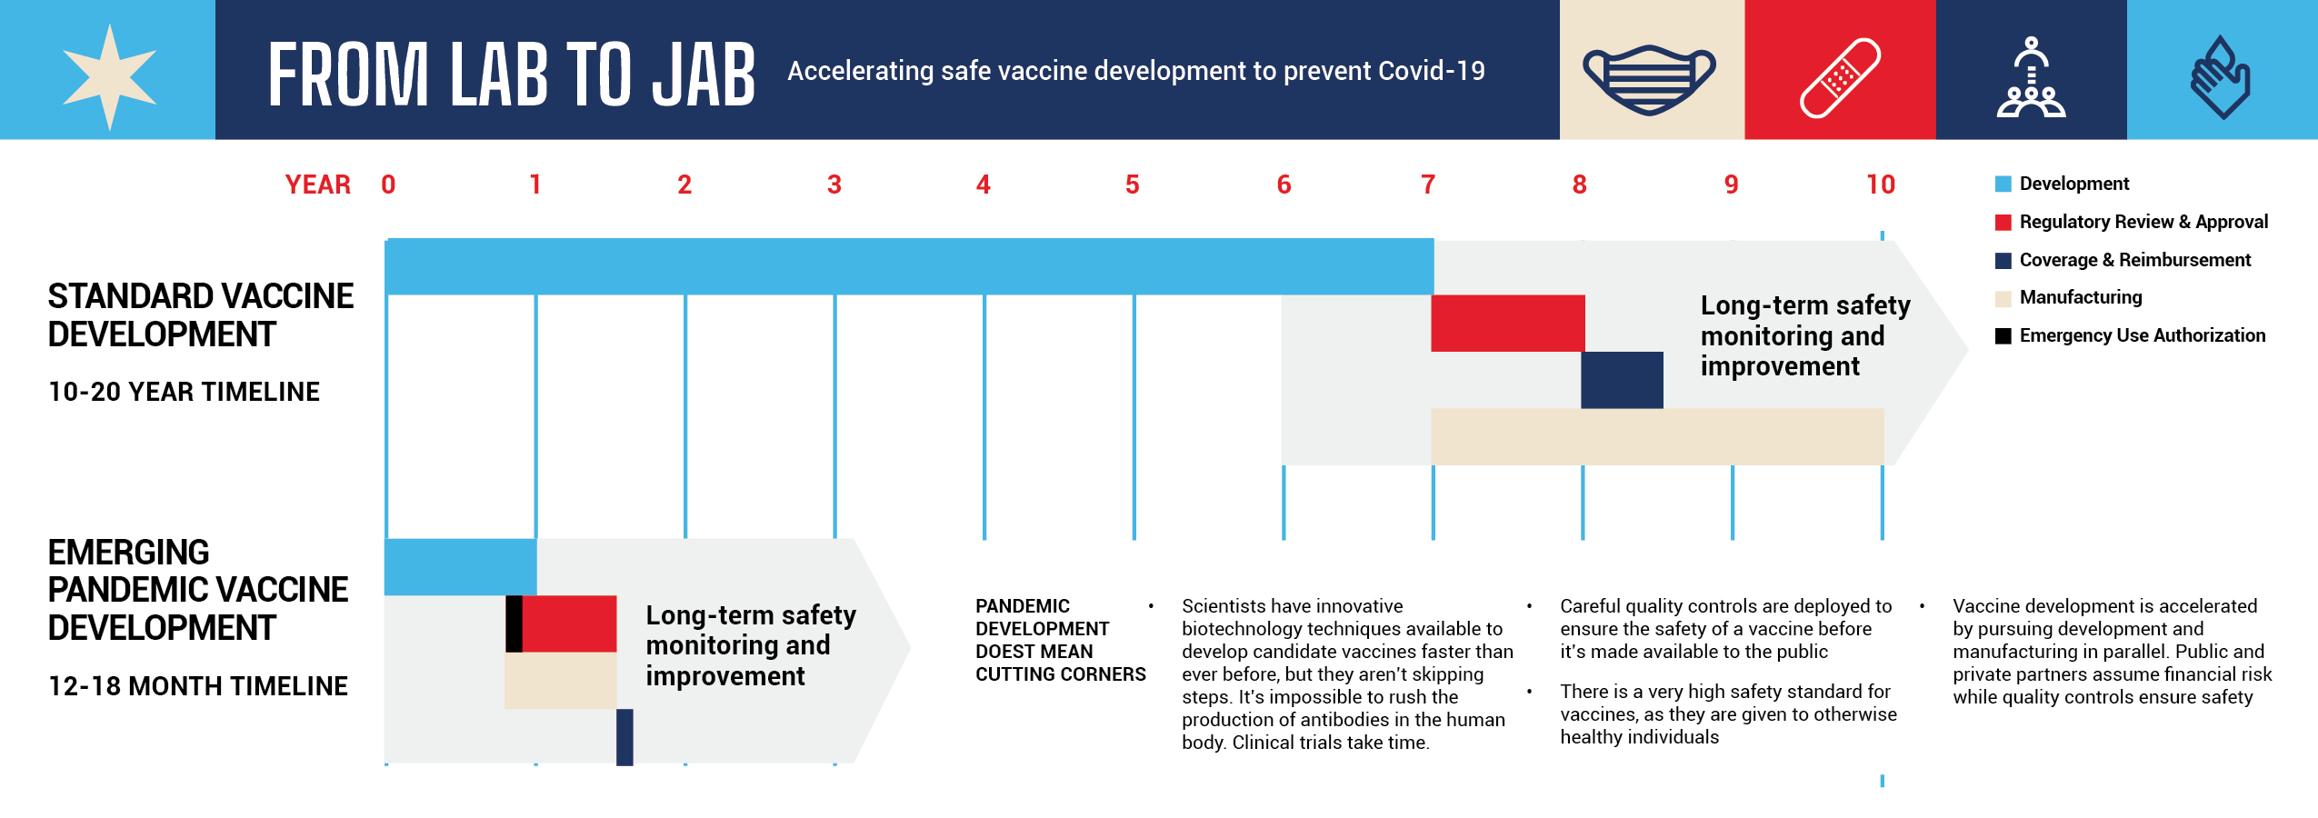
The EUA Process is Safe
The EUA process is accelerated during a public health emergency due to collaboration amongst scientists for development and pursuing the development and manufacturing process in parallel.

Slide 10
Comparing Vaccines
Pfizer
Moderna
43,252 people participated in trials.
Vaccine proved to be 95% effective across all age, genders, racial and ethnic groups.
Requires two doses, the second one 21 days after the first one.
Requires movement and storage at a temperature of -80 to -60 degrees Celsius (ultra-cold).
EUA for 16 years and above
30,351 people participated in trials.
Vaccine proved to be 94.5% effective across all age, genders, racial and ethnic groups.
Requires two doses, the second one 28 days after the first one.
Requires movement and storage at a temperature of -25 to -15 degrees Celsius (normal freezer).
EUA for 18 years and above

Slide 11
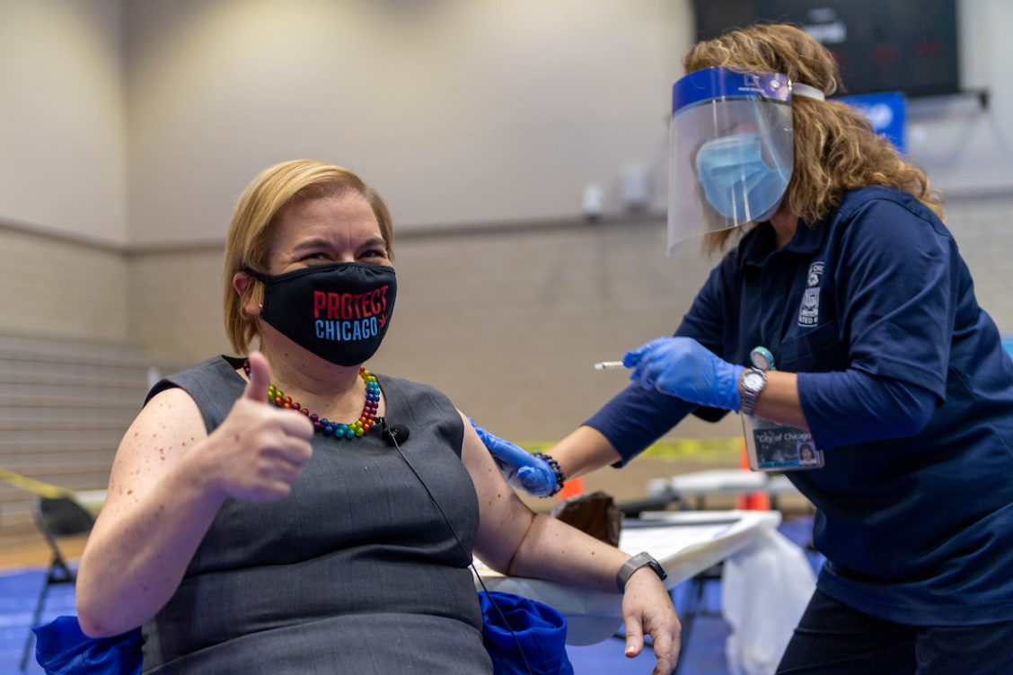
Vaccine Side Effects
Swelling and pain at injection site
Fever
Fatigue
Headache
Chills
Muscle pain or joint pain
Side effects following any vaccine administration are normal.
For most people, side effects are mild and go away in a couple of days.

Slide 12

Importance of the Second Dose
Both the Pfizer and Moderna vaccines require two doses to be most effective.
  In Pfizer trials the vaccine was only 52% effective following the first dose compared to 95% effective for the second dose.
Both vaccines are intramuscular shots, administered in the upper arm.

Slide 13
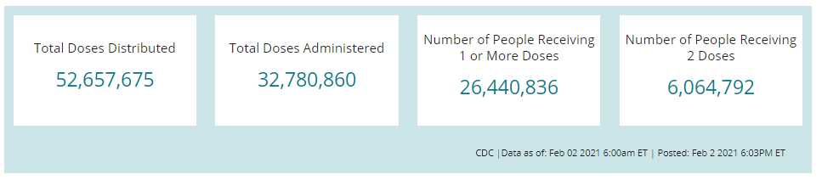
US COVID-19 Vaccine Distribution and Administration
IL: 1,859,850
IL: 1,073,076
Nationwide: 62% of doses distributed have been administered
Illinois: 57% of doses distributed have been administered
CDC COVID Data Tracker
Data as of 2/2/21. CDC defines distributed as doses shipped and transferred directly to pharmacies

Slide 14
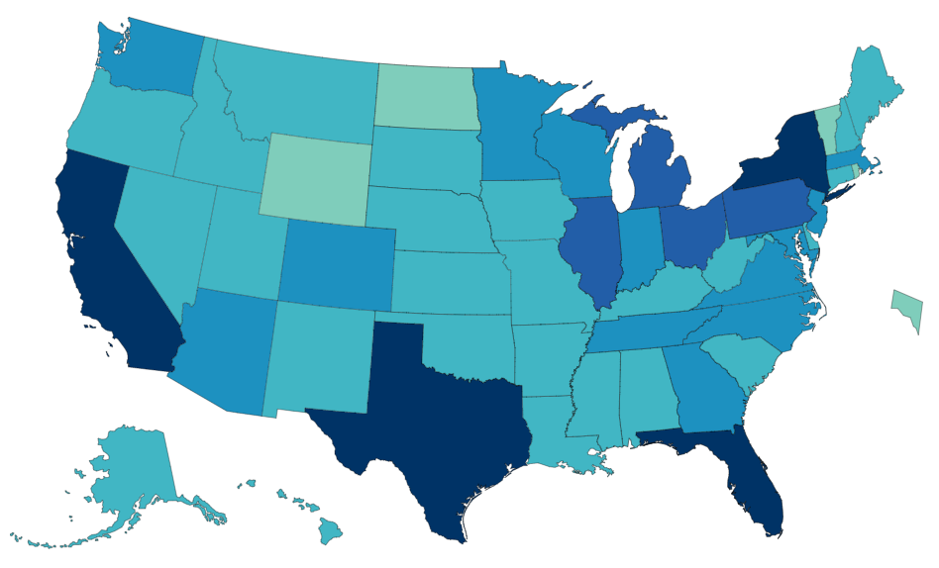
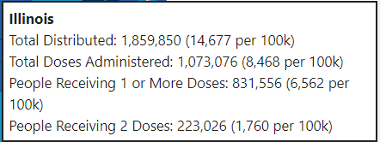
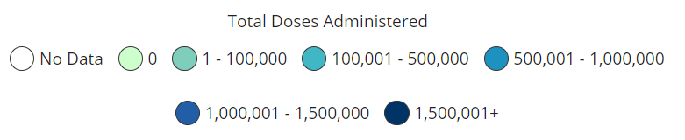
Total Doses Administered
as of 2/2/21
(Count)
CDC COVID Data Tracker

Slide 15
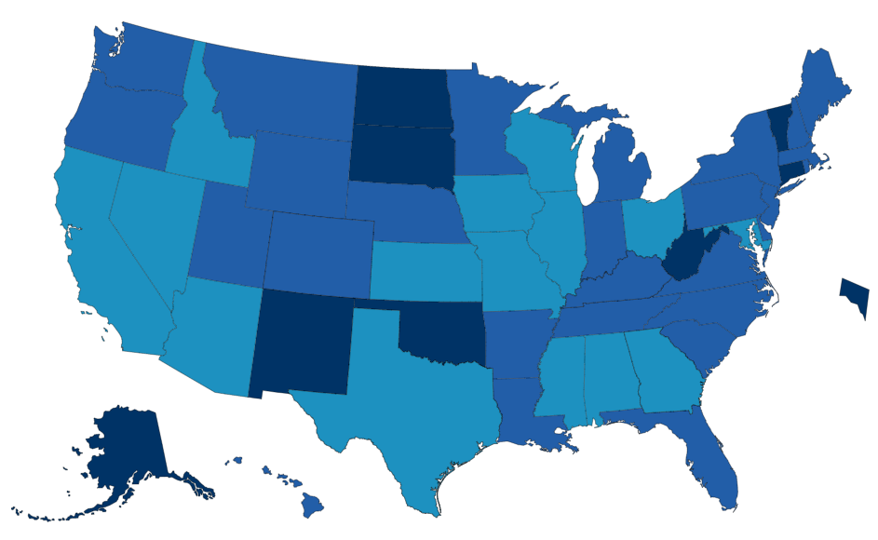
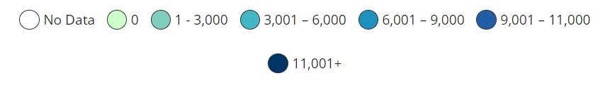
Total Doses administered
as of 2/2/21
Rate (per 100,000 population)
CDC COVID Data Tracker

Slide 16
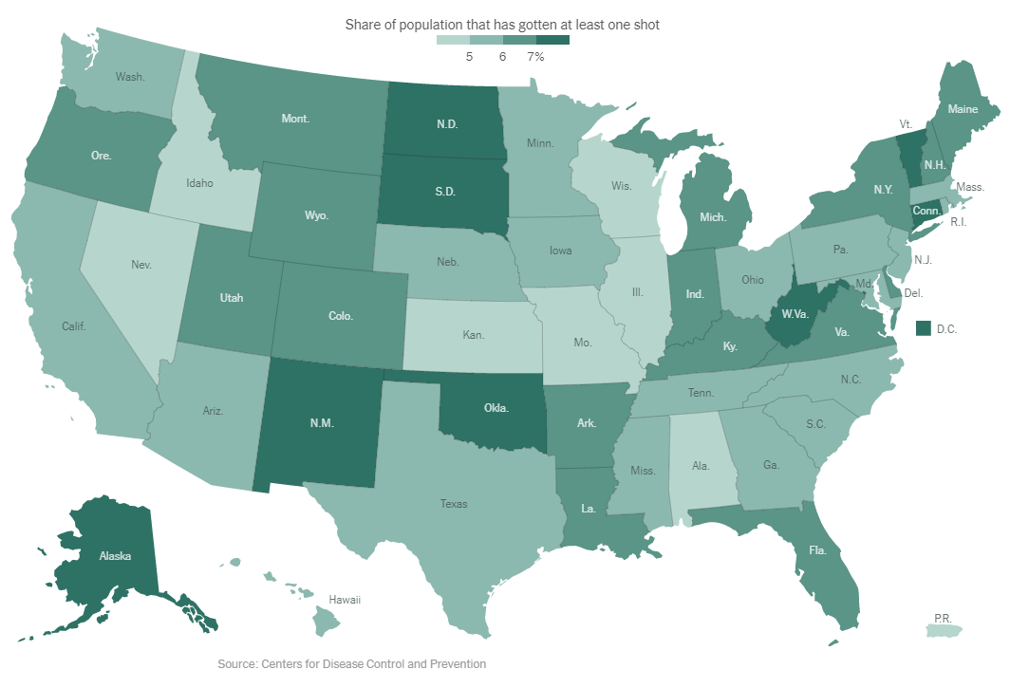
New York Times. 1/28/21

Slide 17
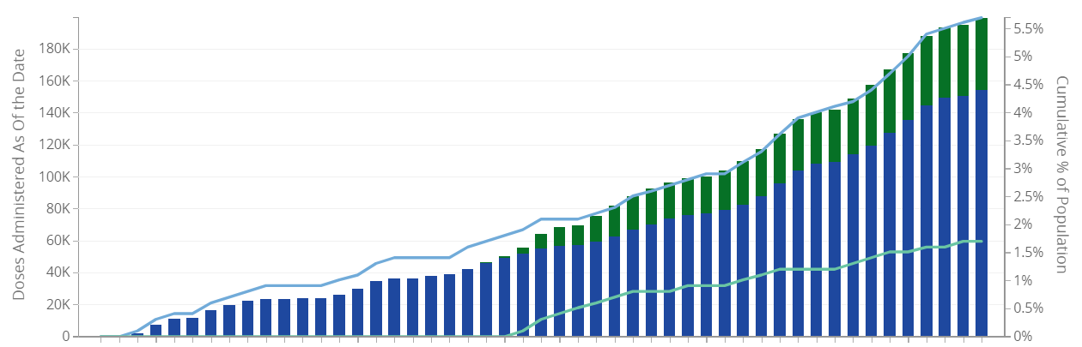
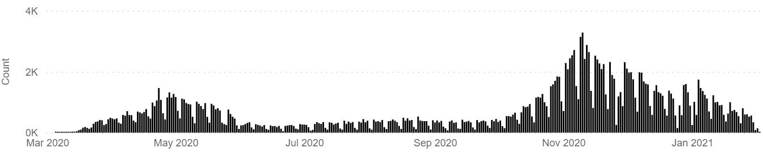
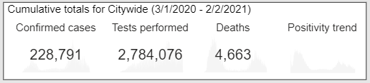
200K COVID-19 vaccine doses given
12/15 – 2/1, Chicago residents
City of Chicago :: COVID Dashboard
Vaccination Data (chicago.gov)

Slide 18
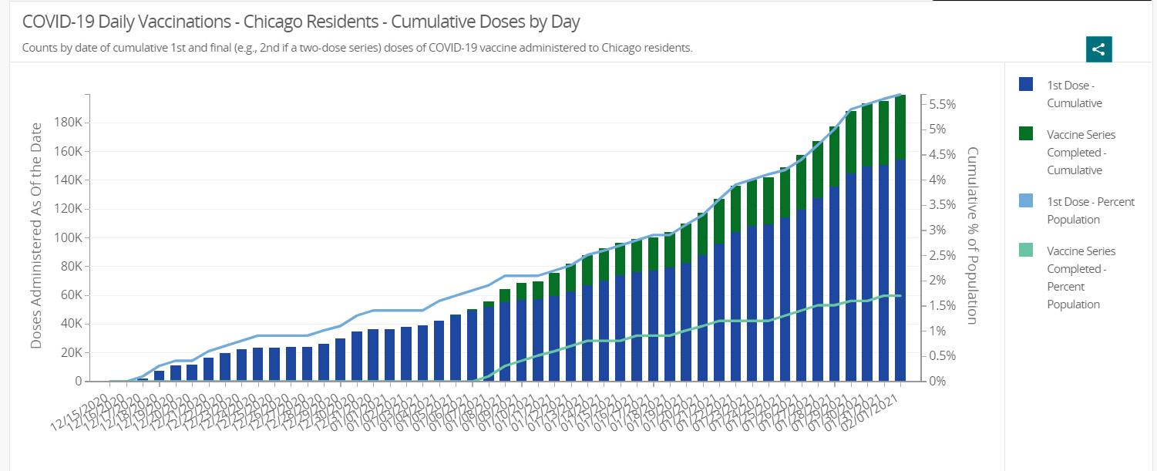
Cumulative Vaccine Doses per Day, Chicago Residents,
Vaccination Data (chicago.gov)

Slide 19
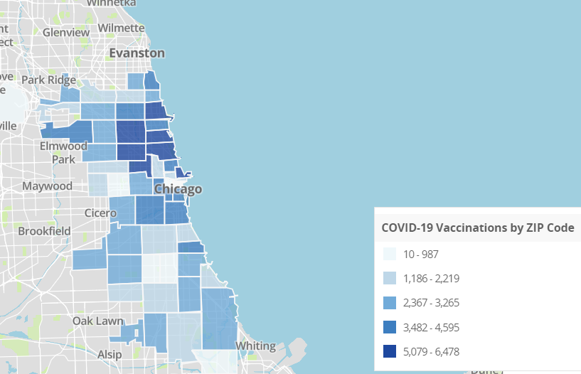
COVID-19 Vaccinations by zip code, Chicago
Vaccination Data (chicago.gov)

Slide 20
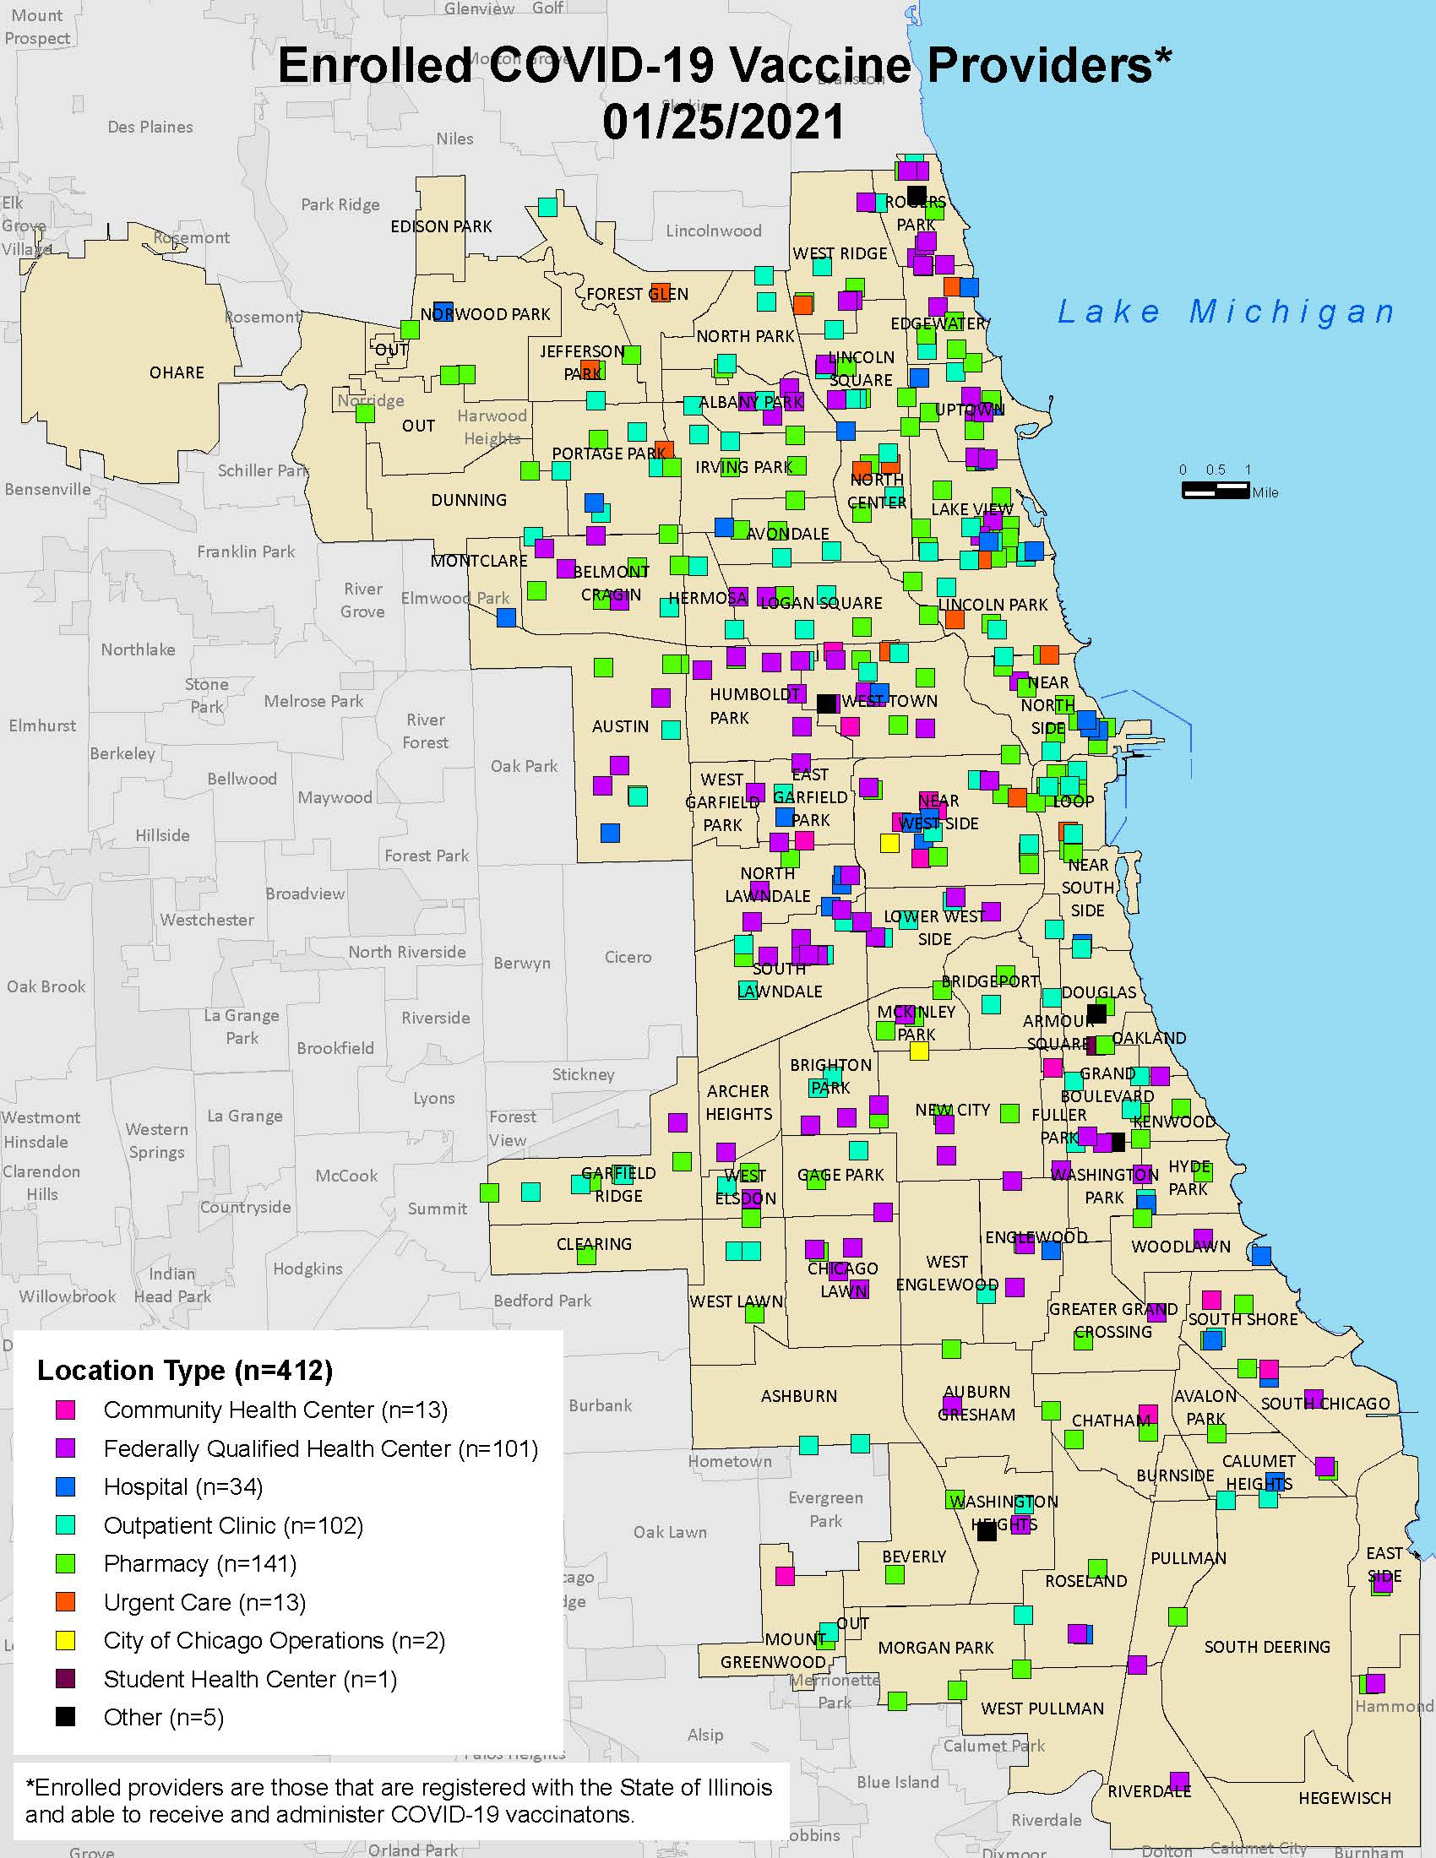
Chicago Provider Enrollment Status
Enrolled providers will administer 90% of all vaccine; the primary source of vaccination should be medical practices.
437 providers enrolled as of 1/28/2021
Expanding recruitment and enrollment team
Focusing outreach on communities without enrolled providers or with high CCVI index
Map updated as of 1/25/21
Notes:
Maribel

Slide 21
99% of Allocated Doses Have Been Pushed Out to Providers
472,600
469,300
Data as of 1/29/21
Notes:
300 doses left to be ordered

Slide 22
7 Days after delivery, 58% of doses were administered
BUT when doses held for long-term care facilities are removed, the percentage increases to 76%
Data as of 1/29/21
Notes:
Removed doses transferred to pharmacies for the LTC program and doses reported that were administered in those settings.
With those data removed, there were 236,650 doses delivered and 179,864 doses administered.

Slide 23
7-day Rolling Average of Doses Administered by Chicago Providers
7-day rolling average, censored 3 days from 1/28/21
Notes:
Starting to see 1st dose administration increase after plateauing for about a month.

Slide 24
Volume of administration increasing across all settings
Week not complete
Dec 13-19
Jan 24-30
Data reported through 1/28/20

Slide 25
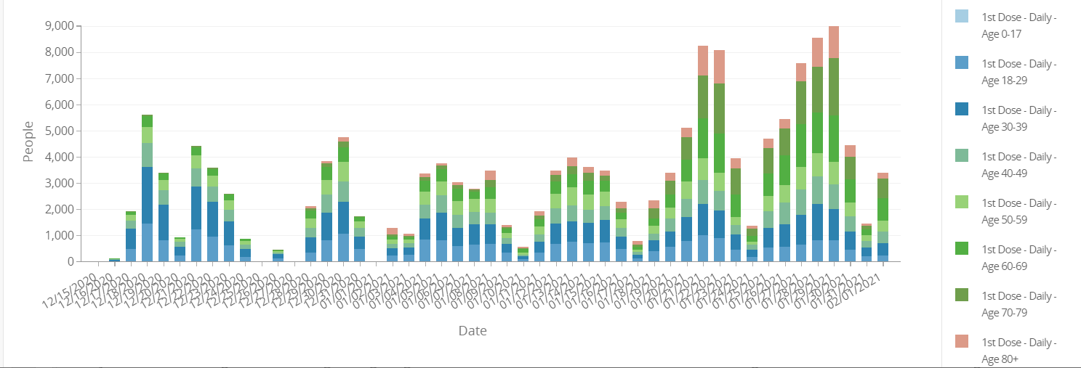
COVID-19 first doses by age group
1b starts
Long-term care pharmacy partnership clinics start
Hospitals could administer excess supply to 65+
Vaccination Data (chicago.gov)

Slide 26
1st Dose Coverage by Age: Big gains among 65+!
+5.2%
+5.6%
+3%
Data reported through 1/28/20
Notes:
Red text is change from last week

Slide 27
COVID-19 vaccines administered by race/ethnicity using imputation methodology
Race/Ethnicity | Total 1st doses | % of 1st doses | % 1st dose population coverage | Population Coverage (1st dose)
Latinx | 18,712 | 19.9% | 2.4% | 1 in 42
Black, Non-Latinx | 17,911 | 19.0% | 2.0% | 1 in 50
White, Non-Latinx | 46,800 | 49.7% | 6.1% | 1 in 16
Asian, Non-Latinx | 10,430 | 11.1% | 5.6% | 1 in 18
Unknown | 14,349 | 13.2%
Chicago | 108,434 | 100% | 4.0% | 1 in 25
As of January 27, 2021, 79% of all vaccination records received by the Chicago Department of Public Health (CDPH) were missing race/ethnicity. CDPH in collaboration with DePaul University Center for Data Science utilized a validated statistical methodology, known as the Bayesian Improved Surname Geocoding Method (BISG), to impute (predict) the race/ethnicity among those missing, based on the zipcode of residence and the surname (last name) of individuals whose COVID-19 vaccination records were missing race/ethnicity. This method was able to predict over 83% of missing data. More information about the methodology can be found here. The numbers in the above table reflect estimates based on data as of 1/27/21. Race-ethnicity derived from data imputation inherently have a level of uncertainty and are not intended to substitute for an individual’s self-reported identification. Imputation is intended as an activity to help the health department and stakeholders better understand and enhance the progress in COVID-19 vaccination efforts citywide. All activities were classified as health surveillance and all procedures for performing BISG data imputation underwent institutional review and approval.
Data represents COVID-19 vaccinations administered to Chicago residents based on home address, as reported by medical providers in Illinois Comprehensive Automated Immunization Registry Exchange (I-CARE). The site of vaccination may not be in the City of Chicago. Percentages reported exclude those still unknown after BISG imputation. All data are provisional and subject to change.
Data Source: Illinois Comprehensive Automated Immunization Registry Exchange (I-CARE), U.S. Census Bureau American Community Survey.

Slide 28
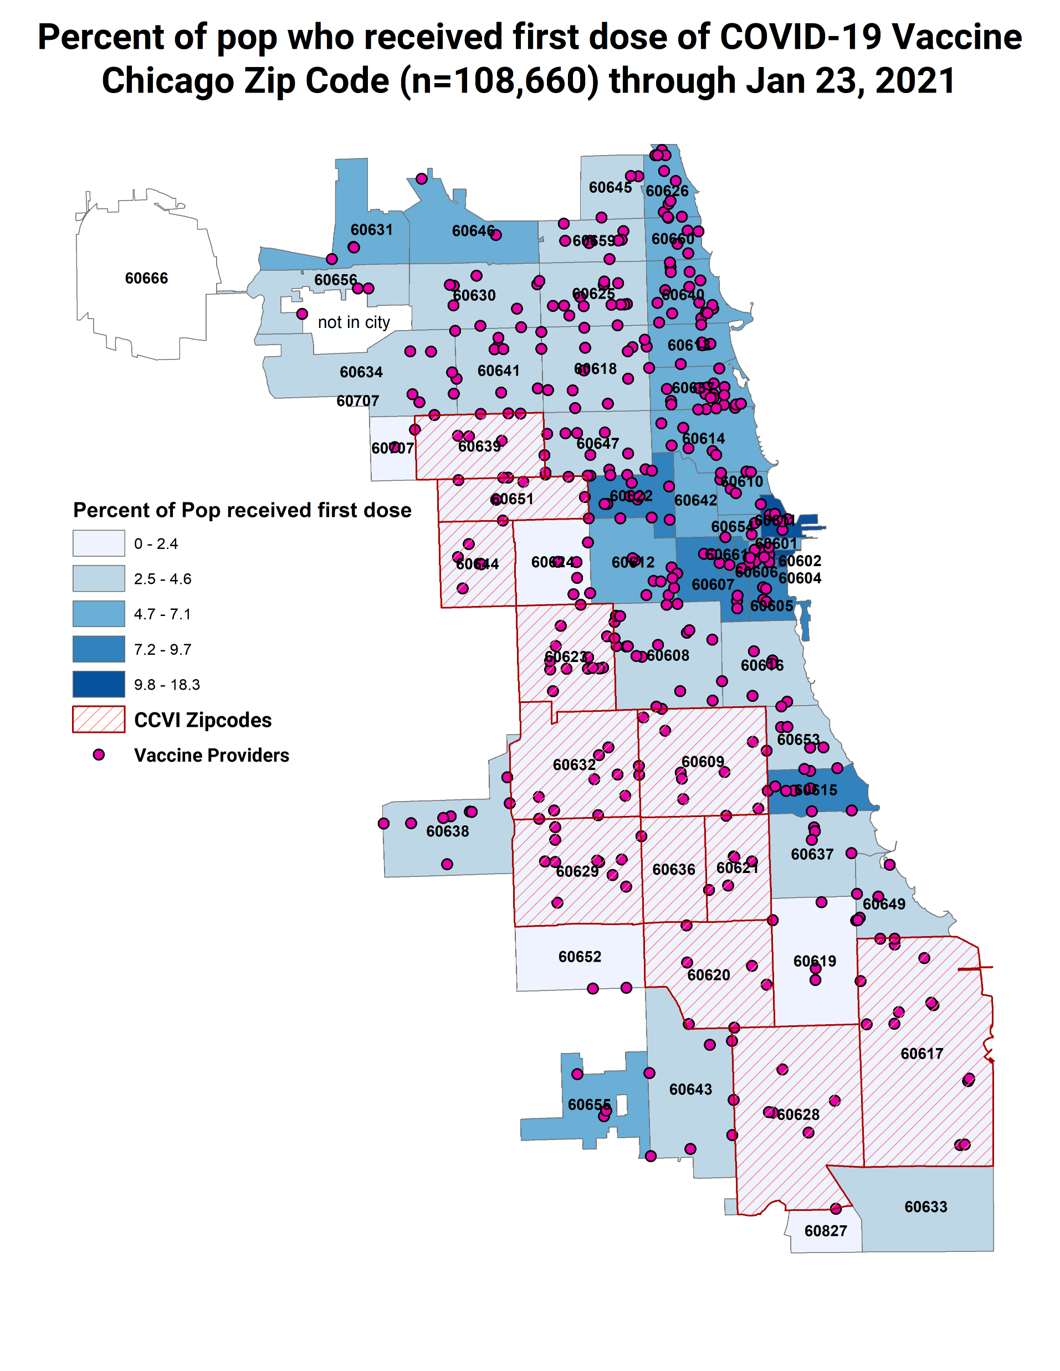
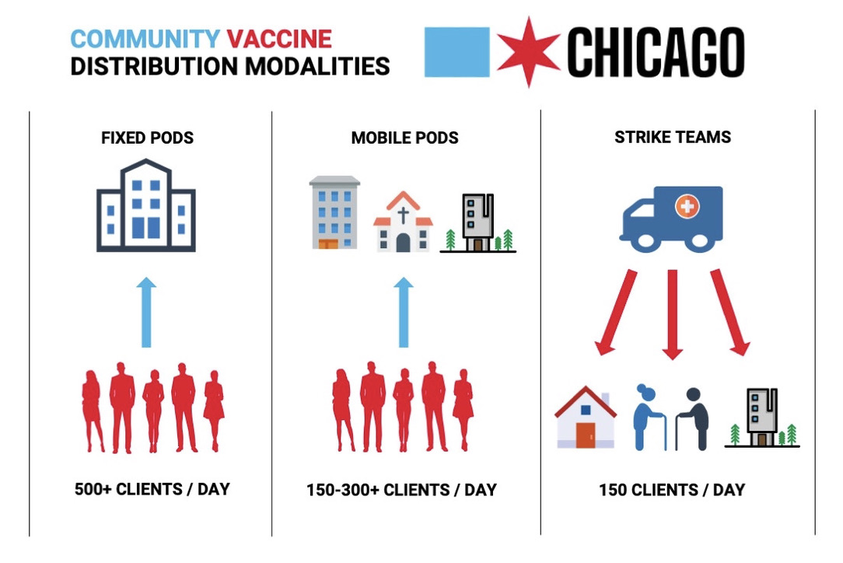
Since Phase 1B started January 25th, how can pediatricians partner with CDPH and other providers across the city to BOOST COVID-19 vaccination?

Slide 29
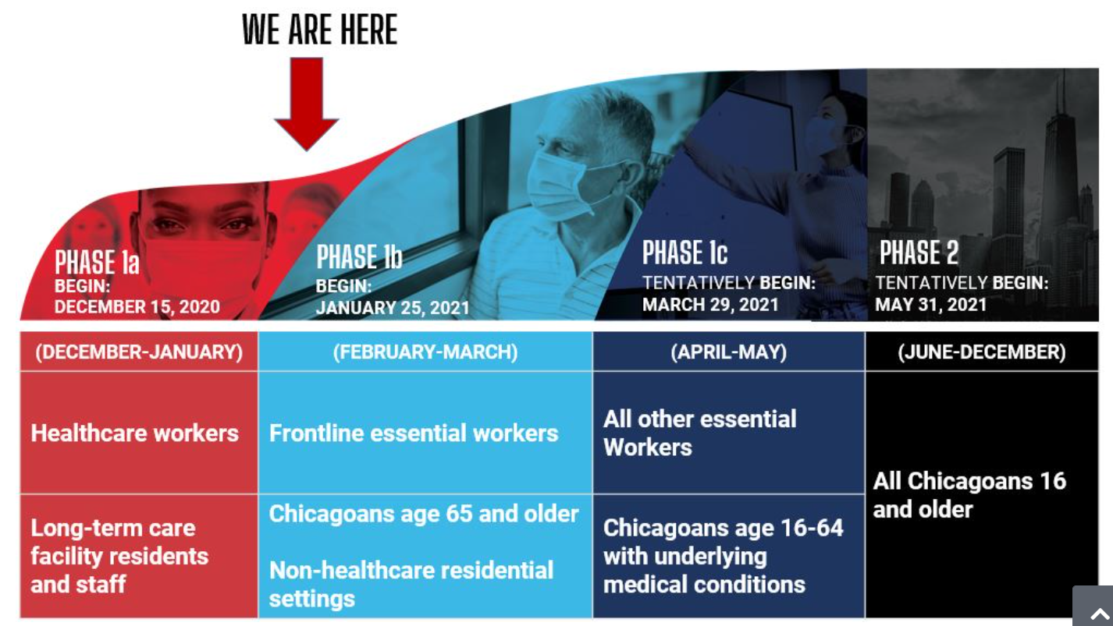
www.chi.gov/covidvax

Slide 30
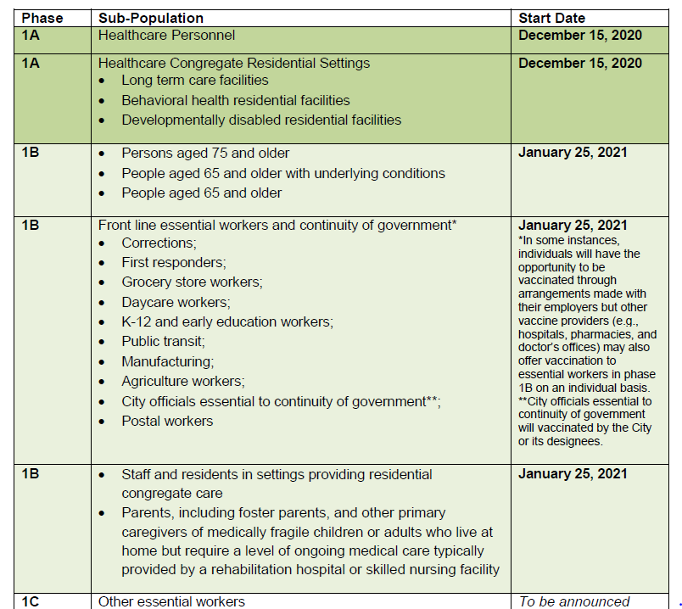
January 25th, 2021 HAN alert posted at: www.chicagohan.org/covidvax

Slide 31
COVID-19 Vaccine Provider Reminders
Vaccine providers should administer all doses received each week, within the week.
Start scheduling appointments for 1B patients or those who self-certify as part of group 1B today (if you haven’t already), schedule a week ahead and have a waiting list
Phases overlap and individuals in an earlier phase remain eligible to receive COVID-19 vaccination in a later phase.
  After intensive and appropriate efforts to reach the prioritized groups, facilities may offer vaccine to persons in lower priority groups when doses are about to expire according to labeling instructions.
Do not reserve vaccine for second doses at this time.
Do not waste COVID-19 vaccine, therefore ensure proper storage and handling and careful scheduling with timed vial opening to avoid unused doses.
Vaccine providers are expected to have the capability to vaccinate at least 50-100 persons per week, beginning the week of January 25th, and at least 100 persons per week thereafter, with appropriate observation and safety protocols in place.
Vaccine providers will receive a weekly REDCap survey to record unused doses and request additional doses. The survey must be completed by Tuesday 5pm (CT). Vaccine orders will be approved based on supply.

Slide 32
Tips to scale up
Post banners/announcements on your webpage to keep your patients updated on your vaccine supply and appointment availability
  Staff up to support phone lines to help navigate patients to vaccine if you cannot provide it
  Map available at “Ways for Individuals to Register for the Vaccine (chicago.gov)”+ chi.gov/covidvax
Establish standing orders to expand and maximize your vaccinator workforce and drastically increase the number of individuals you can vaccinate
Extend vaccine only visit hours to support working families
Vaccinate at every opportunity
Run reports in your EMR or in I-CARE to call your highest risk patients to actively schedule them for appointments
Consider accessible community spaces that you can staff to provide dedicated vaccine services
Consider reasons for vaccine hesitancy in YOUR neighborhoods and be CREATIVE about being vaccine ambassadors or appointing vaccine ambassadors

Slide 33
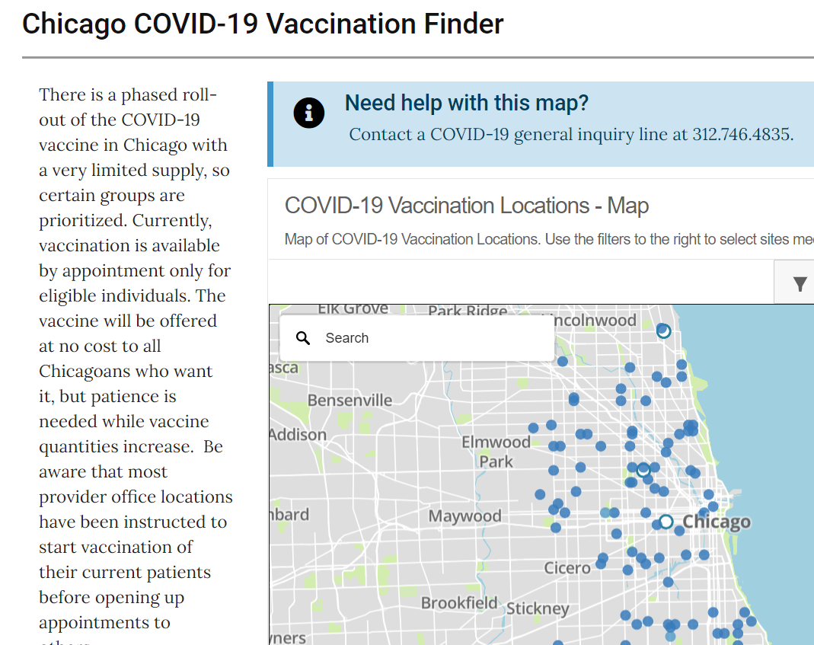

More options to find vaccine and BE found: www.chi.gov/covidvax
Vaccine Finder (chicago.gov)
Launched 2/2/21 – Rush, Amita, Innovative Express Care, City PODs
Notes:
Providers in all 50 wards have vaccine for distribution when Phase 1b opens today.

Slide 34
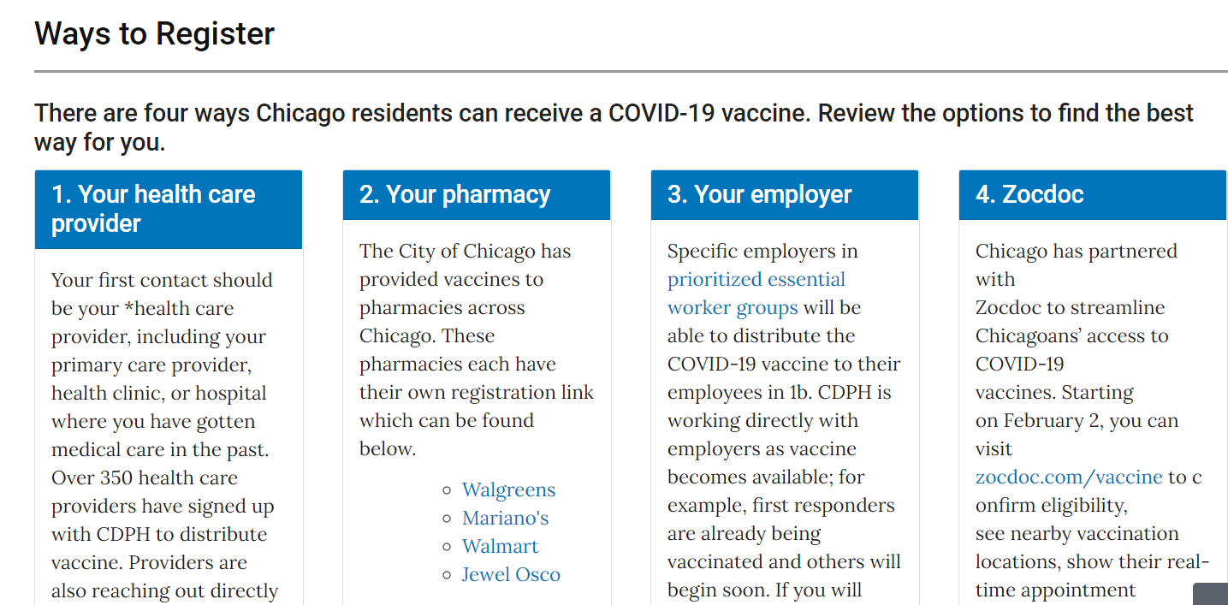
Vaccine Finder (chicago.gov)

Slide 35
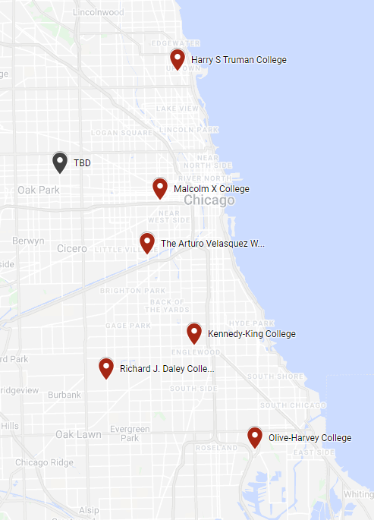
City-Operated Fixed Point of Dispensing Sites
City vaccination sites are intended for workers whose employers are not affiliated with vaccine providers.
POD Location
Public Safety Training Center (Public Safety POD)
Malcom X College
Arturo Velasquez Institute
Richard J. Daley College
Olive-Harvey College
Kennedy-King College
Harry S. Truman College
TBD - West Side Site

Slide 36
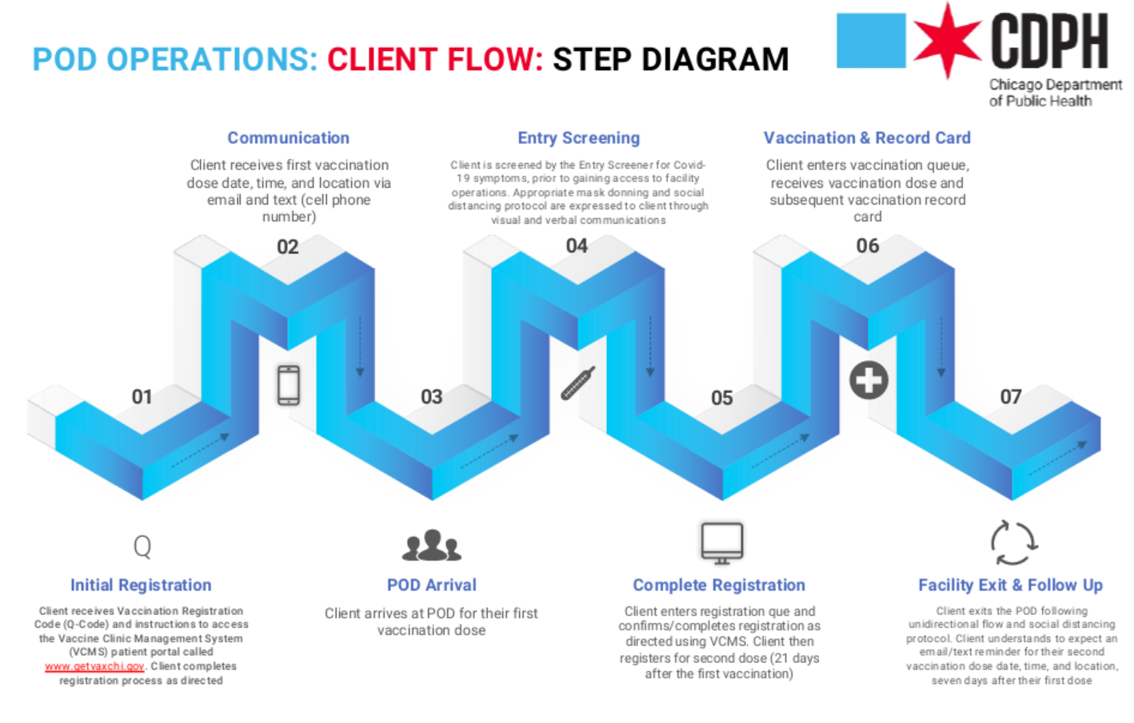

Slide 37
Addressing vaccine equity as health equity
The urgency to vaccinate QUICKLY could not be higher, but EQUITY is central: “Equity is not only part of our COVID-19 strategy, equity is our strategy.“ - MLL
Pediatricians can support non-traditional vaccine providers to scale up operations and avoid missed opportunities – they need confidence, motivation and often resources
  Think Back-to-School season but every healthcare provider in the city!!!
  Help support clinics to increase reporting/data transfer of race/ethnicity in I-CARE
Become a peer counselor to clinics (affiliated or non-affiliated) in high-COVID burden community areas – reach out to me or ICAAP if you are interested
  The PREP act protects vaccine providers from liability when giving pandemic vaccine
  HHS Amends PREP Act Declaration to Increase Workforce Authorized to Administer COVID-19 Vaccines | HHS.gov
Volunteer to provide COVID Vaccine
Physicians and healthcare providers wishing to volunteer to provide COVID vaccine at mass vaccination sites should register though Illinois Helps Volunteer Manager site. You will be able to chose cities and counites where you are willing to volunteer.
Notes:
Public readiness and emergency preparedness act

Slide 38
Chicago COVID19 Community Vulnerability Index (CCVI)
Chicago CCVI identifies communities that have been disproportionately impacted by COVID-19 and are uniquely vulnerable to barriers to COVID-19 vaccine uptake
Vulnerability is defined as a combination of:
  Sociodemographic factors
  Epidemiological factors
  Occupational factors
  Cumulative COVID burden
Ten (10) components included in the index are COVID-specific risk factors and outcomes combined with factors known to be associated with social vulnerability in the context of emergency preparedness
Chicago CCVI is derived from ranking values of the 10 components by geography, then synthesizing them into a single composite weighted score. The higher the score, the more vulnerable the geographic area
In Chicago, we are currently measuring CCVI at the community area level
Adapted and modified from Surgo Ventures collaboration https://precisionforcovid.org/ccvi and the CDC Social Vulnerability Index

Slide 39
CCVI Findings
  Rank-values of Chicago community areas ranged from 4 (lowest vulnerability) to 64 (highest vulnerability). Tie scores between CAs were ranked equally with each other.
  A high CCVI score correlates most strongly with high mobility during COVID, low socioeconomic status, high rates of COVID hospital admission and high rates of COVID mortality
  Strength of index appears well balanced between traditional measures of vulnerability (SES) and COVID-specific measures (mobility, morbidity/mortality)
  26 HIGH Vulnerability Community Areas and 15 in the top quintile
    7 majority Latinx; 8 majority Black;
    9 communities on the Northwest and Southwest sides and 6 on Southside and far Southside;
    Top 15 includes all PC+ zipcodes and 2 of 3 RERRT community areas
  Residents of high vulnerability community areas have been almost 3 times as likely to have died from COVID-19 as low vulnerability community areas. Top 10 CAs account for 25% of all COVID-19 deaths.

Slide 40
Top 15 Chicago COVID-19 Community Vulnerability Index
  2 community areas (Burnside, Fuller Park) of the 26 HIGH do not appear on this ranking due to very small populations (<2500 persons (as of 2019))

Slide 41
Protect Chicago Plus:
3 Equity Game-Changers
Focusing on High-Burden Communities based on the Chicago COVID Vulnerability Index (CCVI)
Zip | Community | Score | Rank
60636 | West Englewood | 64 | HIGH
60609 | New City | 60 | HIGH
60632 | Gage Park | 59 | HIGH
60623 | North Lawndale | 58 | HIGH
60623 | South Lawndale | 58 | HIGH
60629 | Chicago Lawn | 58 | HIGH
60621 | Englewood | 55 | HIGH
60628 | Roseland | 55 | HIGH
60632 | Archer Heights | 53 | HIGH
60620 | Washington Heights | 53 | HIGH
60644 | Austin | 53 | HIGH
60639 | Montclare | 53 | HIGH
60617 | South Deering | 52 | HIGH
60639 | Belmont Cragin | 52 | HIGH
60651 | Humboldt Park | 52 | HIGH

Slide 42
Protect Chicago Plus:
2. Prioritizing Vaccine for high-burden communities and targeting operations
  30% of City’s supply will go to providers serving 4-5 Protect Chicago Plus communities at a time
    Supply allocation will be prioritized to providers in certain zip codes and,
    Sponsoring healthcare providers will be partnered with each community to ensure access to healthcare and proper staffing for community vaccination events.
3. Guided Acceleration of vaccination in high-burden communities

Slide 43

Protect Chicago Plus = Community Based Vaccination Planning Process
Who are we trying to reach?
  15 communities with 40% uptake by 27 April
How are we going to reach them?
  Targeted engagement | Mobilization | Outreach
  30% vaccine supply allocation and hyper-local distribution strategy
  Hyper-local communications strategy
How is this supported?
  Community Based Vaccination Teams
    Community Groups | Lead Agency
    Medical Director, Vaccine Operations Center, Mayor’s Office

Slide 44
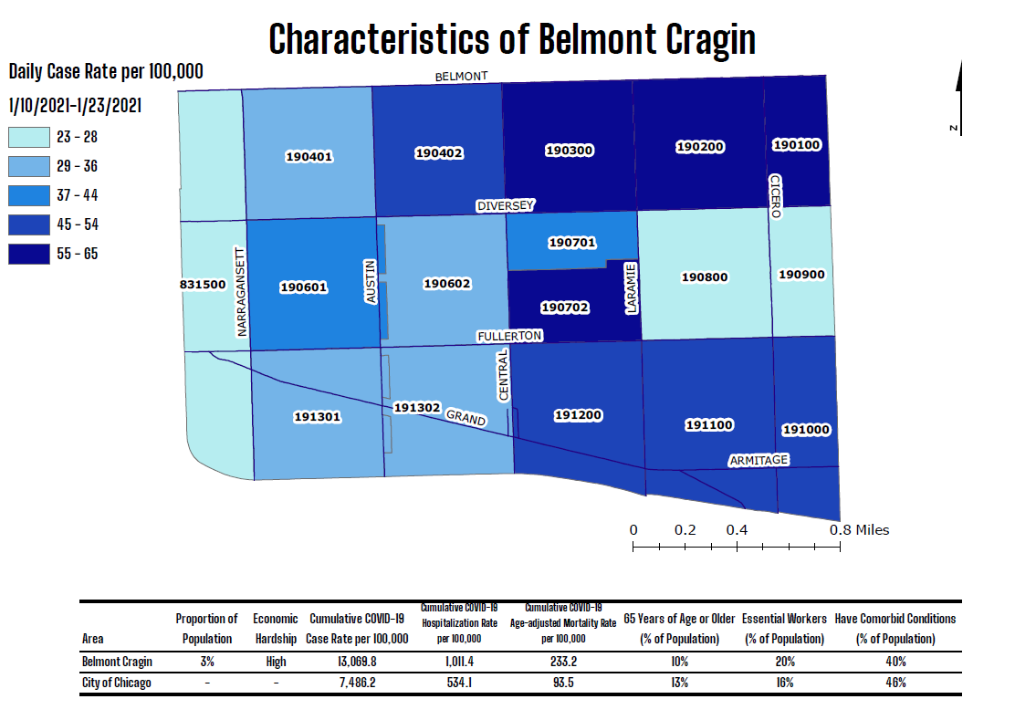

Slide 45
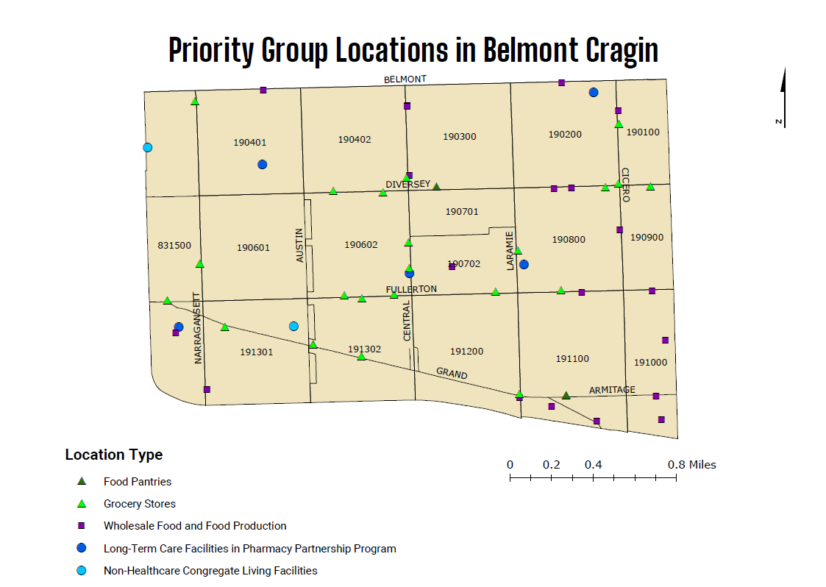

Slide 46
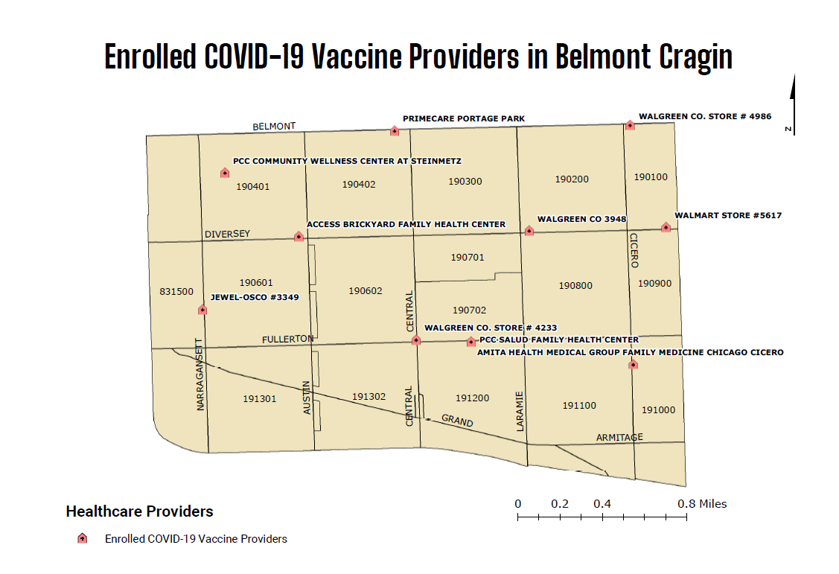

Slide 47
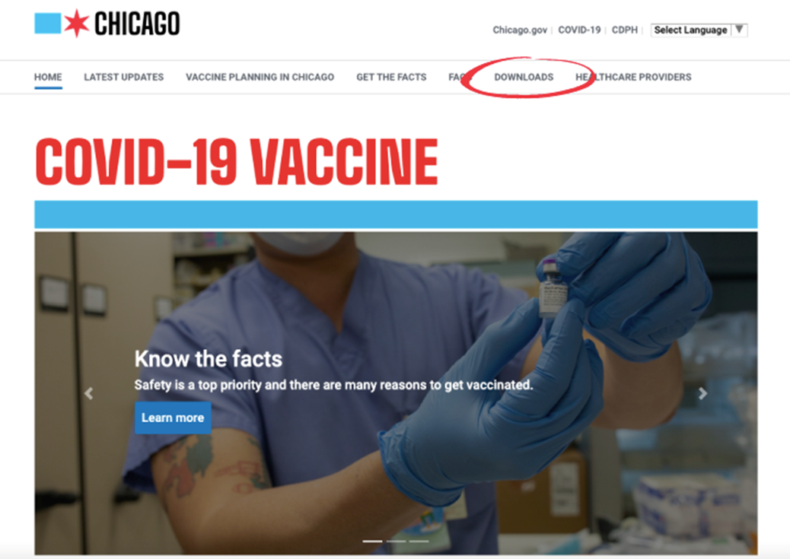
Jump in!
Become a COVID-19 provider and vaccinate your patient’s families if they are in 1B and prepare for when vaccines will receive EUAs for kids!
Remind your patients’ families and communities that even though the vaccine is here, we still need to keep up safe practices.
Make and share educational videos.
Hang fact sheets and posters about the vaccine.
Discuss the benefits of vaccination on social media – become a Vaccine Ambassador or “Tweet”-iatrician.
Refer to resources and toolkits available on the CDPH website.
www.chicago.gov/covidvax
www.chicagohan.org/covidvax
Volunteer to support other providers by becoming a COVID vax peer counselor.
Volunteer to support schools to become COVID-19 providers or host vaccination events.
Enroll in ZocDoc or tell us you want to be on the Chicago Vaccine Finder map.

Slide 48
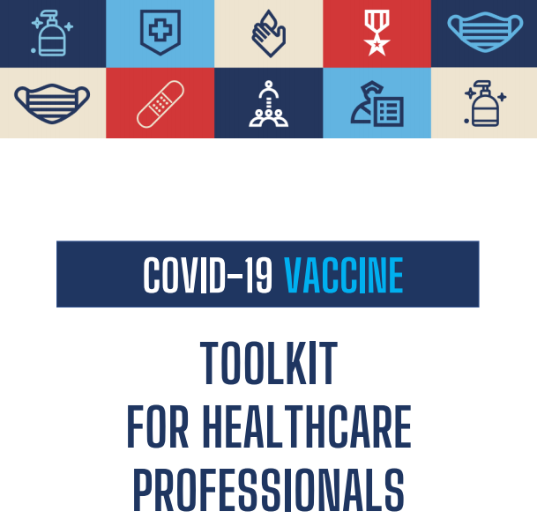
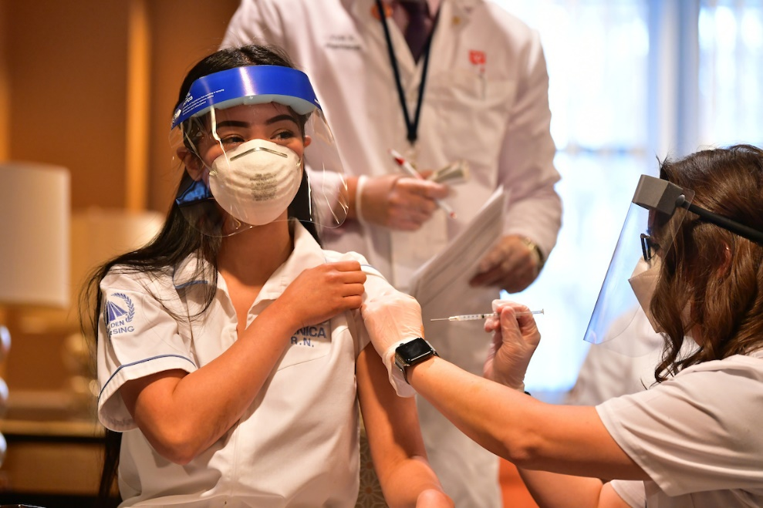
Understanding and Explaining mRNA COVID-19 Vaccines | CDC
Sign up to be a COVID-19 vaccine provider now by visiting www.chicagohan.org/covidvax for instructions
Contact ICAAP to get involved as a COVID vax peer counselor or email:
Marielle.Fricchione@cityofchicago.org
Healthcare Provider Vaccination Toolkit (chicago.gov)

Slide 49
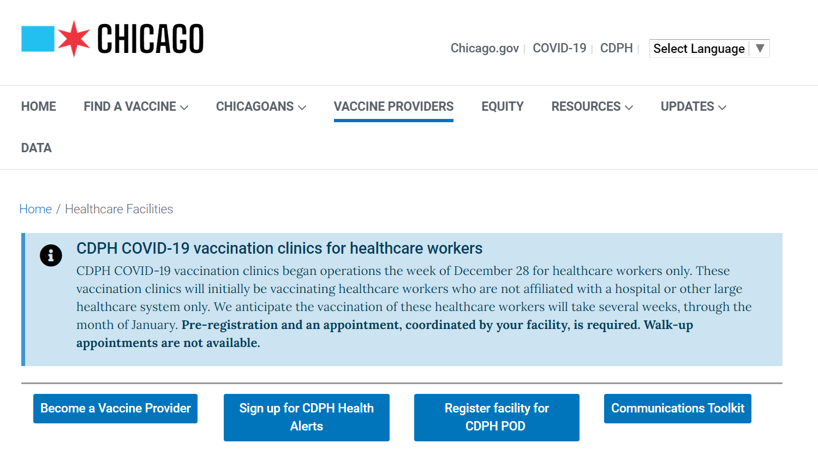

Healthcare Facilities (chicago.gov)

