Slide 1
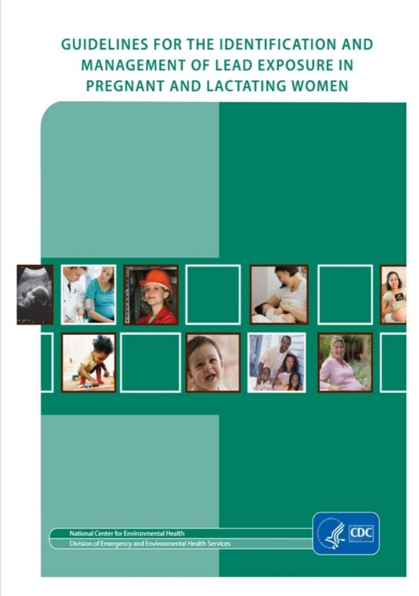
Lead in Pregnancy Screening Guidelines – CDC 2010
If the pregnant women is at risk for lead exposures, check lead at first prenatal visit
Additional evaluations & counseling for women with BLL of 5 µg/dL or higher
Recommendations for breast feeding based on mother’s blood lead level
www.cdc.gov/nceh/lead/publications/LeadandPregnancy2010.pdf

Slide 2
State of Illinois Guidelines for Lead in Pregnancy
https://dph.illinois.gov/content/dam/soi/en/web/idph/files/publications/etrpreconceptualcounselingpregnancybreastfeeding.pdf

Slide 3
Illinois Department of Public Health
http://www.dph.illinois.gov/sites/default/files/Prenatal_riskEvaluation_LeadExposure.11.25.2015.pdf

Slide 4
Screen ALL Pregnant women with these questions:
Any “yes” response triggers blood lead level

Slide 5
Women with BLL ≥5 μg/dL
BLL, μg/dL | Follow-up
5-14 | Within 1 month
15-24 | Within 1 month and every 2-3 months
25-44 | BLL 1-4 weeks and monthly
≥45 | Within 24 hours; Subsequent BLLs depend on treatments
Determine exposures, provide education
Ensure Calcium, Vitamin D, iron sufficiency
Get CORD BLOOD LEAD on infant

