Slide 1
IDPH VFC SUMMIT
September 24, 2026
Notes:
Hello and welcome to the 2026 IDPH VFC Summit, hosted by the Illinois Chapter of the American Academy of Pediatrics, or ICAAP, and the Illinois Department of Public Health. We are so excited and honored to be hosting these summits for the fourth year. Thank you for joining us for the first of six events we’ll be hosting over the next few months. My name is ____ and I am a _________ at ICAAP. A few housekeeping items before we get started today. First, please make sure that you check in at the table in the hallway if you have not already. This is important because we want to make sure we have everyone’s attendance accurately marked. You will only receive a link to the evaluation for CME credit if you checked in. It’s also important to stop at the check in table so you can grab a trivia card. We will have a break in about an hour where you can visit our sponsors and get your trivia card filled out. Completed cards can be returned to the check-in table, and at the end of the event, we will have a drawing where two lucky winners will win an Amazon gift card.
We’d also like to thank IDPH staff for joining us today. We’d like to give a minute for them to introduce themselves.

Slide 2
IDPH/ICAAP VFC Summit Trivia Game
Please take a trivia card from the registration table and visit our sponsors for a chance to win a prize at the end!
Each card has a series of questions that you will be responsible for answering by visiting each of the sponsor tables. Each sponsor is responsible for providing the answer to their assigned question. Some questions can only be answered by a sponsor.
Write your answers in the appropriate box on the card. Once the entire card is filled out, turn it in to an ICAAP staff member or place it in the designated submission box to be entered into today’s drawing for an Amazon gift card. Only completed cards will be entered into the raffle.
Notes:
This year, we updated our sponsor interactive activity! We have VFC Summit Trivia this year, and with that, each card has a series of questions that you will be responsible for answering by visiting each of the sponsor tables. Each sponsor is responsible for providing the answer to their assigned question. Some questions can only be answered by a sponsor. Visit each sponsor, ask the question that is listed for them on the card, and write the answer the sponsor provides CLEARLY in the appropriate box on the card. Once the entire card is filled out, turn it in to an ICAAP staff member or place it in the designated submission box at the registration table to be entered into today’s drawing for an Amazon gift card. Only correctly completed cards will be entered into the raffle. Before we get started with today’s summit, please feel free to enjoy your breakfast and start our trivia game!

Slide 3

Accreditation Statement
The Illinois Chapter, American Academy of Pediatrics is accredited by the Illinois Medical Society (ISMS) to provide continuing medical education for physicians.
The Illinois Chapter, American Academy of Pediatrics designates each live event for a maximum of 3.75 AMA PRA Category 1 Credit(s)™. Physicians should claim only the credit commensurate with the extent of their participation in the activity.
Nurses, Nurse Practitioners, and Medical Assistants can submit Certificates of Attendance to their accrediting board to claim credit for participation in the live events.
Notes:
This is ICAAP’s CME accreditation statement. This live conference offers 3.75 continuing education credits. To receive those credits, you must fill out an evaluation. The evaluation link will be shared via a QR code at the end of the presentations today and also in a follow-up email by the end of this week.

Slide 4
CME Financial Disclosures
Name and Credentials: | Please select your role in this activity: | Was there a financial disclosure? | List of Mitigated Disclosures
Stephanie Atella MPH, CHES | ICAAP Staff | No
Jennifer L. Burns | Faculty/Presenter | No
Meredith Volle, MD, MPH | Faculty/Presenter | No
Syed Rizvi, MD, PhD | Summit Planning Committee Member (IDPH Staff) | No
Katrina Galati, MPH, CHES | Summit Planning Committee Member (IDPH Staff) | No
Ryan Haswell | Summit Planning Committee Member (IDPH Staff) | No
Tricia Scerba, MD, MBA | Faculty/Presenter | No
Sharon Hovey, MD | Faculty/Presenter | No
Susan Sirota, MD | Faculty/Presenter | Yes | I have been paid in stock options for my consulting role for Pediametrix
Heather L Shryock | Summit Planning Committee Member (IDPH Staff) | No
Melanie Goff | Summit Planning Committee Member (IDPH Staff) | No
Brandi Vogt-Cervantes, MSGH, CHES | ICAAP Staff | No
Alexandra Arca | ICAAP Staff | No
LaDaryl Hale | Summit Planning Committee Member (IDPH Staff) | No
Monica Del Ciello | ICAAP Staff | No
Vishakha Nunda, MD | CME Reviewer | No
Jaime Novales | CME Reviewer | No
Notes:
This is our disclosure grid which includes everyone who helped with the presentation. All financial relationships have been thoroughly mitigated.

Slide 5
Agenda
8:00 – 8:30 AM
Check-in & Breakfast
8:30 – 9:45 AM
IDPH VFC Program Updates
2026 AAP Vaccine Schedule
11:20 – 11:40 AM
Vaccine Trends
12:30 – 12:45 PM
Awards & Closing
9:45 – 10:05 AM
Networking Break
10:05 – 11:20 AM
11:40 – 12:30 PM
Interactive Activity
Notes:
Here is our agenda for the day. We have three main sessions, one break, and one interactive activity. We will have time at the end of each presentation for questions. We strongly encourage everyone to use our networking break to interact with today’s sponsors at the tables outside of the room to complete their trivia card and for a chance to win a prize. Winners will be chosen at the end of the event. After all the presentations, we will also have some awards to give out to recognize clinics that have achieved exemplary vaccine coverage.

Slide 6
IDPH VFC Program
Brandi Vogt-Cervantes, MSGH, CHES
ICAAP
Notes:
Is this anyone’s first time participating in the VFC program?

Slide 7
Learning Objectives
After this session, participants will be able to:
Describe inventory reconciliation, vaccine ordering best practices, and other Illinois VFC mandates.
Implement effective vaccine storage and handling practices and keep vaccine waste to a minimum.
Outline the VFC program recommendations, requirements, and updates.
Use the I-CARE support portal and order vaccines through I-CARE.
Notes:
Here are the learning objectives for this session. After this session, participants will be able to Use the I-CARE support portal and order vaccines through I-CARE, Describe inventory reconciliation, vaccine ordering best practices, and other Illinois VFC mandates, Outline the VFC Program recommendations, requirements, and updates, and Implement effective vaccine storage and handling practices and keep vaccine waste to a minimum.

Slide 8
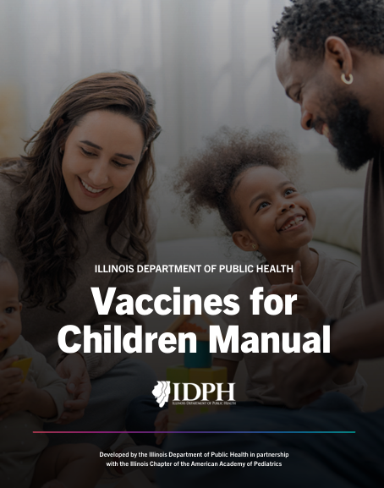
New! 2026 IDPH VFC Manual
Discontinue the use of the old manual and begin referencing the updated version immediately.
You should not expect to find policies and guidance that will require overhauls to your VFC program operations.
Notes:
Some very exciting news this year, the Illinois VFC Program Manual has been overhauled! This updated, streamlined manual is THE source for VFC programs, operations, guidance, and resources. VFC Providers should bookmark this resource, discontinue the use of the old manual, and begin referencing the updated version immediately. Providers who are active in Illinois’ VFC program, regularly utilize I-CARE, have attended annual VFC summits, and receive SIREN alerts should not expect to find policies and guidance that will require overhauls to your VFC program operations in this manual.

Slide 9
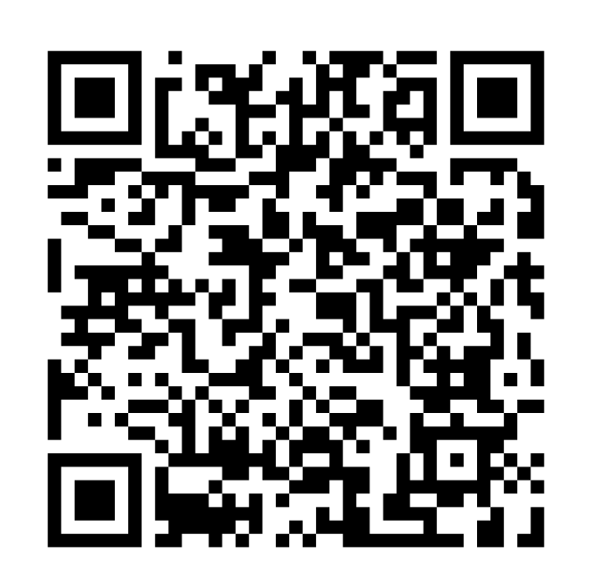
Follow Along with Us!
Pull up the manual!
  Visit illinoisaap.org/vaccines-for-children/ or scan the QR code.
Notes:
This session of the presentation will follow the updated manual. You can access the manual and follow along by scanning the QR code on the screen. Or, you can visit illinoisaap.org/vaccines-for-children and scroll down a little bit until you see the “Resources for Illinois VFC Providers” section and “IDPH VFC manual”. If you have not already seen the newest version of the IDPH VFC manual, we encourage you to take this opportunity to familiarize yourself with it.

Slide 10
Overview of the VFC Program
Manual pages 8-16
Notes:
If you are following along with us through the VFC manual, the content on the next few slides are covered on pages 8 through 16.

Slide 11
Overview - VFC Program
Federally funded by the Centers for Disease Control and Prevention (CDC).
Provides vaccines at no cost to children who may not otherwise get them.
Those eligible are 18 years and younger and one of the following:
  Uninsured or Underinsured
  Medicaid Title 19 or 21 eligible
  American Indian or Alaskan Native
Notes:
The Illinois VFC program is funded by the CDC and provides free vaccines to children who may not be able to afford them. This includes children 18 years and younger, uninsured and underinsured children, children with Medicaid, or children who are American Indian or Alaskan Native. We will discuss more about VFC program eligibility later in the presentation!

Slide 12
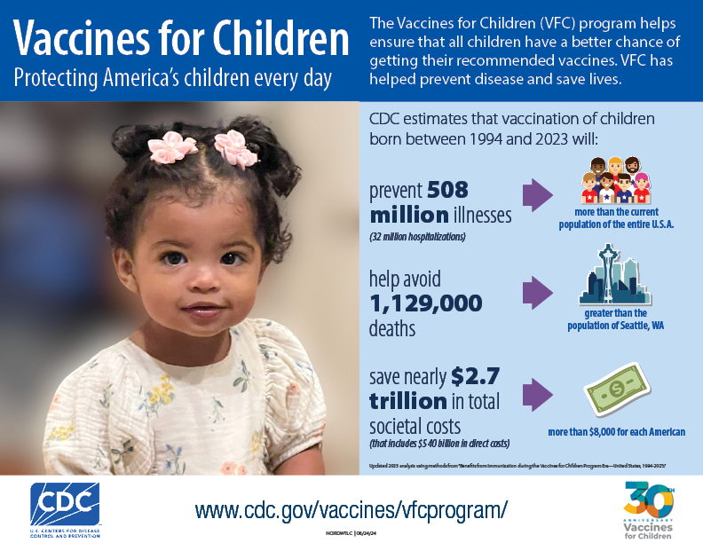
Benefits
Notes:
The benefits of the VFC program include:
• Reducing referrals of children from private providers to health departments for vaccination.
• Saving VFC-enrolled providers out-of-pocket expenses for vaccine.
• Eliminating or reducing vaccine cost as a barrier to immunizing.
VFC providers contribute to increased immunization coverage and reduced delays in immunizations and, subsequently, the risk of serious illness or death from vaccine-preventable diseases.

Slide 13

SIREN Alerts
The planning, alerting, and notification system for IDPH.
Register at https://www.siren.illinois.gov/.
Notes:
Make sure you are signed up for SIREN alerts!
This is how you can easily get rapid notifications on outbreaks, updates, and other important health alerts.

Slide 14
VFC Provider Requirements
Be licensed in Illinois to administer vaccines to children 18 years old and younger.
Be willing and able to follow all VFC program requirements, policies, and procedures.
Have the capacity to order, receive, manage, store, and monitor the temperature of public vaccines.
Be open at least four consecutive hours for three days a week to receive VFC vaccines.
Record keeping and reporting adverse reactions to VAERS and MedWatch.
Notes:
These are the VFC program provider requirements and some of the responsibilities clinic staff agree to as part of being a VFC provider. These requirements have not changed in several years.

Slide 15
VFC Recertification
VFC sites are required to complete recertification in I-CARE every two years.
Includes updating forms in I-CARE.
  Provider Agreement, Policy Acknowledgement, training module certificates of completion, and Digital Data Logger (DDL) calibration certificates, etc.
Completing CDC’s Provider Agreement.
Remember: Updating the provider profile and completing required education training are annual.
Notes:
VFC sites must submit for recertification every two years. Providers must also complete all necessary paperwork including the CDC provider agreement.
The provider signing the Provider Agreement for a multi-provider practice must have the authority to sign on behalf of the entity.
All licensed health care providers (MD, DO, NP, PA, pharmacist) at your facility who have prescribing authority must be listed with professional license numbers and individual NPI numbers (VFC Enrollment Form).
The paperwork is submitted in I-CARE every other spring.
the provider profile and completing required education/training happens every year

Slide 16
Routine and Emergency Vaccine Management Plans
Must follow the requirements outlined in the CDC’s Vaccine Storage and Handling Toolkit. Plans should include:
Contact information for current Primary and Backup Vaccine Coordinators.
Staff roles and responsibilities.
Documented training related to vaccine management.
Storage and handling practices, including how to handle temperature excursions.
Procedures for vaccine ordering, receiving, inventory control, stock rotation, and handling vaccine loss and waste.
Procedures for situations, including transport, equipment malfunction, power failure, and natural disaster.
Notes:
It is required to keep a Vaccine Management Plan, which includes procedures for routine temperature monitoring, inventory management, etc., and an Emergency Vaccine Management Plan with detailed emergency protocols for equipment failure, power outages, or natural disasters, etc. ensuring all vaccines are protected and the cold chain is maintained. To create these plans, follow the requirements outlined in the CDC’s Vaccine Storage and Handling Toolkit. Management plans must be updated annually or more frequently as needed.
Providers should follow all CDC VFC storage and handling toolkit requirements including ordering vaccines, using required equipment, digital data loggers, and maintaining the vaccine cold chain.

Slide 17
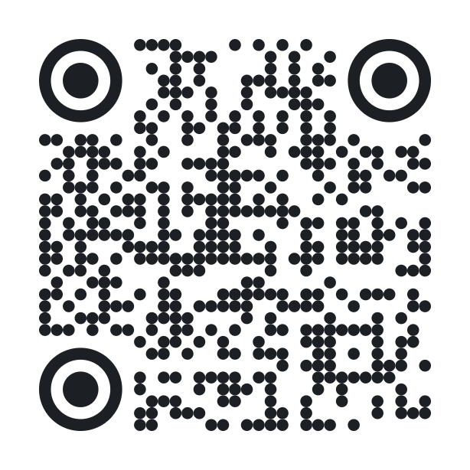
Knowledge Check Activity
Go to pe.app/vfc or scan the QR code to join.
  You do not need to rejoin or scan the QR code for every poll, but it is on each poll slide if you need it.
  If you close the device tab with the poll, it can be reopened at any point during today’s presentation.
When a poll is on screen, it will automatically show that poll question on your device. Your answer does not lock in and can be changed multiple times. Live results will be shown after the voting period ends.
Knowledge checks are anonymous, we encourage honest answers!
Notes:
Throughout today’s presentation, we will have brief knowledge check questions for you all to answer via a system called Poll Everywhere, which allows you to respond to questions in real-time via your phone, computer, or tablet. Poll Everywhere uses a join code or QR code to enable you to participate. There are 2 ways to join: 1. You can open the browser on your phone or computer and navigate to pe.app/vfc. 2. You can scan the QR code with your phone. You do not have to rescan the QR code or retype the join code for every question, but the information will be on each poll slide if you need it. The poll will not advance to the next question until it displays on screen, so we encourage you all to keep the Poll Everywhere page to be open on your device throughout the presentation. The join code is displayed at the top left of the screen on each poll, as well as a QR code on the right. When a new poll is displayed in the presentation, the question will update on your device for you to respond to.

Slide 18
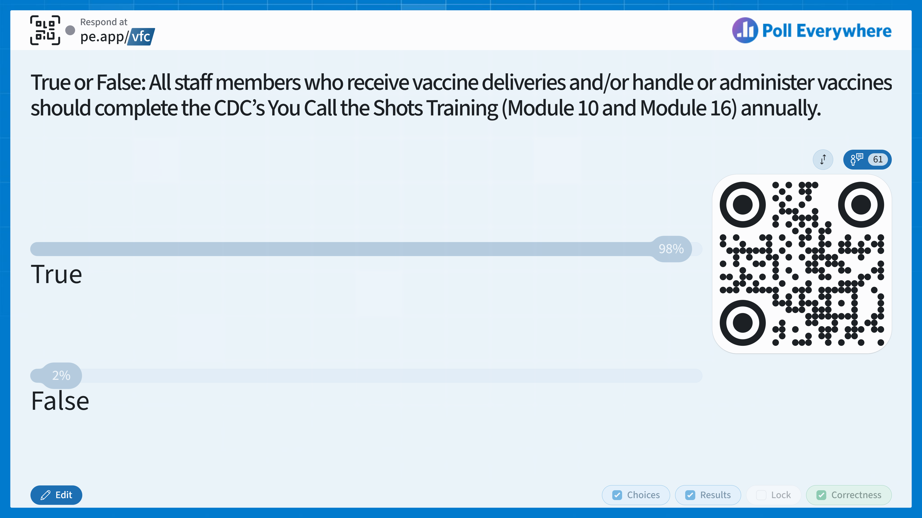
Notes:
Answer: TRUE.
All staff members who receive vaccine deliveries and/or handle or administer vaccines should complete the CDC’s You Call the Shots Training annually. There are two required videos from the CDC’s You Call the Shots training, modules 10 and 16. This training also meets the annual education requirement!

Slide 19
Knowledge Check
True or False: All staff members who receive vaccine deliveries and/or handle or administer vaccines should complete the CDC’s You Call the Shots Training (Module 10 and Module 16) annually.
True
False
Notes:
Answer: TRUE.
All staff members who receive vaccine deliveries and/or handle or administer vaccines should complete the CDC’s You Call the Shots Training annually. There are two required videos from the CDC’s You Call the Shots training, modules 10 and 16. This training also meets the annual education requirement!

Slide 20
Staff
Each site must identify a Primary and Backup Vaccine Coordinator.
  They are responsible for ordering, receiving, rotating, and monitoring vaccines.
  They must be fully trained on plans for vaccine ordering, storage, handling, transport, and inventory management.
  They must keep up-to-date on the CDC’s Vaccine Storage and Handling Toolkit.
Notify IDPH of staff changes by completing the Vaccine Program Site Updates form.
Notes:
In general, vaccine coordinators are responsible for the storage and handling of vaccines, as well as being an expert on routine and operating procedures for vaccine ordering, storage, handling, transport, and inventory management. There must be a primary vaccine coordinator and a backup vaccine coordinator at each site. Both coordinators must be trained and maintain documentation of competency for the specific task(s) they do. Detailed information about coordinator responsibilities is available in the VFC manual. IDPH must be notified any time there is a change in vaccine coordinator or medical director.

Slide 21
Training
All staff members who receive vaccine deliveries and/or handle or administer vaccines should complete annual education requirements.
  Complete You Call The Shots Module 10
  Complete You Call the Shots Module 16
  Attending this training meets this requirement!
BOTH training modules must be documented in the vaccine management plan and submitted annually in I-CARE.
Notes:
There are also required education components. All vaccine coordinators as well as any staff who handle VFC vaccines must complete annual education on vaccine storage and handling. There are two required videos from the CDC’s You Call the Shots training, modules 10 and 16. This training meets the annual education requirement! You will need to submit your CME/CE/certificate of completion into I-CARE. Documentation of training must be retained in the vaccine management plan and submitted with annual enrollment and will be reviewed during site visits. I-CARE does send an automated message to each individual coordinator whose training document (or documents) is/are about to expire. They get this 30 days ahead of time. The two documents may expire at the same time or at different times, so they will get a message about each expiring document individually.

Slide 22
Site Visits - Enrollment
These visits review:
  VFC program requirements
  Proper vaccine storage and handling
  Appropriate resources to implement requirements
  Vaccine Management Plans
Be prepared for follow-up visits during the first year.
Notes:
There are 4 types of site visits you can expect: enrollment, compliance, storage and handling, and an education site visit. We will go through each of those. First is the enrollment visit. Before being approved to order vaccines, VFC providers will need to complete an enrollment visit. This also includes practices that are re-enrolling after an absence.
The purpose of the enrollment visit is to educate providers about VFC program requirements and proper vaccine storage and handling. Certify locations have the appropriate resources to implement program requirements, confirm staff know who to contact at IDPH if problems arise, especially with storage and handling issues, and Review Vaccine Management Plans.

Slide 23

Notes:
Answer: C
IDPH compliance visits are repeated every 12-24 months. A new IDPH VFC site must be enrolled and active in the VFC program for 3-6 months before receiving a compliance site visit. But IDPH’s goal is 18-21 months for clinics without any known issues. This visit could be scheduled or unannounced.

Slide 24
Knowledge Check
How often is a compliance visit completed by IDPH at a VFC site?
Every 3-6 months
Every 7-11 months
Every 12-24 months
Every 25-36 months
Notes:
Answer: C
IDPH compliance visits are repeated every 12-24 months. A new IDPH VFC site must be enrolled and active in the VFC program for 3-6 months before receiving a compliance site visit. But IDPH’s goal is 18-21 months for clinics without any known issues. This visit could be scheduled or unannounced.

Slide 25
Site Visits - Compliance
Sites must be enrolled and active in the VFC program for 3-6 months before receiving a compliance site visit.
  Compliance site visits are repeated every 12-24 months.
The goals of a compliance site visit are to:
  Verify provider details, eligibility, and documentation.
  Review storage and handling best practices (per unit and sitewide).
  Ensure inventory management follows the requirements outlined in the Provider Agreement.
Notes:
IDPH will conduct a compliance visit to ensure providers are following all requirements. Sites must be enrolled and active in the VFC program for 3-6 months before receiving a compliance site visit. The compliance site visit is repeated every 12-24 months. Compliance visits ensure providers are up to date with their provider profile, vaccine management, storage and handling equipment, maintaining proper documentation, and screening and billing requirements among other things.
We will discuss compliance visits in more detail later in this session.

Slide 26
Site Visits - Storage and Handling
These visits may be scheduled or unannounced.
These visits review:
  Vaccine inventory management
  Vaccine storage and handling equipment and monitoring
  Vaccine storage and handling procedures and Vaccine Management Plan
  Appropriate storage and handling-related documentation
Important: Vaccines purchased with federal funds that are deemed non-viable due to provider negligence must be replaced on a dose-for-dose basis with privately purchased vaccines.
Notes:
IDPH is required to conduct a certain percentage of visits as unannounced visits. These visits ensure all vaccines are properly stored, handled, and labeled and to make sure all storage and temperature monitoring equipment are properly maintained.
Any vaccine purchased with VFC funds that are deemed non-viable due to provider negligence must be replaced with privately purchased vaccine.
If a site is noted to have a lot of storage & handling issues they might be more likely to be selected for an unannounced storage and handling visit…

Slide 27
Site Visits - Education
These visits are scheduled in advance with IDPH and clinical staff.
These visits:
  Introduce IDPH staff to new site clinical staff.
  Review vaccine storage procedures and temperature monitoring.
  Discuss steps needed to complete the VFC onboarding process and more!
Notes:
Education visits are usually for new VFC sites to familiarize themselves with the VFC program, processes, and IDPH Staff. This visit is also used for discussing any additional steps needed to complete the VFC onboarding process.

Slide 28
VFC and I-CARE
Manual pages 17-19
Notes:
The next few slides have additional information on VFC and I-CARE. To follow along, please view VFC manual pages 17 through 19.

Slide 29
I-CARE
Resources, forms, log-in issues, FAQs, and more can be found on the Quick Assist tab.
I-CARE can share records with these jurisdictions:
  City of Philadelphia
  Florida
  New Jersey
  Refugee Immunization Information Exchange
  Rhode Island
  Arizona
  Connecticut
  Ohio
  New Mexico
  Indiana
  Maryland
  Utah
  Kentucky
  Michigan
  Missouri
  Wisconsin
  The Department of Veterans Affairs
  Tennessee
  US Virgin Islands
  Puerto Rico
  Mississippi
Notes:
Illinois Comprehensive Automated Immunization Registry Exchange or ICARE is Illinois’s Immunization Information System that all VFC providers must be enrolled in. It allows public and private healthcare providers to share the immunization records of Illinois residents with other physicians statewide. All vaccine management is completed in I-CARE. VFC providers not in compliance will not be able to continue participating in the VFC program.
I-CARE is able to share records with other jurisdictions, including all of the following states and entities listed on screen.

Slide 30
I-CARE & HL7
Share Electronic Health Record (EHR) with I-CARE using HL7 data exchange.
  Contact EHR vendor to determine HL7 compatibility.
Begin HL7 onboarding process: Onboarding Questionnaire.
Fill out the HL7/Data Quality Updates Form when changing EMRs, implementing HL7, etc.
For information on HL7 messages: I-CARE HL7 Specifications.
Notes:
HL7 data exchange allows electronic health records to automatically update the required immunization data into I-CARE. If you are wanting to get set up with HL7, you should first reach out to your health record vendor to make sure your current EHR system is compatible with HL7. When you have confirmed your EHR is compatible, you can start the onboarding process by completing an onboarding questionnaire. Sites should fill out the HL7/Data Quality Updates Form, which can also be found under the Quick Assist tab in I-CARE, when changing their EMR, implementing HL7, experiencing HL7 connection issues, or addressing vaccine-related data quality concerns. You may need to acquire an additional interface for your EHR to send and exchange immunization data.
For information on HL7 messages, please visit the I-CARE website linked or you can also email dph.icare@illinois.gov
For specific use in immunization messaging, the CDC and American Immunization Registry Association (AIRA) have developed the HL7 Version 2.5.1 Implementation Guide (IG), which further refines the HL7 standard. It is located on the CDC’s website at: https://www.cdc.gov/iis/technical-guidance/

Slide 31
Vaccine Ordering and Tracking
Manual pages 20-22
Notes:
For those following along, information on vaccine ordering and tracking can be found on VFC manual pages 20 through 22.

Slide 32
Ordering Vaccines
The following should be up-to-date before submitting an order:
  Vaccine inventory
  Patient immunization records
  Temperature logs for all appliances
  Data logger certificates of calibration
  Vaccine incident reports for temperature excursions
  Delivery hours, including lunch hours or other closures
IDPH recommends placing smaller and more frequent orders.
Notes:
Vaccine ordering is completed in I-CARE. It is the responsibility of the provider to appropriately schedule and place vaccine orders and to rotate vaccine stock properly. Patient records, temperature logs, valid data logger certificates, vaccine incident reports for any temperature excursions, and accurate vaccine inventory are required to be up to date to place vaccine orders. Delivery hours must be entered and updated in I-CARE, which includes lunch or other break hours. IDPH suggests ordering smaller, more frequent orders to reduce waste; order as often as needed.
Orders can be tracked in I-CARE.

Slide 33
Vaccine Management – Borrowing Vaccines
Borrowing between VFC & private vaccine inventory must be under rare, unplanned occurrences.
  Cannot serve as a replacement for privately purchased inventory.
Must be properly documented and reported.
Borrowed doses must be replaced.
Notes:
Original caption: Borrowing between VFC and private vaccine inventory is prohibited. VFC-enrolled clinics are expected to maintain adequate inventories of vaccine for their privately insured and VFC-eligible patients. Vaccines provided through the Illinois VFC program cannot be used to replace a clinic’s privately-purchased vaccine inventory.
You can transfer VFC vaccine between VFC clinics, but a transfer request form should be submitted in I-CARE and approved by IDPH.

Slide 34
Incorrect or Missing Vaccine Shipment
Verify a shipment is accurate by ensuring the packing slip matches the vaccines received. Cross-check all lot numbers against inventory in I-CARE.
Vaccine Shipping Incident Report – To notify IDPH of shipping issues.
Shipping labels are emailed to the VFC Primary Coordinator on file. If another staff member needs to receive the label, or a label needs to be reissued, submit a Replacement Return Label request.
Notes:
Upon receiving a vaccine shipment, verify that the shipment is accurate by ensuring the packing slip matches the vaccines received. Cross-check all lot numbers against inventory in I-CARE. Lot numbers are automatically added to I-CARE when the order status is marked as “Complete.” Use the Vaccine Shipping Incident Report to notify IDPH of any shipping issues, including: Out-of-range temperatures, Missing vaccines, Lot number discrepancies, Damaged vaccines, Shipments not received. Provider responsibility begins as soon as vaccines arrive at the clinic. It is very important for the vaccine cold chain to be maintained to help ensure vaccine potency. It also helps save money and avoids having to re-vaccinate. It is not enough to just look at the vaccine vial as an indicator of maintaining the cold chain. Questions about storage and handling can be found in the new 2026 IDPH VFC Manual or the new 2026 CDC Vaccine Storage and Handling Toolkit.
Shipping labels are emailed to the VFC Primary Coordinator. If the Primary Coordinator is unavailable and another staff member needs to receive the label, or if a label needs to be reissued, submit a Replacement Return Label request.
Any issues should be reported within two hours to the Illinois VFC Program Services Staff‑ at 217-785-1455. If you do not immediately reach anyone, please call again and follow up with an email to dph.vaccines@illinois.gov.
• When emailing about an order, clinics must include these details: VFC site PIN, I-CARE order number ID, What vaccines are incorrect or missing from the order.

Slide 35
Storage and Temperature Monitoring
Manual pages 23-26
Notes:
In the new VFC manual, information on storage and temperature monitoring can be found on pages 23 through 26.

Slide 36
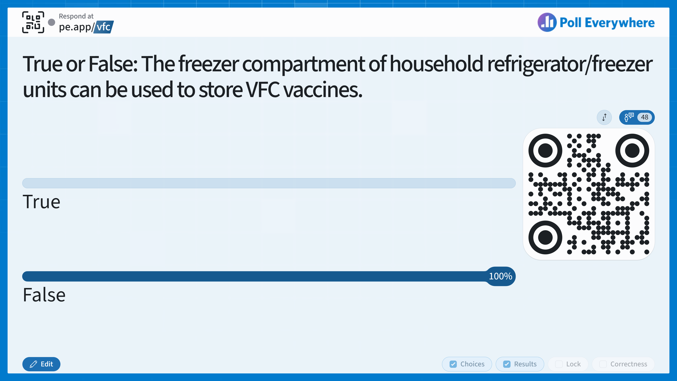
Notes:
Answer: False - only the refrigerator compartment can be used for storage.
Page 23 of manual.

Slide 37
Knowledge Check
True or False: The freezer compartment of household refrigerator/freezer units can be used to store VFC vaccines.
True
False
Notes:
Answer: False - only the refrigerator compartment can be used for storage.
Page 23 of manual.

Slide 38
Required Equipment
Storage units should be placed in a well-ventilated room, between 68°F - 77°F, without anything blocking them.
  Refrigerators should maintain temps between 2° C - 8° C (36°F - 46°F).
  Freezers should maintain temps between -50° C and -15° C (-58°F - +5°F).
  Recommended to set temps in Celsius and record to 1 decimal place.
Record temperatures:
  Any time staff are in the clinic, at least 3x/week.
  2x/day and the min/max temps at the start of every day.
Notes:
Vaccine appearance is NOT a reliable indicator that vaccines have been stored in appropriate conditions.
Storage units should be placed in a well-ventilated room, between 68 to 77 degrees Fahrenheit. Internal refrigerator temperatures should be between 2 and 8 degrees Celsius and between -50 to -15 degrees Celsius for internal freezer temperature.
Coordinators should record temperatures anytime they are in the clinic or collect the readings on paper every day you are in the clinic with minimum and max temps being recorded at the start of every day. Doors should always stay closed. A door that is not sealed properly or left opened unnecessarily not only affects the temperature in a unit, it also exposes vaccines to light, which can reduce potency of some vaccines. Consider using safeguards to ensure the doors of the unit remain closed—for example, self-closing door hinges, door alarms, or door locks.

Slide 39
Required Equipment
Purpose-built or pharmaceutical-grade refrigerators and freezers are preferred.
Stand-alone refrigerator and freezer units may also be used.
Household refrigerator/freezer units – only the refrigerator compartment can be used.
Never store vaccine in a dorm-style or bar-style combined refrigerator/freezer unit.
Notes:
Refrigerators and freezers should be purpose-built, pharmaceutical-grade or stand alone. All storage units must meet guidelines and be certified by an approved source. Combination refrigerator/freezer units can be used but only the refrigerator component can be used for storage. Vaccines should also not be stored in dorm or bar style combination storage units. (page 23)

Slide 40
Required Equipment
VFC vaccines must be stored separately from other vaccine types.
Some purpose-built units separate public & private vaccine stock electronically.
  If electronic, an inventory printout must be available upon request.
Power Supply:
  Plug in only one storage unit per electrical outlet.
  Post “DO NOT UNPLUG” warning signs at outlets and on storage units.
  Use caution when using power outlets that can be tripped or switched off.
Notes:
Storage units should allow for physical or electronic separation of public and private vaccines. If a provider follows electronic separation, then an inventory printout must be readily available. Some units can produce reports listing inventory by funding type and data logger reports. Rotate vaccine stock so the vials with the soonest expiration date are at the front (used first). Immediately remove expired vaccine from stock. Determine regular intervals for rotation (i.e., weekly), including when there is a vaccine delivery.
Protect your power supply - only plug in one unit per outlet and write “do not unplug” near the outlets. Other important power supply tips include using a safety-lock plug and avoiding the use of built-in circuit switches, outlets with activated wall switches, and multioutlet power strips. Providers should be prepared to remove and relocate vaccines in a situation like a power outage.

Slide 41
Digital Data Loggers
DDLs must have a current certificate of calibration.
Some purpose-built units have built-in DDLs. Make sure these meet all the requirements.
A back-up DDL must be available.
Data from DDLs should be downloaded and reviewed at least weekly.
DDL files must be retained for a minimum of 3 years.
Temperature data logger data files must be made available upon request.
Notes:
Digital data loggers, or DDLs, continuously measure and record the temperature of vaccine in a storage unit. This data can be retrieved with special software or a website and should be kept for 3 years to monitor long-term trends and/or recurring problems. All data loggers are required to have a current certificate of calibration and follow the manufacturer’s recommended re-testing guidelines. If you're using a purpose-built unit with a built-in DDL, ensure it meets all VFC requirements, has a current certificate of calibration, and contact the manufacturer to learn how to recalibrate the DDL before it expires.
It is important to have a backup data logger in the case another logger fails to keep temperatures or is undergoing calibration testing. Calibration testing is required for the back up DDLs and should be scheduled for a different date than the other DDL so the testing is not done at the same time.

Slide 42
DDLs
The DDL must be equipped with:
A temperature probe or sensor.
An active temperature display outside the unit that can be easily read without opening the unit’s door.
Continuous temperature monitoring and recording capabilities and capacity to routinely download data.
Back-Up DDLs:
Must have a readily available backup device with a valid certificate of calibration testing.
Calibration testing date for the backup device should be staggered or differ from that of the primary device.
IDPH recommends that clinics have at least two backup DDLs.
Notes:
Digital data loggers must have a temperature probe or sensor, an active temperature display outside the unit that can be read without opening the unit door, and continuous temperature monitoring and recording capabilities to download data. Additional recommended features include alarms for out-of-range temps, temperature display showing current, minimum, and max temps, low battery indicator, accuracy of +/-1 degree Fahrenheit and user programmable logging intervals. Often, suitable dataloggers will be marketed with a statement that they meet CDC/VFC requirements; while you are still responsible for ensuring that these DDLs meet requirements, looking for this statement may be helpful when comparing DDLs.
VFC providers must have a readily available backup DDL with a current and valid certificate of calibration testing. To prevent the certificate of calibration testing of the primary and backup devices from expiring at the same time, the date of calibration testing of the backup device should be staggered from the date of calibration testing of the primary device. IDPH recommends that clinics have at least two backup DDLs for transport, or as many DDLs needed to properly transfer all vaccines in stock, if needed.

Slide 43
DDLs
Confirmation the instrument passed testing (or instrument in tolerance).
Certificates of Calibration Testing must include:
Model/device number.
Serial number.
Date of calibration (report or issue date).
Meets specifications and testing requirements for the American Society for Testing and Materials (ASTM) Standard E2877 tolerance Class F (0.5 °C) or better.
Certificates of Calibration must indicate at least one of the following:
Conforms to ISO 17025.
Testing was performed by an ILAC/MRS Signatory body accredited laboratory.
Is traceable to the standards maintained by NIST.
Notes:
The certificates of calibration testing must include a model/device number, serial number, date of calibration, and confirmation the instrument passed necessary testing. The certificates of calibration must also indicate one of the following items: Conforms to ISO 17025, Testing was performed by an ILAC/MRS Signatory body accredited laboratory, Is traceable to the standards maintained by NIST, meets specifications and testing requirements for the American Society for Testing and Materials (ASTM) Standard E2877 tolerance Class F (0.5 °C) or better. Often, suitable dataloggers will be marketed with a statement that they meet CDC/VFC requirements.

Slide 44
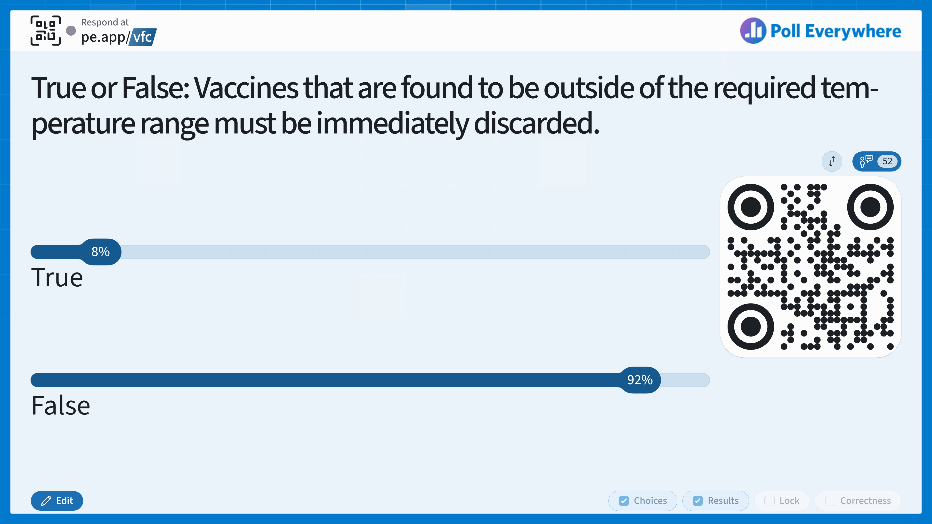
Notes:
Answer: False – Vaccines should be marked DO NOT USE and the manufacturer should be contacted to determine viability

Slide 45
Knowledge Check
Vaccines that are found to be outside of the required temperature range must be immediately discarded.
True
False
Notes:
Answer: False – Vaccines should be marked DO NOT USE and the manufacturer should be contacted to determine viability

Slide 46
Temperature Excursions
Any temperature reading outside the recommended ranges in the manufacturers’ package inserts.
Manufacturers will help determine if the vaccine is still viable.
Review storage & handling policies and take the appropriate actions.
Complete the Vaccine Incident Report in I-CARE.
Unsure if an excursion occurred?
  Mark vaccine “DO NOT USE!”
  Do not use or discard until the manufacturer determines viability and IDPH VFC is contacted.
Notes:
Any temperature excursion should be acted upon immediately by anyone who identifies it. A Vaccine Incident Report should be completed in I-CARE. If you are unsure if any excursion happened, then label the vaccine with “DO NOT USE.” Do not dispose of or use the vaccine until someone has checked in with the manufacturer and the IDPH VFC program.

Slide 47
Inventory Management
Manual pages 27-29
Notes:
As we cover information regarding inventory management on the next few slides, the information is reflected on VFC manual pages 27-29.

Slide 48
Inventory Management
Vaccine accountability is one of the program’s highest priorities because vaccine losses are absorbed directly by the VFC program’s budget.
Review the IDPH Vaccine Loss and Replacement Policy.
  Serves as the policy for management of incidents that result in loss of all publicly funded vaccines provided through the IDPH Immunization Program.
Notes:
Vaccine accountability is a cornerstone of the VFC program and one of the program’s highest priorities. Vaccine losses are absorbed directly by the VFC program’s budget. Since the Illinois VFC program is so important to the health and well-being of the children in Illinois, it is essential that every dose of vaccine is used to provide protection against preventable diseases. All VFC providers should continually monitor vaccine storage and handling practices. VFC providers are required to report all wasted, expired, spoiled or lost vaccine to the Illinois VFC program. You should review the Vaccine Loss and Replacement Policy. It goes into detail about situations requiring vaccine replacement.

Slide 49
Transferring Vaccines
Acceptable when:
  The vaccine is six months or less from the expiration date and unable to be used.
  A Vaccine Preventable Disease outbreak is occurring.
  A clinic closes.
Transfer requests will be reviewed on a case-by-case basis when:
  Vaccines are more than six months from the expiration date.
  There is an immediate need before an order can be received.
The cold chain must be maintained (use DDL when transferring).
  Ensure the transportation container is approved for vaccine storage.
If a site does not have a place to transfer to, they can use the Provider List to find one.
Notes:
Transferring vaccines between sites is acceptable for any type of vaccines except influenza vaccines. Transferring vaccines is acceptable in many situations, and some situations require review on a case-by-case basis. If your site would like to transfer vaccines but does not have a place to transfer them to, I-CARE’s Provider List can help you find one. When transferring vaccines, please ensure your transportation containers are approved for vaccine storage and transportation. Most containers for storage and transportation of food and beverages are NOT approved for vaccines.

Slide 50
Off-Site Clinics
Manual pages 30-31
Notes:
Off-Site clinic information can be found on pages 30 and 31 of the VFC manual, which we will cover on the next slide.

Slide 51
Temporary Off-Site Vaccine Clinics
Request process:
  Submit annual Off-Site Vaccination Clinic Plan for approval before off-site clinics can be held.
  Once approved, notify IDPH 48 hours prior to each individual clinic.
  Review the Off-Site Clinic Dashboard and Off-Site Clinic Procedures and Best Practices.
Transportation, storage, and handling must meet VFC program guidelines.
  How to Transport Vaccines for an Off-Site Clinic
Notes:
Hosting off-site clinics in places like community centers, churches, or drive-through settings can help increase vaccine accessibility for patients. Providers can offer VFC vaccines at temporary off-site clinics, which can increase vaccine accessibility for patients. The request process was updated in 2024 and includes submitting an annual Off Site Vaccination Clinic Plan and notifying IDPH 48 hours prior to each individual event. As another reminder, please ensure your transportation containers used for temporary off-site vaccine clinics are approved for vaccine storage and transportation. For additional questions, the off-site clinic dashboard and presentation about off-site clinic procedures and best practices can help you navigate this process. All VFC program requirements still apply for transport, storage, and handling. The linked video from the CDC provides additional details.

Slide 52
Achieving Inventory Accuracy
Manual pages 32-35

Slide 53
Achieving Inventory Accuracy
Complete vaccine inventory weekly to ensure physical stock matches I-CARE’s inventory.
  Review I-CARE vaccine inventory.
  Compare I-CARE inventory to physical vaccine inventory.
  Mark any expired/spoiled vaccines and return those doses.
  The Inventory Analysis Helper Report (IAHR) can help show administered shot errors that may not be deducted properly from a site’s vaccine inventory.
  If discrepancies still exist, use the Inventory Discrepancy form to request assistance.
Notes:
Maintaining an accurate inventory is a core responsibility of the VFC program. Doing so allows clinics to receive vaccines faster, and when requested, provides accurate records for patients and clinic operations. Vaccine inventory should be completed weekly to ensure physical stock matches I-CARE’s inventory. The main components to ensure a clean inventory are:
Review the clinic’s I-CARE vaccine inventory listed within the Vaccines Tab. Alternatively, you can view and print the Vaccine Inventory Report found in the I-CARE Reports section.
Compare I-CARE inventory to your physical vaccine inventory and note any discrepancies.
Mark any expired/spoiled vaccines appropriately and return those doses, if appropriate. If discrepancies exist, run the site’s Immunization Activity Report and compare your site’s EHR records to ensure all doses are accounted for.
If discrepancies still exist, run the site’s Mismatch Report and Inventory Analysis Helper Report. Keeping these two reports as clean as possible will help reduce inventory issues and speed up vaccine orders.
If discrepancies still exist, use the Inventory Discrepancy form to request assistance.

Slide 54
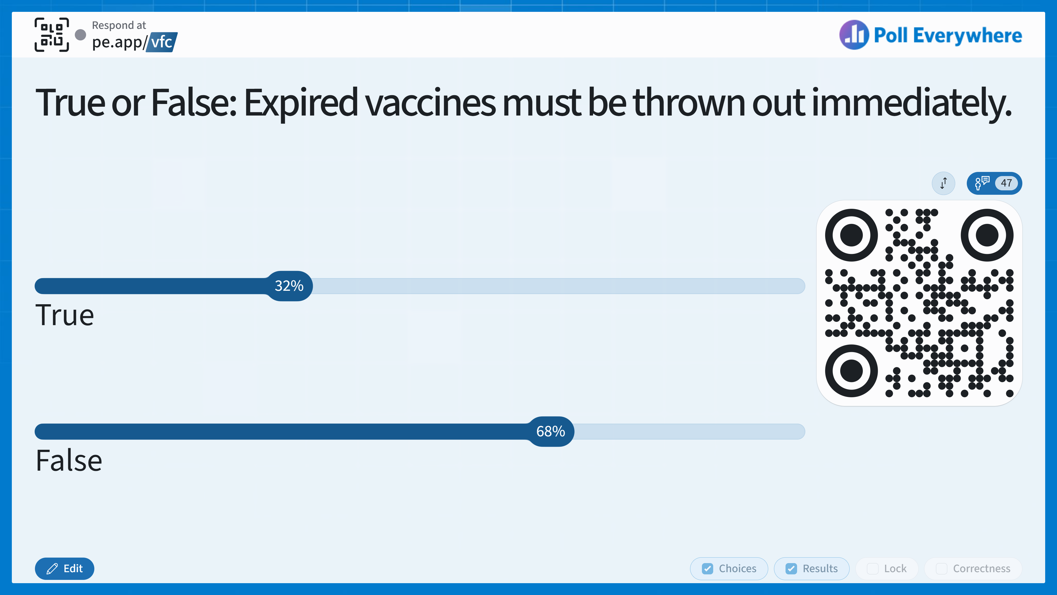
Notes:
Answer: False – Expired VFC vaccines should be sent back to IDPH and marked in I-CARE.

Slide 55
Knowledge Check
True or False: Expired vaccines must be thrown out immediately.
True
False
Notes:
Answer: False – Expired VFC vaccines should be sent back to IDPH and marked in I-CARE.

Slide 56
Removing & Returning Vaccines
Removing Expired Vaccines
Click on the lot and select “Add Transaction.”
Select the “Transaction Type” as “Expired/Spoiled (Return)”.
Enter the appropriate code and fill the quantity.
Hit the green SAVE button.
Returning Vaccines
All VFC vaccines received from IDPH should be returned upon expiration.
Remove expired vaccines from the storage unit and enter them into I-CARE.
The Primary Coordinator will receive an email with the Return Label and packing slip.
Notes:
If a site’s inventory has remained accurate after marking the expired vaccine, the new balance for the lot should be at 0. If so, a site can move the lot out of stock. All VFC vaccines received from IDPH, including seasonal vaccines such as flu and COVID, should be returned upon expiration. If vaccines expire, they can no longer be stored in the same storage unit with viable vaccines. They should be separated and labeled “Do Not Use”. To receive a mailing label to return the vaccines to McKesson, remove any expired vaccines from the storage unit and enter the expired vaccine transaction into I-CARE. Once the waste/return transaction is complete, the Primary Coordinator will receive an email with the Return Label and packing slip.

Slide 57
Administering VFC Vaccines
Manual pages 36-42

Slide 58
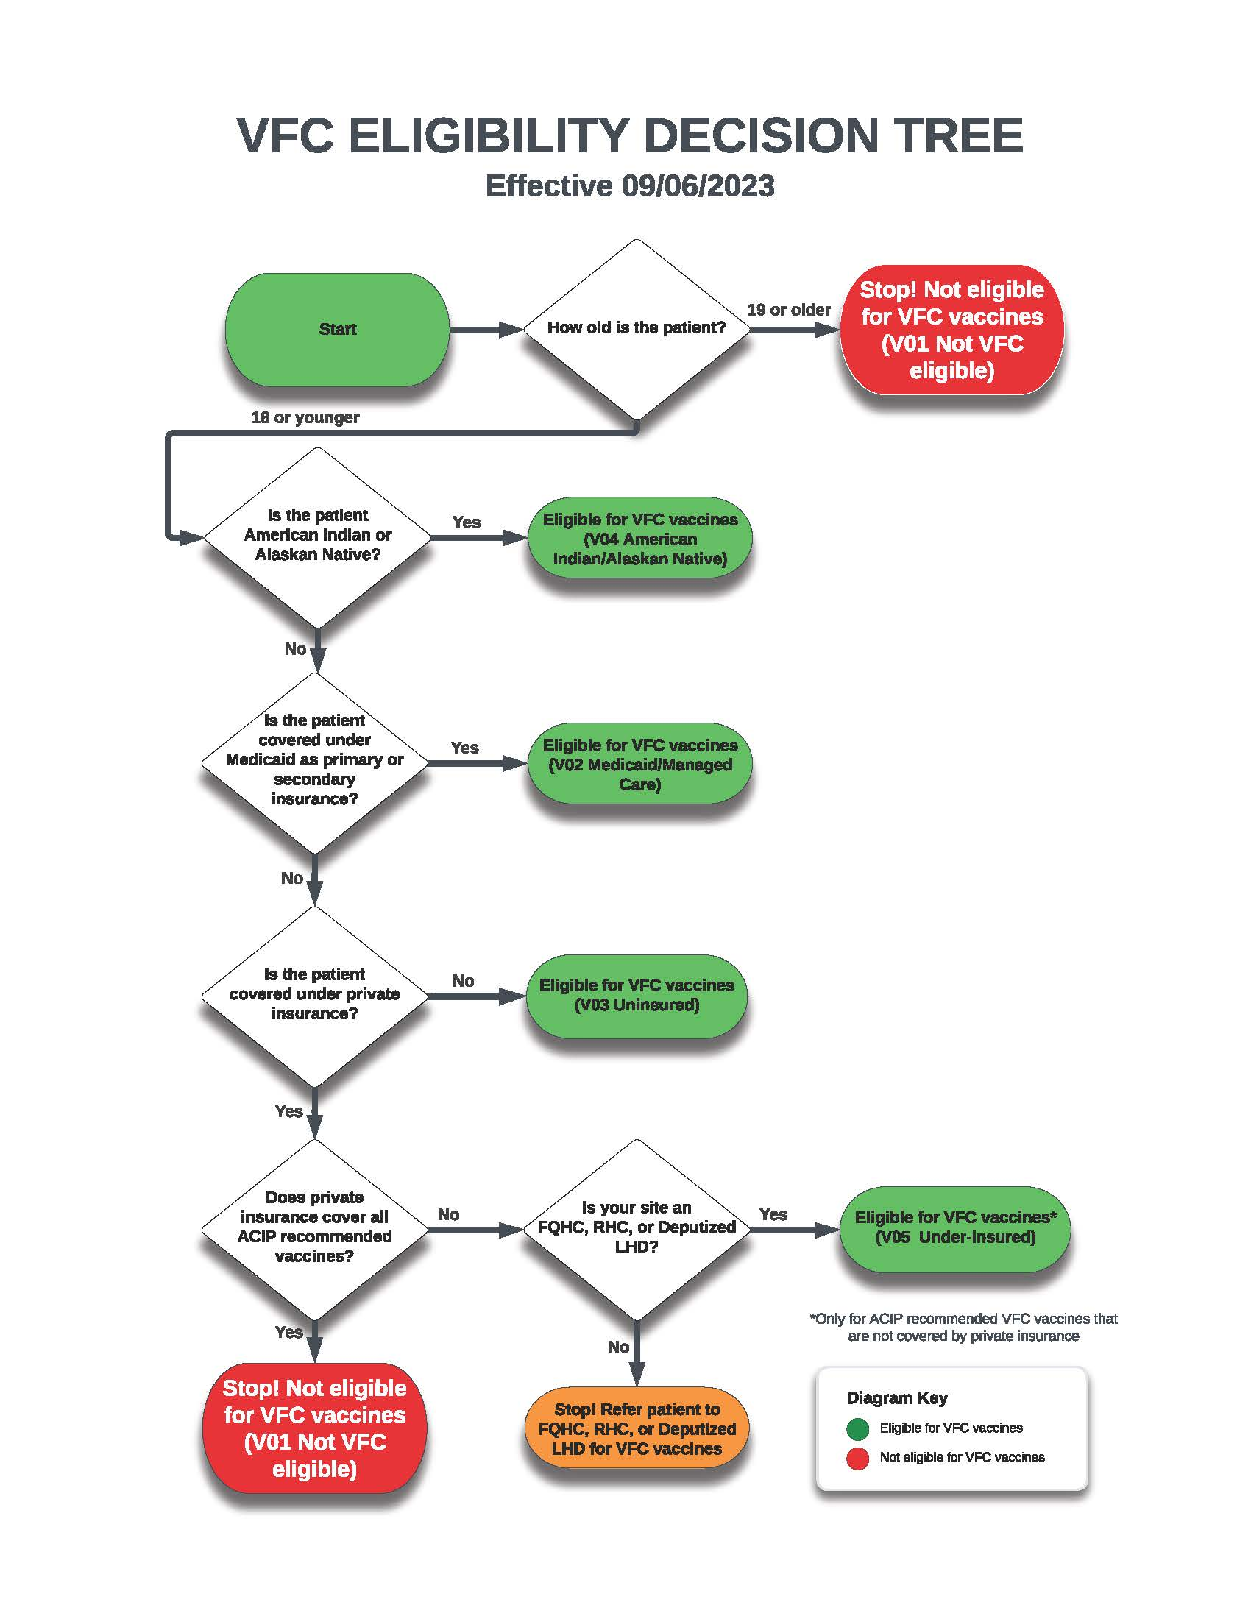
Eligibility
VFC Eligibility Criteria | Definition
American Indian or Alaska Native (AI/AN) | This population is defined by the Indian Health Care Improvement Act (25 U.S.C. 1603). (AI/AN children are VFC-eligible under any circumstance.)
Medicaid-eligible | Children who are eligible for the Medicaid program. For the purposes of the VFC program, the terms “Medicaid-eligible” and “Medicaid enrolled” are used interchangeably.
Uninsured | Children not covered by any health insurance plan.
Underinsured | Underinsured means the child has health insurance, but the insurance policy: Children who have health insurance, but the coverage does not include any vaccines. Children who have health insurance, but the coverage does not include all vaccines recommended by the Advisory Committee on Immunization Practices (ACIP). Children who have health insurance, but coverage has a fixed dollar limit (or cap) for vaccines. Children who have health insurance, but the insurance does not provide first-dollar coverage for vaccines.
Notes:
Any patient 19 years of age or older is NOT eligible for VFC vaccines, regardless of insurance status. Occasionally, children may be eligible for more than one category. A provider must select and document the category that will require the least amount of out-of-pocket expenses to the parent/guardian for the child to receive necessary immunizations. This table shows the eligibility criteria and definition for each.

Slide 59
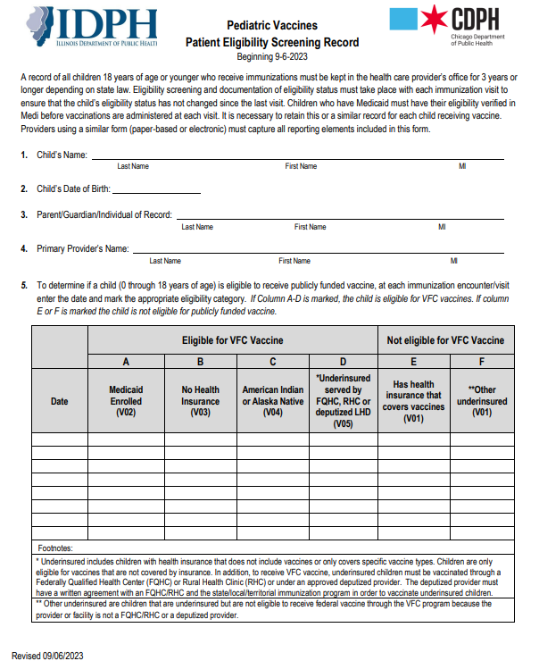
Patient VFC Eligibility Screening
Providers must verify VFC eligibility before administering VFC vaccines.
Use the MEDI system or equivalent system (with HFS 270/271 electronic transaction data).
The Patient Eligibility Screening Form allows recording of responses to VFC eligibility questions.
  Providers or parents/guardians may complete the VFC eligibility portion of the form.
Notes:
Providers must screen and document patient eligibility in the patient’s permanent medical record (either paper-based or electronic) using the either VFC Patient Eligibility Screening Record or document the required elements in the electronic medical record. The MEDI or equivalent system may be used for verification. Eligibility must be verified at every visit. The Patient Eligibility Screening Form developed by IDPH provides a means of recording parent response to VFC eligibility questions. The provider, parent, or guardian may complete the VFC eligibility portion of the form. Verification of parental responses is not required. The Patient Eligibility Screening Form is also available in Spanish to be more accessible to parents and caregivers.
Link: https://illinoisaap.org/wp-content/uploads/2026/04/Patient-Eligibility-Screening-Record-spanish.pdf

Slide 60
Child’s Insurance Status | VFC-Eligible? | VFC Eligibility Category
Enrolled in Medicaid. | Yes | Medicaid (V02).
Has private health insurance plan with Medicaid as secondary Insurance. | Yes | Medicaid (V02). The provider should choose the option that is most cost-effective for the family.
Has health insurance covering all vaccines but has not yet met plan’s deductible or paid for other services received at visit. | No | Insured (V01). This applies even when primary insurer would deny reimbursement for the cost of the vaccine and its administration because the plan’s deductible has not been met.
Has health insurance covering all vaccines but has not yet met plan’s deductible or paid for other services received at visit and has Medicaid as secondary insurance. | Yes | Medicaid (V02).
Has health insurance covering all vaccines, but the plan has a fixed dollar limit or cap on amount that it will cover. | Yes | Insured (V01) until the fixed dollar limit is met. Underinsured (V05) after the fixed dollar limit is reached.
Has an insurance plan that does not cover all ACIP-recommended vaccines. | Yes | Underinsured (V05). Child can only receive vaccines not covered by the plan.
Has health insurance, but plan does not cover any vaccines. | Yes | Underinsured (V05). With implementation of ACA, this situation should be rare.
Has no health insurance coverage. | Yes | Uninsured (V03).
Has private health insurance that covers all vaccinations and is AI/AN. | Yes | AI/AN (V04). The provider should choose the eligibility category most cost effective for the family.
Has Medicaid and is AI/AN. | Yes | Medicaid (V02) or AI/AN (V04). Providers should use Medicaid for the administration fee (least out-of-pocket expense for family).
Notes:
Children who have health insurance, but coverage does not include all vaccines recommended by ACIP, Children who have health insurance, but coverage has a fixed dollar limit (or cap) for vaccines, Children who have health insurance, but the insurance does not provide first-dollar coverage for vaccines.
This chart goes through different insurance status scenarios, vfc-eligibility status, and corresponding eligibility category.

Slide 61
Referring a Child
Underinsured children are only eligible for vaccines that are not covered by health insurance and can only be vaccinated through a Federally Qualified Health Center (FQHC), Rural Health Clinic (RHC), or deputized provider.
LHDs should complete the Request Memorandum of Understanding (MOU) form to request a delegated authority from an FQHC or RHC to vaccinate underinsured children.
  The FQHC or RHC must be a VFC provider.
  LHDs should retain a copy of their MOU and submit it every 24 months during VFC recertification.
Notes:
Children who are underinsured are eligible to receive VFC vaccine only through a FQHC, RHC, or LHD under an approved deputized agreement. It is required for a Memorandum of Understanding (MOU) to be completed, and a copy of the MOU must be kept and submitted every 24 months during VFC recertification.

Slide 62
VIS & Record Keeping
immunize.org/vaccines/vis
Give patient’s guardian a Vaccine Information Statement (VIS) for any vaccine under the National Vaccine Injury Compensation Program (NVICP).
It is required to document the following and maintain the records for at least three years:
  Name of vaccine administered
  Date vaccine was administered
  Date VIS was given
  Publication date of VIS
  Name of vaccine manufacturer
Vaccine lot number
Name and title of person who administered the vaccine
Address of clinic where vaccine was administered
Notes:
A vaccine information statement must be provided each time a vaccine covered under the National Vaccine Injury Compensation Program is administered. It must be the most up-to-date version. You can provide other materials but the VIS must be distributed. If a VIS for a certain vaccine is unavailable, you should not delay administration of the vaccine. Instead, you can use the manufacturer’s package insert, written FAQs, or any other document to inform patients about the benefits and risks of that vaccine. Immunize.org is a great resource where you can access vaccine information statements in various languages.
It is also required to document information about the vaccine administration including information about the vaccine itself, who administered it, and certifying you provided the VIS. Records must be maintained for at least three years.

Slide 63
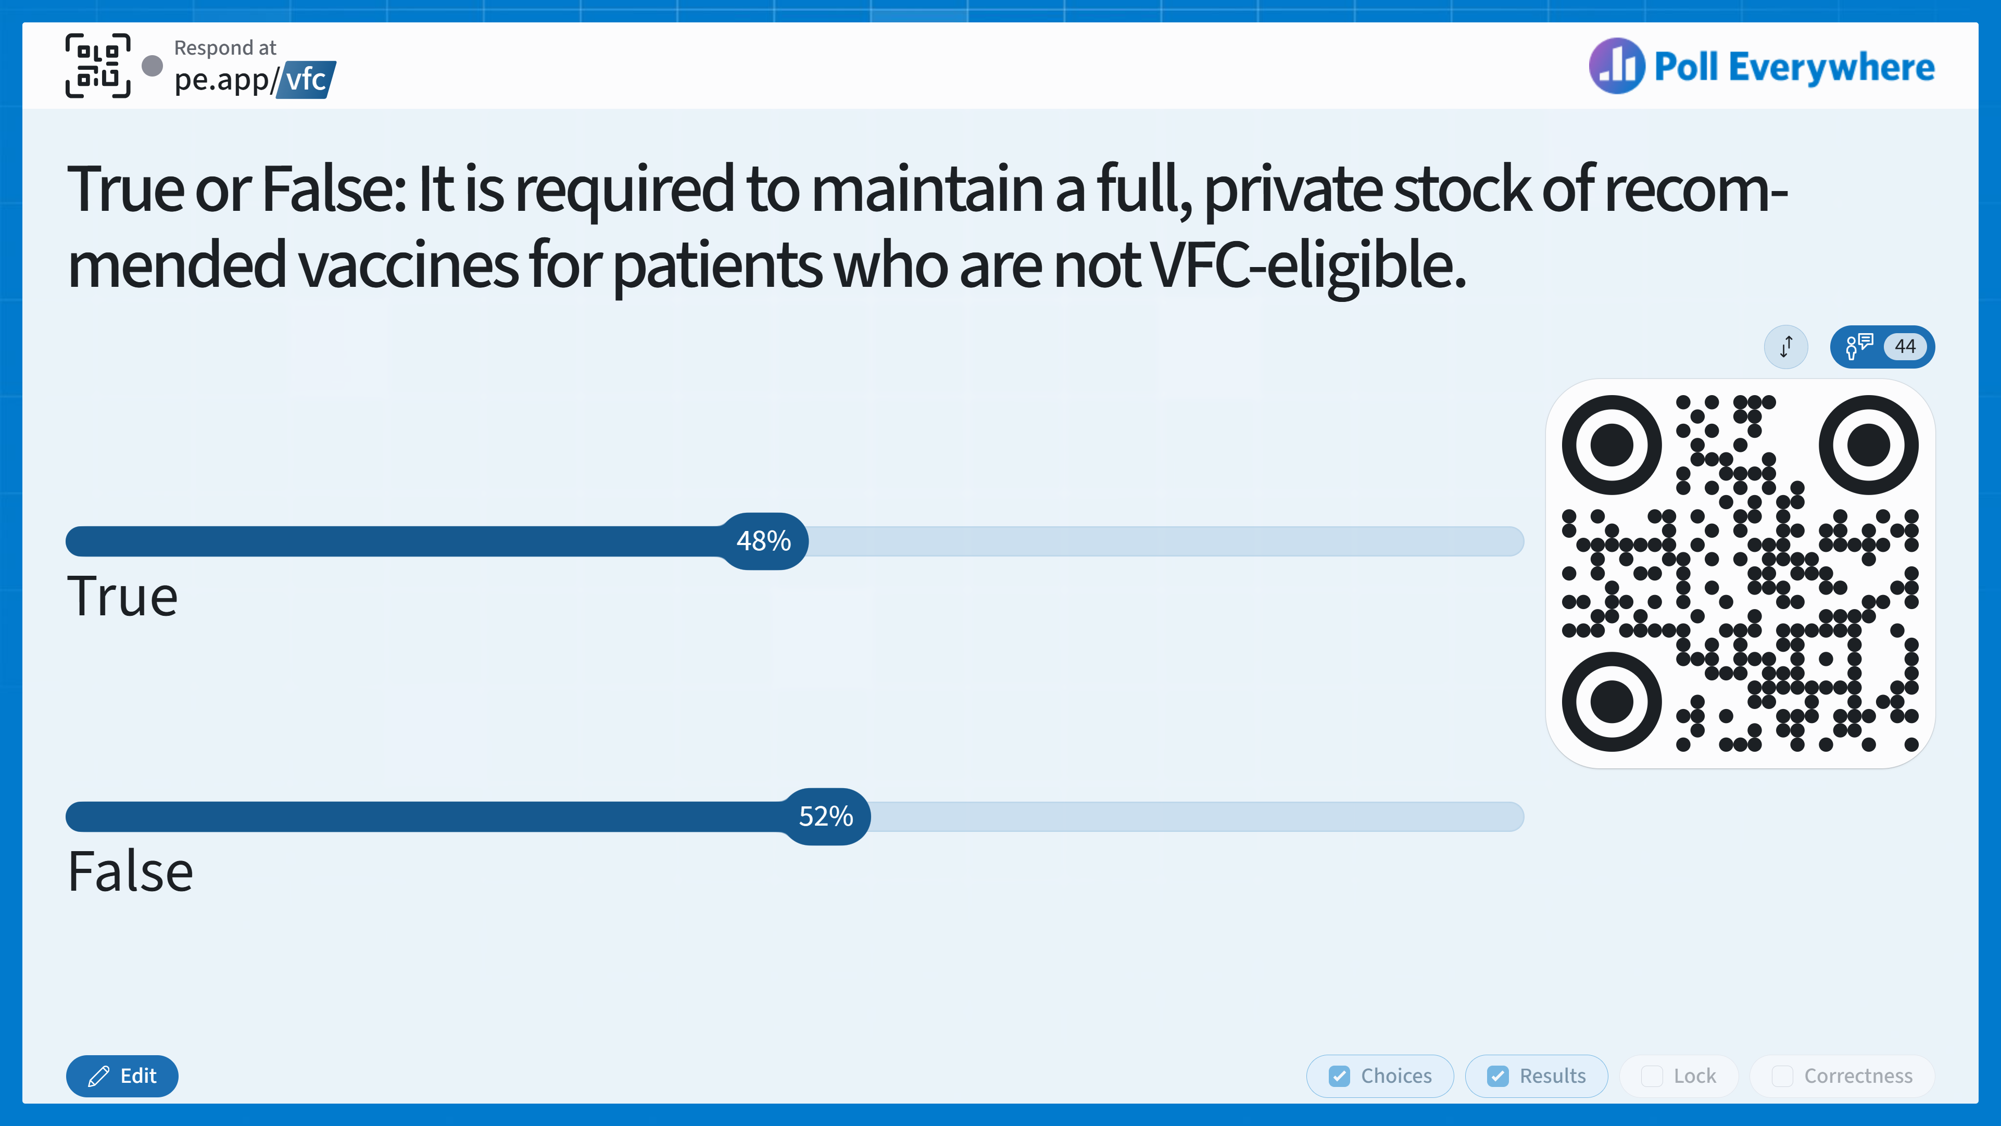
Notes:
Answer: False
CDC does not require VFC providers to maintain a full stock of all ACIP-recommended vaccines for non-VFC-eligible patients if they do not plan to offer all ACIP-recommended vaccines to this population. This guidance includes, but is not limited to, COVID vaccines and RSV monoclonal antibody products.

Slide 64
Knowledge Check
True or False: It is required to maintain a full, private stock of recommended vaccines for patients who are not VFC-eligible.
True
False
Notes:
Answer: False
CDC does not require VFC providers to maintain a full stock of all ACIP-recommended vaccines for non-VFC-eligible patients if they do not plan to offer all ACIP-recommended vaccines to this population. This guidance includes, but is not limited to, COVID vaccines and RSV monoclonal antibody products.

Slide 65
Vaccine Stock for Non-VFC Patients
CDC does not require VFC providers to maintain a full stock of all recommended vaccines for privately insured children if they don’t plan to offer all vaccines to this population.
  This includes COVID-19 vaccines and RSV monoclonal antibodies.
We hope that you will still stock and offer all recommended vaccines to all patients!
  Private vaccine stock must be stored separately and clearly labeled.
Notes:
The CDC no longer requires VFC providers to maintain a full stock of all recommended vaccines for privately insured children if they don’t plan to offer all vaccines to this population. However, even though it is not required, we hope that you will still stock and offer all recommended vaccines to all of your patients, regardless of their VFC eligibility status. If you choose to vaccinate privately insured (non-VFC-eligible) patients, you should maintain a separate supply of the vaccines they plan to offer to this population. Using VFC stock to immunize non-VFC-eligible patients is not allowed.

Slide 66
Billing - Medicaid Secondary Insurance*
Option 1: The provider can administer VFC vaccines and bill Medicaid for the administration fee.
Considerations:
Easiest way for a provider to use VFC vaccines and bill Medicaid for the administration fee.
No out-of-pocket costs to the parent for the vaccine or the administration fee.
Option 2: The provider can administer private stock vaccines and bill the primary insurance carrier for both the cost of the vaccine and the administration fee.
Considerations:
The provider may be reimbursed a higher dollar amount if a privately purchased vaccine is administered and both the vaccine and the administration fee are billed to the primary insurer.
*Consider these options for AI/AN populations that qualify for VFC under a second category, as the family may be responsible for administration fees.
Notes:
If a child does have Medicaid as secondary insurance, there are two options for billing:
The first is you can administer the VFC vaccine and bill Medicaid for the administration fee.
The second is you can administer the private stock vaccine and bill the primary insurance.
Either way, you should bill the patient in a way that is most cost-effective for the family. The family of a child with Medicaid as secondary insurance should never be billed for a vaccine or an administration fee.

Slide 67
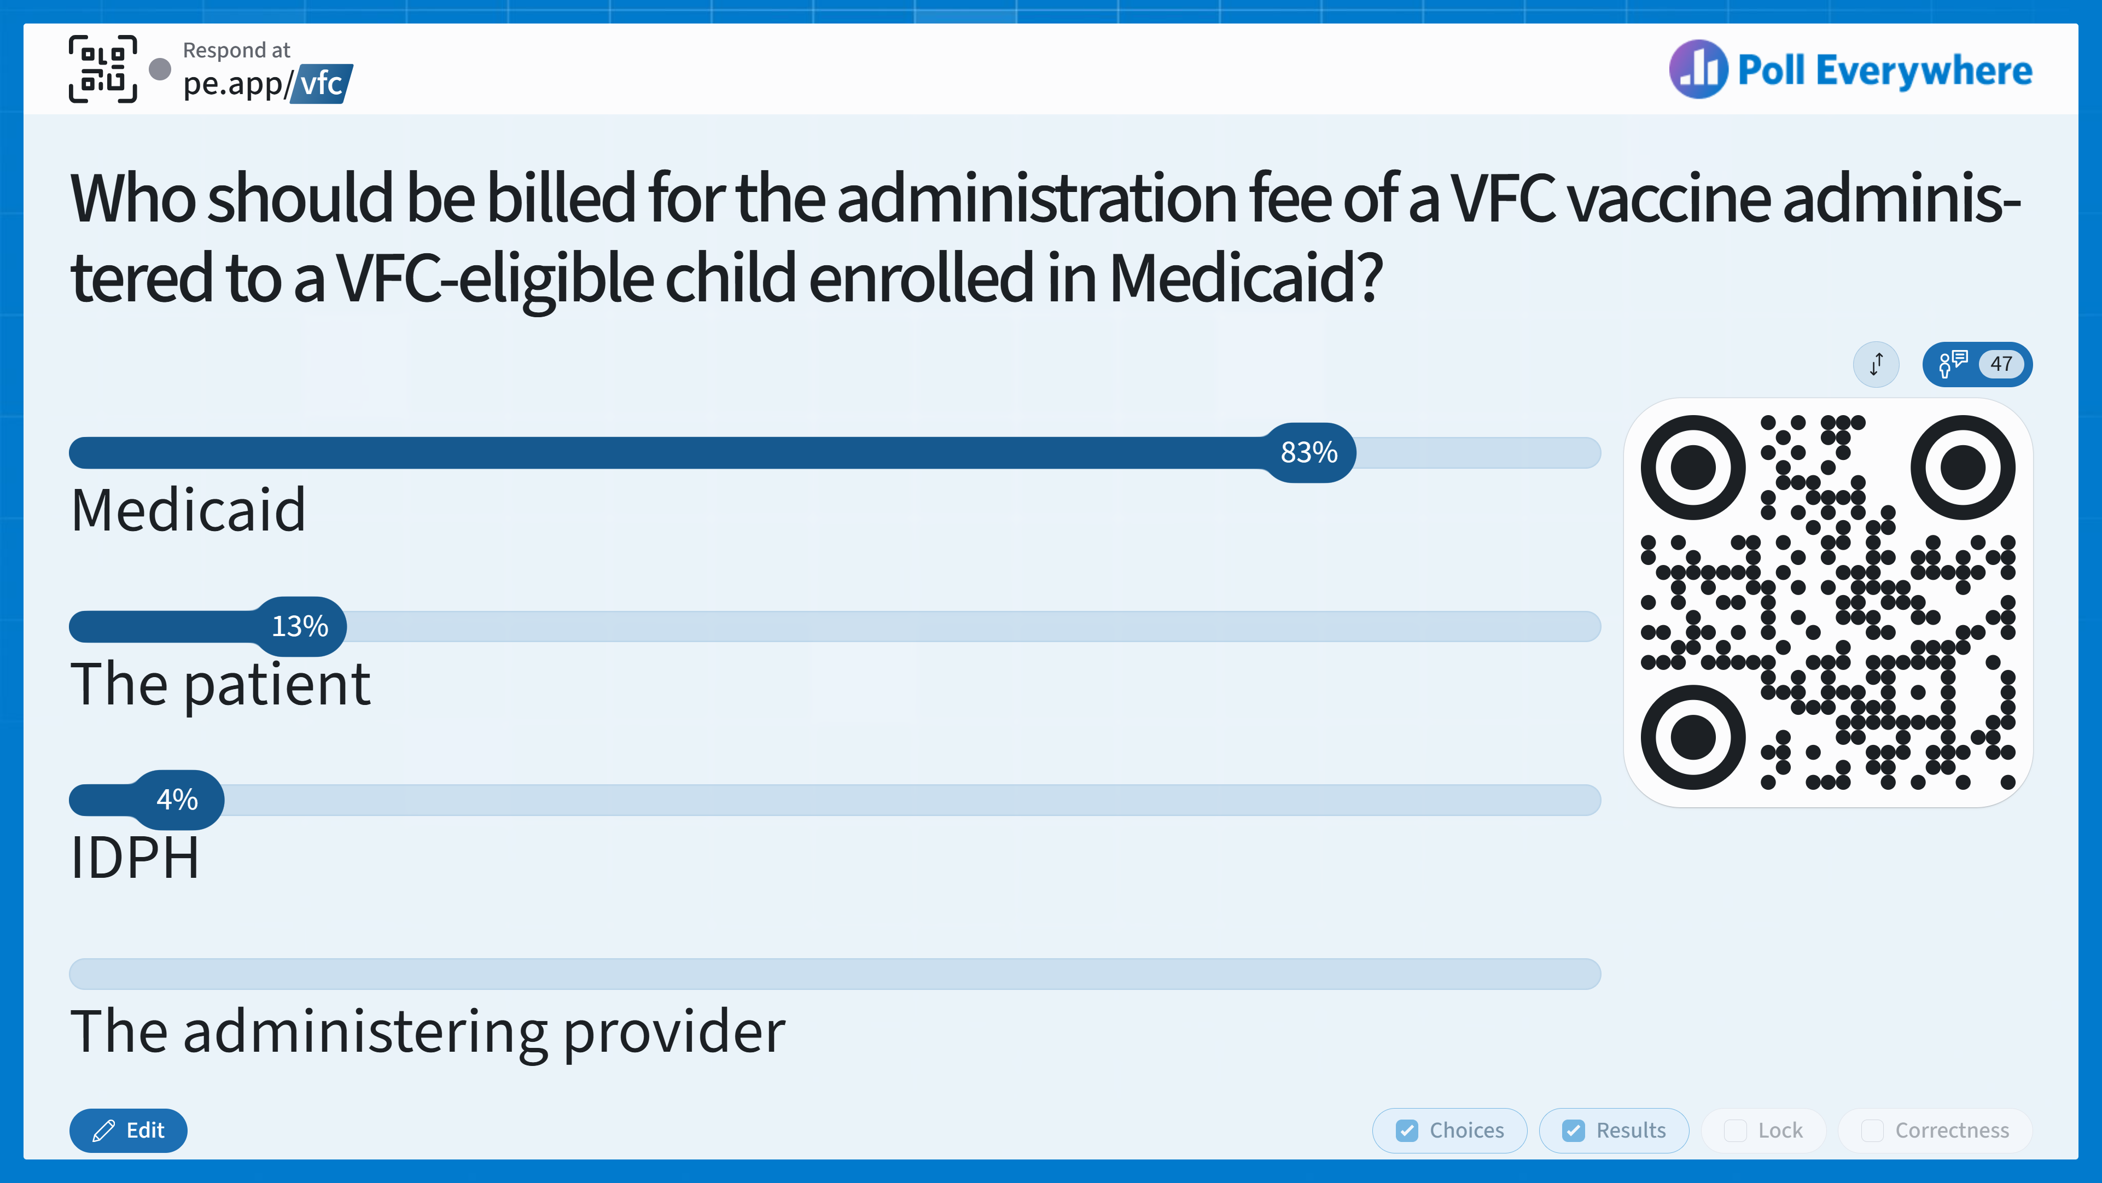
Notes:
Answer: A
Bill only Medicaid for the administration fee for VFC-eligible children enrolled in Medicaid (per vaccine and not per antigen).

Slide 68
Knowledge Check
Who should be billed for the administration fee of a VFC vaccine administered to a VFC-eligible child enrolled in Medicaid?
Medicaid
The patient
IDPH
The administering provider
Notes:
Answer: A
Bill only Medicaid for the administration fee for VFC-eligible children enrolled in Medicaid (per vaccine and not per antigen).

Slide 69
Administration Fees
Patients and families cannot be charged for publicly purchased vaccines.
Bill only Medicaid for the administration fee for VFC-eligible children enrolled in Medicaid (per vaccine and not per antigen).
  Administration fee for non-Medicaid VFC children cannot exceed $23.87.
Unpaid VFC vaccine administration fees may not be sent to collections, and VFC providers may not refuse to vaccinate an eligible child due to inability to pay.
Notes:
For VFC children enrolled in Medicaid make sure you only bill Medicaid for the admin fee. Admin fees are per vaccine and not per antigen. Providers may bill for the administration fee for non-Medicaid vfc-eligible children within 90 days of vaccine administration. Unpaid vaccine administration fees may not be sent to collections. The vaccine administration fee for non-Medicaid VFC-eligible children must not exceed $23.87 per dose. You may not refuse to vaccinate eligible children due to unpaid vaccine administration fees.

Slide 70
Reporting Adverse Reactions
Healthcare providers are required to report to VAERS:
Adverse events (AEs) in the VAERS Table of Reportable Events Following Vaccination.
AEs listed by the manufacturer as a contraindication.
Healthcare providers are strongly encouraged to report to VAERS:
AEs that occur after administering a vaccine licensed in the U.S.
Vaccine administration errors
Report AEs after administration of RSV monoclonal antibodies alone to MedWatch online. Report AEs after the coadministration of an RSV monoclonal antibody and vaccine to VAERS.
Notes:
VAERS is a national vaccine safety surveillance program that collects reports of adverse events after a vaccine is administered. Clinicians, providers, vaccine manufacturers, and the public can submit reports to VAERS. Healthcare providers are required by law to report to VAERS any adverse event listed in the VAERS Table of Reportable Events Following Vaccination that occurs within the specified time period after vaccinations and an adverse event listed by the vaccine manufacturer as a contraindication to further doses of the vaccine. It is also strongly encouraged to report a couple other scenarios to VAERS, including any adverse event that occurs after the administration of a vaccine licensed in the United States, whether it is or is not clear that a vaccine caused the adverse event and vaccine administration errors.
Adverse events that occur after administration of RSV monoclonal antibodies alone should be reported to MedWatch online. Adverse events that occur after the coadministration of an RSV monoclonal antibody and vaccine should be reported to VAERS. In this case, reporting the same adverse events to MedWatch is not necessary.

Slide 71
Compliance Site Visits and Immunization Quality Improvement for Providers (IQIP)
Manual pages 43-44
Notes:
The next two slides we will be giving an overview of compliance visits and IQIP. For additional information, please view pages 43-44 of the VFC manual.

Slide 72
Compliance Site Visits
Sites must be enrolled and active in the VFC program for 3-6 months before receiving a compliance site visit.
  Repeated every 12-24 months.
  Clinics also enrolled in the Adult Immunization Program (AIP) and Illinois Vaccine Access Program (IVAP) will receive site and compliance reviews during their VFC visit.
This visit includes reviewing:
  The Provider Profile
  Vaccine ordering and inventory management
  Policies, procedures, and the Vaccine Management Plan
  Vaccine storage and handling equipment, procedures, and documentation
  VFC screening requirements and billing practices
  Availability of all vaccines for VFC-eligible patients
  VFC-related document retention
Notes:
Compliance visits ensure providers are up to date with their provider profile, vaccine management, storage and handling equipment, maintaining proper documentation, and screening and billing requirements among other things. For clinics who are also enrolled in the Adult Immunization Program (AIP) and Illinois Vaccine Access Program (IVAP) will receive site and compliance reviews during their VFC visit. If problems are identified during the visit, the Regional Coordinator will work with provider staff to create a corrective action plan.
**Organization NPI**

Slide 73
IQIP
A 12-month process that includes 4 visits over the course of a year.
  Initial Visit: Discuss clinic workflow, baseline coverage levels, and review the national IQIP Strategies and best practices.
  Check-Ins: Completed at 2, 6, and 12 months. Technical assistance is provided at each visit, and coverage levels are compared to baseline at 6 and 12 months.
Notes:
IQIP supports providers in implementing quality improvement strategies that increase childhood and adolescent coverage levels in line with the vaccine schedule. IQIP is a twelve-month process that includes four visits over a year, with an initial visit followed by three other visits at two months, six months and twelve months into the program. VFC providers should expect to participate in IQIP every three to four years and visits typically take place virtually but can be scheduled in person if a site prefers. IDPH staff will reach out to VFC Coordinators to schedule IQIP visits. If your clinic is interested in scheduling an IQIP visit, please email your regional staff representative.

Slide 74
Reporting Fraud/Abuse
Manual page 45

Slide 75
Fraud and Abuse
Fraud and abuse may include:
  Providing VFC vaccines to non-VFC-eligible children.
  Billing a patient or third party for a VFC vaccine.
  Denying VFC-eligible children a VFC vaccine due to inability to pay an administration fee.
  Failing to screen for and document eligibility at each visit.
  Failing to properly maintain VFC records and requirements.
  Failing to properly store and handle VFC vaccines, etc.
Fraud and Abuse Protocol for Illinois Providers for additional details and expectations.
Notes:
By enrolling in the VFC program, you agree to comply with all program requirements. VFC providers must operate in a manner intended to avoid fraud and abuse. Some examples of fraud and abuse include billing a patient or third party for a VFC vaccine, failing to properly maintain VFC records and requirements, and denying VFC eligible children VFC vaccines. If fraud and abuse is suspected, IDPH will investigate. Intentional fraud and abuse will result in termination from the VFC program.

Slide 76
I-CARE Reports
Manual Pages 46-55
Notes:
I-CARE has many different reports that can be helpful in managing your vaccine inventory. We will be going over a handful of these reports in more detail in the next few slides.

Slide 77
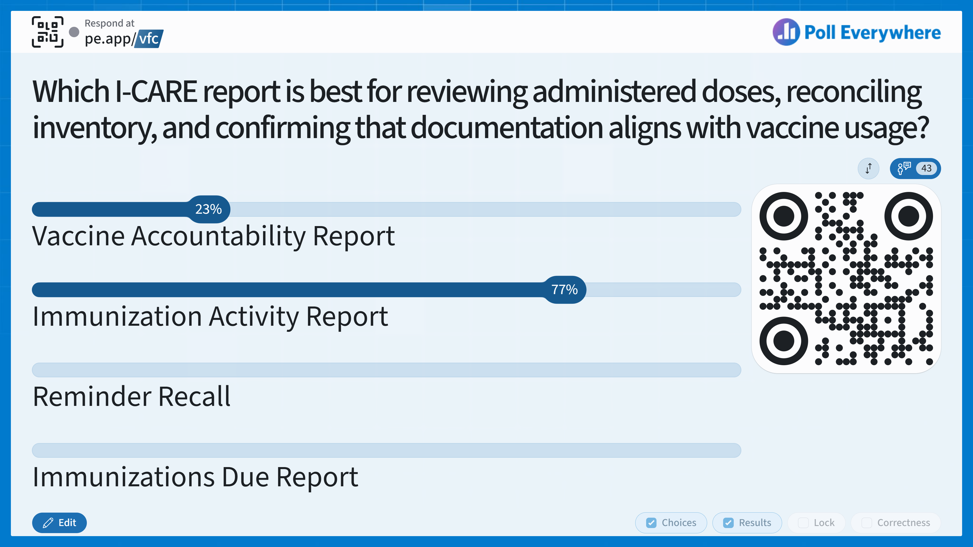
Notes:
Answer: B, Immunization Activity Report. Providers should compare their EHR reports to this I-CARE report to ensure the EHR and I-CARE report match and ensure all doses are accounted for.

Slide 78
Knowledge Check
Which I-CARE report is best for reviewing administered doses, reconciling inventory, and confirming that documentation aligns with vaccine usage?
Vaccine Accountability Report
Immunization Activity Report
Reminder Recall
Immunizations Due Report
Notes:
Answer: B, Immunization Activity Report. Providers should compare their EHR reports to this I-CARE report to ensure the EHR and I-CARE report match and ensure all doses are accounted for.

Slide 79
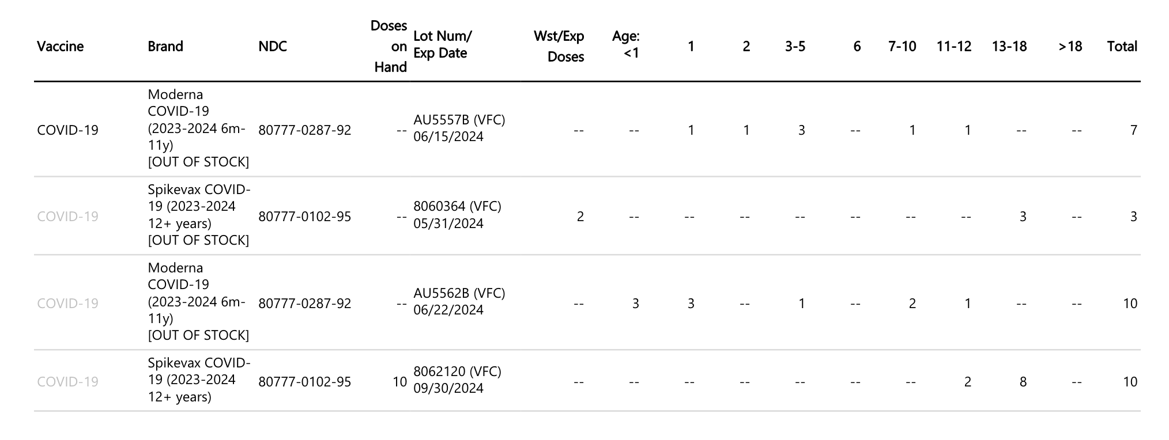
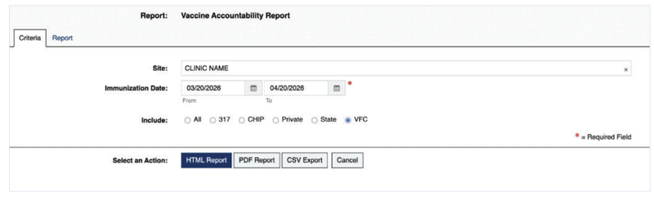
Vaccine Accountability Report
Notes:
The Vaccine Accountability Report generates a report summarizing doses administered, wasted, and expired during a selected time period. A 12-Month Inventory Summary, including the provider’s wastage level, is also included in this report and can help identify trends and support compliance with vaccine accountability requirements. It is best to run the accountability report from the date of the last order. It is important to spot check that doses are inputting into patient records and deducting from inventory.

Slide 80
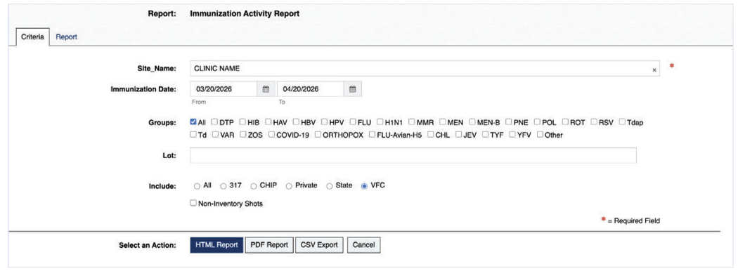
Immunization Activity
Notes:
The Immunization Activity report generates a summary list of all immunizations administered during a selected time period. This report is useful for reviewing administered doses, reconciling inventory, and confirming that documentation aligns with vaccine usage.

Slide 81
Patients
Patient List Export:
  I-CARE can generate a comma-delimited text file, i.e. an Excel spreadsheet, of patients that match a given criterion.
Managing Active Patients:
  Use the main search bar or the “Patients” tab, which provides a more robust search.
Notes:
I-CARE can generate a comma-delimited text file, like an Excel spreadsheet, of patients that match a given criterion. You can also use the main search bar or the “Patients” tab to search for and manage active patients. The patients tab provides a more robust search, including an advanced search function, as well as a button to manually add a new patient.

Slide 82
Immunizations Due & Immunizations Given
Immunizations Due Report: Active patients who are overdue for a particular vaccination.
  Use this report to determine which patients need to come in and help use vaccines that are expiring soon.
Immunizations Given Report: Active patients who received a dose during the specified time frame.
  Use this report to review immunizations given over specific time frames, to target missing doses, or review possible data entry issues.
Notes:
The Immunizations Due Report will generate a list of active patients at your site who are overdue for a particular vaccination. Providers can use this report to determine patients in their population that need to come in for an appointment. Providers also use this report when they have vaccine in their inventory that expires soon. You can use this list to remind patients to schedule an appointment to receive their next vaccination with a Reminder Recall Report, which we will show on the next slide. The Immunizations Given Report will generate a list of active patients who received a dose during the specified time frame. Use this report to review immunizations given over specific time frames, to target missing doses, or to review possible data entry issues.

Slide 83
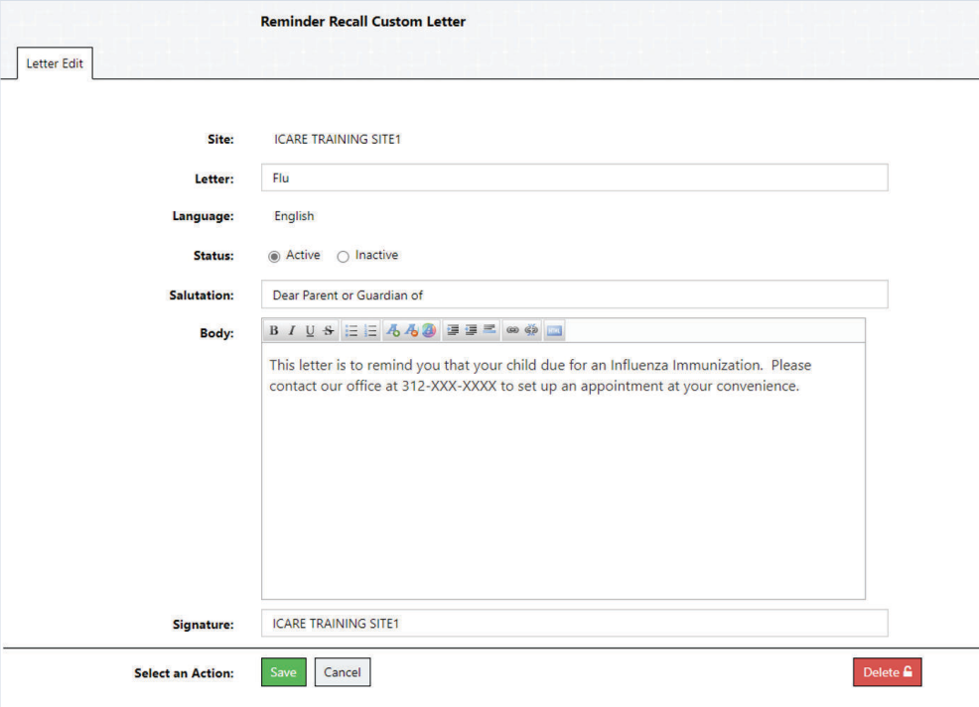
Reminder Recall & Customize Letters
Reminder Recall Reports:
  To remind patients of a future vaccination or to target patients who are past due for a vaccination.
Customize Letters:
  To create customized messages to send to patients about returning for forecasted or overdue vaccinations
Notes:
Reminder Recall Reports are used to remind patients of a future vaccination or to target patients who are past due for a vaccination. Providers can generate a patient list or create customized letters to send out notifications. These notifications can be sent digitally or printed and mailed to patients and their families. This can be used for a specific vaccination type, that can be selected in the “Groups” section (highlighted in blue box) or a VFC provider can leave the default “All” box checked as a general patient population reminder.

Slide 84
Childhood & Adolescent Coverage Level
Childhood Coverage Level Report:
  Active patients and the percentage of how many patients who are fully vaccinated for each vaccine group before their 2nd birthday.
Adolescent Coverage Level Report:
  There is a 13-year-old report and a 17-year-old report.
Notes:
The Childhood Coverage Level and Adolescent Coverage Level reports are used to generate immunization coverage levels on active patients who match the search criteria. The Childhood Coverage level report measures active patients who are fully vaccinated for each group before their second birthday while the Adolescent Coverage Level Report, measures whether kids are up to date on vaccination before their 13th and 17th birthdays.

Slide 85
Invalid Doses & Missed Opportunities
Invalid Doses: Used in quality assurance review and flags any problems.
  Looks at each vaccine/vaccine group and matches it against the vaccine administration schedule to make sure vaccines are being administered correctly.
Missed Opportunities: A summary of patients who have missed opportunities
  Used in quality assurance visits.
Notes:
The invalid doses report is used in quality assurance review and flags any problems. It looks at each vaccine and vaccine group and matches against the vaccine administration schedule to make sure vaccines are being administered correctly. The Missed Opportunities report shows a summary of patients who have missed opportunities; it is also used in quality assurance visits. Generating a Missed Opportunity Summary report will show all the missed opportunities for an entire site. When a patient presents for vaccination, make sure to give all vaccines that are due and overdue at the same time if possible.

Slide 86
Site Updates
Manual pages 56-57

Slide 87
Moving & Unenrolling
New Location
Notify the IDPH Immunization Program before a move so the equipment and plan to transport the VFC vaccines can be reviewed/approved.
  Vaccine Program Site Updates form in I-CARE.
Notification should occur at LEAST 30 DAYS ahead of time.
Notes:
If a site is moving to a new location, they should notify IDPH at least 30 days in advance and complete the vaccine program site updates form. We hope to not have any sites unenroll from the VFC program, but if it is necessary, there are also steps that should be taken to ensure timely notification is made and remaining vaccines are transferred. A site must provide a 30-day minimum notice of unenrollment, reconcile their inventory, and attempt to transfer remaining viable vaccines. LHDs are a great place to start! Sites must also be ready to provide at least 3 months of DDL temperature data. For more information, review the manual.

Slide 88
Adult Immunization Program (AIP)
Provides low- to no-cost vaccines to uninsured and underinsured adults ages 19 years and older.
Most individuals with Medicaid, Medicare, or private insurance are not eligible.
LHDs, FQHCs, and RHCs can order these vaccines to distribute.
Most routine vaccines, except HPV and PCV, due to funding limitations.
Notes:
The Adult Immunization Program provides low- to no-cost vaccines to uninsured and underinsured adults ages 19 years and older. These vaccines are federally funded and most individuals with Medicaid, Medicare, or private insurance are not eligible. Local health departments, federally qualified health centers, and rural health clinics can order these vaccines to distribute. Most routine vaccines are available except for HPV and PCV due to funding limitations.

Slide 89
IVAP
State-funded program which provides low- to no-cost vaccines to Illinoisians.
LHDs, FQHCs, and RHCs can order these vaccines to distribute.
COVID-19 vaccines and RSV monoclonal antibodies are included for individuals regardless of insurance status.
  Note: Administer VFC to eligible patients when the provider has doses in stock.
Prevnar 20 and Gardasil 9 are available for adults 19 years+ who are uninsured or underinsured.
  These replace vaccines that are no longer available in the AIP program.
Notes:
Illinois Vaccine Access Program This state funded program provides low cost to free vaccines to Illinoisians of all ages. Again, local health departments, federally qualified health centers, and rural health clinics can order these vaccines to distribute. COVID-19 vaccines and RSV monoclonal antibodies are included for individuals regardless of insurance status. Please note that VFC vaccines should be administered to eligible patients when the provider has doses in stock. Additionally, Prevnar 20 and Gardasil 9 are available for adults 19 years and older who are uninsured or underinsured. These replace vaccines that are no longer available in the AIP program.

Slide 90
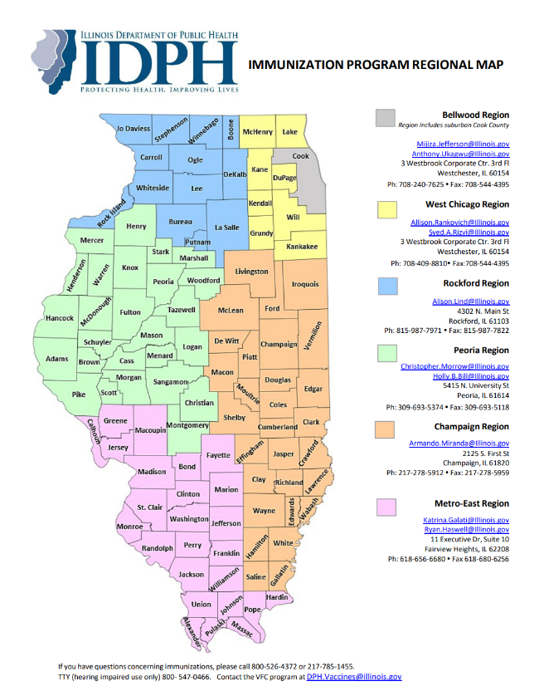
IDPH Regional Contacts
DPH.Vaccines@illinois.gov
Notes:
This slide shows the IDPH regional immunization program map with regional contacts. You can also reach the VFC program by emailing them.

Slide 91
Questions
Notes:
Now we have some time to go over questions that attendees submitted with their registration. We can also use this time to go over any new questions that have come up.

Slide 92
Attendee Submitted Questions
9/24/26
Notes:
Now we have some time to go over questions that attendees submitted with their registration. We can also use this time to go over any new questions that have come up.
How do agencies get hepatitis B birth dose records?
Can you use I-CARE as your computerized charting and dispose of paper records in X years?
If you have an FQHC in your building and the health department gives their VFC vaccines, can the health department bill an admin fee?

Slide 93
Attendee Submitted Questions
10/19/26
Notes:
Now we have some time to go over questions that attendees submitted with their registration. We can also use this time to go over any new questions that have come up.

Slide 94
Attendee Submitted Questions
10/20/26
Notes:
Now we have some time to go over questions that attendees submitted with their registration. We can also use this time to go over any new questions that have come up.

Slide 95
Attendee Submitted Questions
12/2/26
Notes:
Now we have some time to go over questions that attendees submitted with their registration. We can also use this time to go over any new questions that have come up.

Slide 96
Attendee Submitted Questions
12/10/26
Notes:
Now we have some time to go over questions that attendees submitted with their registration. We can also use this time to go over any new questions that have come up.
Any other tips and tricks/short cuts for navigating I-CARE?
Can you speak about polio and menb forecasts in I-CARE?
Can you provide more information about the mismatch report?

Slide 97
Break!
Please return at: 10:12

Slide 98
Recommended Child and Adolescent Immunization
Schedule for Ages 18 Years or Younger (AAP)
Jennifer Burns CPNP, IL-FP APN

Slide 99
Learning Objectives
After this session, participants will be able to:
Summarize current vaccine schedules and recommendations.
Apply the respiratory virus immunization recommendations for the 2026 – 2027 season.
Outline new vaccine products and updates.
Notes:
These are the learning objectives for this session. After this session, participants will be able to summarize current AAP vaccine schedules and recommendations, apply respiratory virus immunization recommendations for this season, and outline new vaccine products and updates.

Slide 100
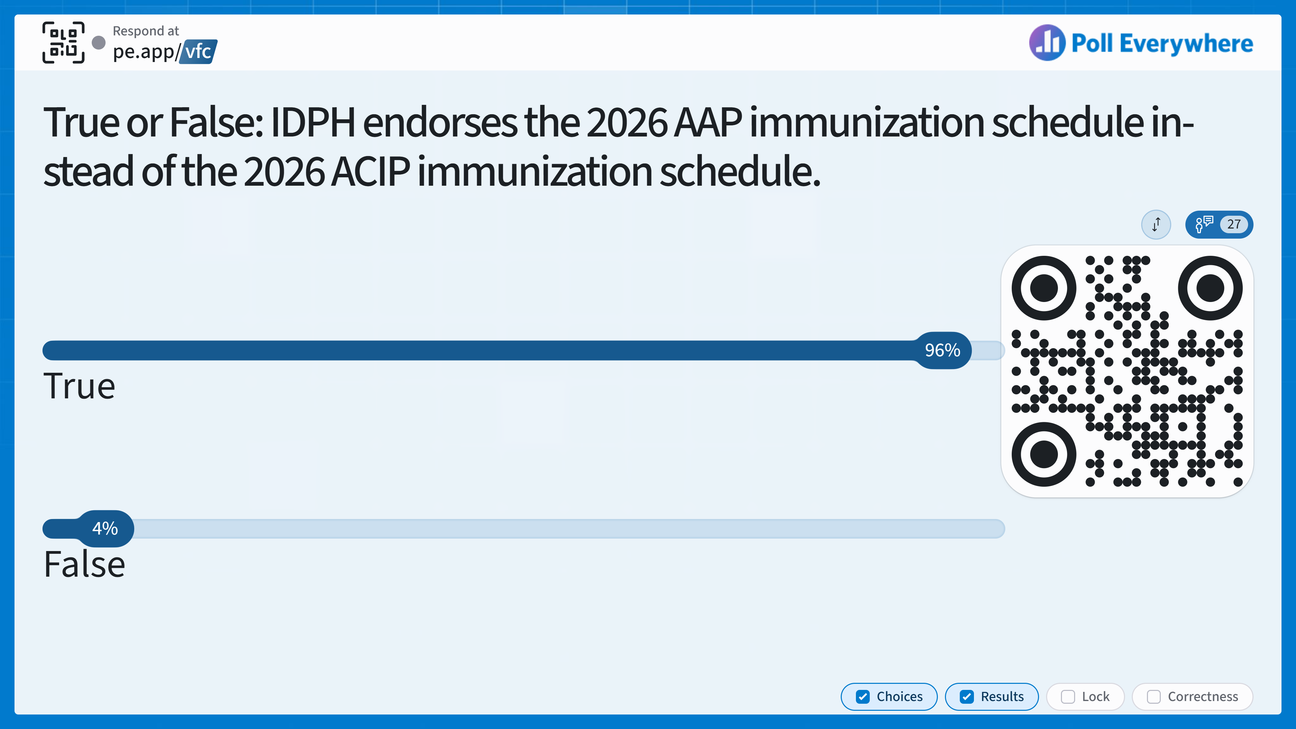
Notes:
Answer: True
IDPH endorses the American Academy of Pediatrics (AAP) immunization schedule, meaning IDPH does not recommend adjustments to the childhood immunization schedule based on federal policy changes made by HHS Secretary Robert F. Kennedy Jr. and President Trump’s executive order.

Slide 101
Knowledge Check
True or False: IDPH endorses the 2026 AAP immunization schedule instead of the 2026 ACIP immunization schedule.
A. True
B. False
Notes:
Answer: True
IDPH endorses the American Academy of Pediatrics (AAP) immunization schedule, meaning IDPH does not recommend adjustments to the childhood immunization schedule based on federal policy changes made by HHS Secretary Robert F. Kennedy Jr. and President Trump’s executive order.

Slide 102
Value of Immunizations
An AAP study demonstrated that routine childhood vaccines help prevent unnecessary morbidity and mortality, as well as have cost-saving impacts.
Estimated vaccine costs of $8.5 billion were entirely offset by the avoided $63.6 billion in disease-related costs.
https://publications.aap.org/pediatrics/article/150/3/e2021056007/188497/Value-of-the-Immunization-Program-for-Children-in?autologincheck=redirected
Notes:
We know how valuable vaccines are not only because they decrease morbidity and mortality, but also have cost-saving impacts.
From 2017-2021, the ACIP-recommended schedule for routine childhood immunization has targeted 14 vaccine-preventable disease.
Using this recommended schedule and the 2017 birth cohort, it was demonstrated that immunizations prevented over 17 million cases of disease and 30,000 deaths. The estimated vaccines costs of $8.5 billion were entirely offset by the avoided $63.6 billion in disease-related costs.

Slide 103
History of AAP Vaccine Recommendations
1934
The AAP made recommendations to guide pediatricians’ use of vaccines for the first time.
1938
AAP’s Committee on Immunization Procedures published the Red Book for the first time.
1955
The AAP collaborated with the National Foundation for Infantile Paralysis (present-day March of Dimes) to promote polio immunization.
1964
ACIP was established after a collaboration between AAP, the American Public Health Association, and U.S. government (Vaccine Assistance Act of 1962).
1993
AAP and ACIP pledge to develop one vaccine schedule, and the VFC program was created on August 10, 1993.
https://publications.aap.org/aapnews/news/32762/AAP-has-been-leading-voice-on-childhood-vaccine?autologincheck=redirected
https://www.cdc.gov/vaccines-for-children/about/index.html
Notes:
The AAP has been a consistent leader at providing evidence-based recommendations and guidance for infants, children, and adolescents from vaccine-preventable illnesses since 1934, decades before the ACIP was established. Even as immunization recommendations and partnerships have evolved, the AAP has been a consistent leader within those conversations. Before the 2025 divergence between ACIP and AAP, the most notable divergence came in 1989 when they disagreed on when to administer the second dose of the MMR vaccine. But for over 30 years, since 1993 and the creation of the VFC program, ACIP and AAP had harmonized their vaccine schedules up until 2025.

Slide 104
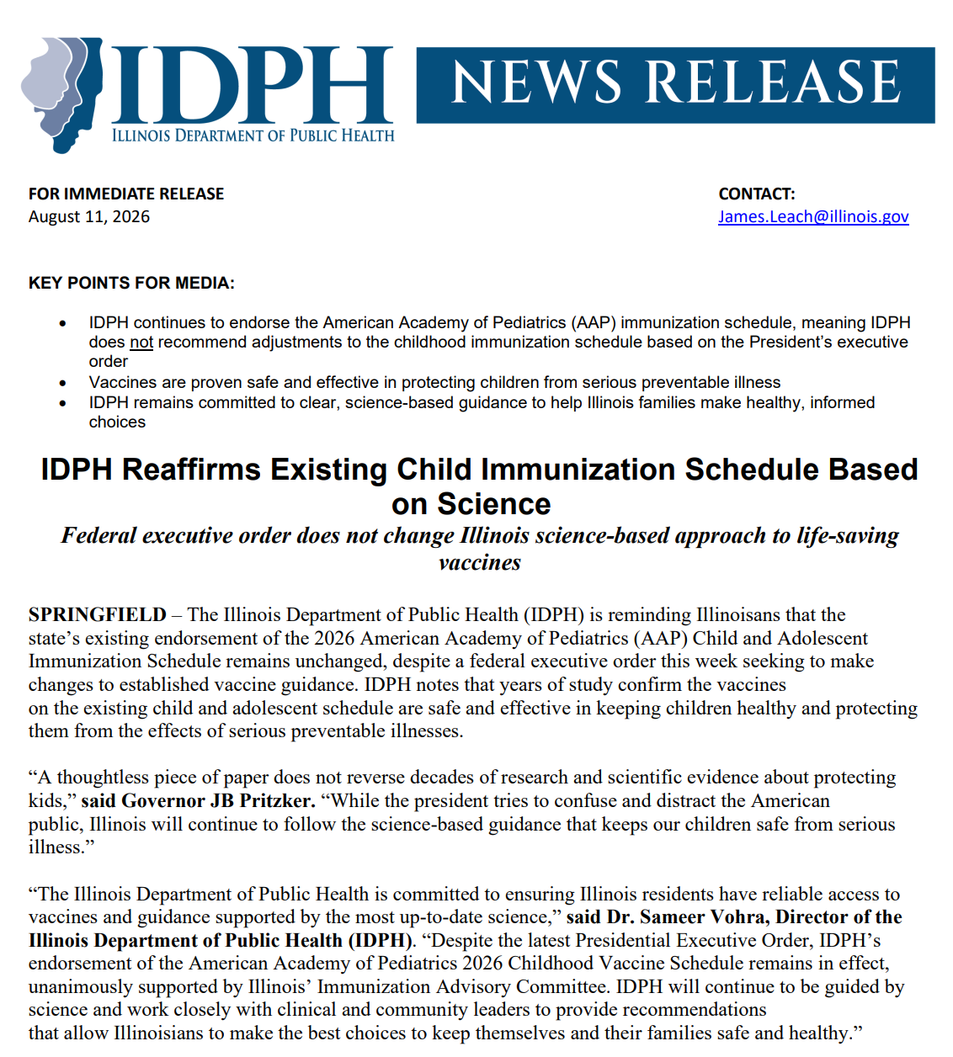
Illinois
Follows Evidence-Based, Science-Based Vaccine Recommendations
Notes:
Immunization schedules give children protection based on: Ages when vaccines will work best with their immune systems, when they are most vulnerable to certain diseases, and risk of exposure to disease and how that disease impacts health, giving children protection when they are most vulnerable.

Slide 105
Federal Vaccine Policies
A lot of announcements, changes, changing back, confusion, etc.
Bottom line: Clinical operations have not changed - please continue to vaccinate based on the AAP recommendations, as endorsed by IDPH.
https://publications.aap.org/aapnews/news/34722/AAP-s-historic-victory-in-vaccine-lawsuit-a?searchresult=1?autologincheck=redirected
https://www.whitehouse.gov/presidential-actions/2026/08/delivering-gold-standard-childhood-vaccine-recommendations-for-americans/
https://publications.aap.org/aapnews/news/35792/AAP-Executive-order-to-reduce-childhood-vaccines?autologincheck=redirected
https://illinoisaap.org/wp-content/uploads/2026/08/20260811_IDPH_News_Release_Vaccine_Guidance.pdf
Notes:
In the past year and half there have been many announcements, changes, changing back to the original policy, generation of confusion as a result, and more. But at the end of the day, we want to emphasize that clinical operations have not changed and we should continue to vaccinated based on AAP recommendations as endorsed by IDPH.

Slide 106
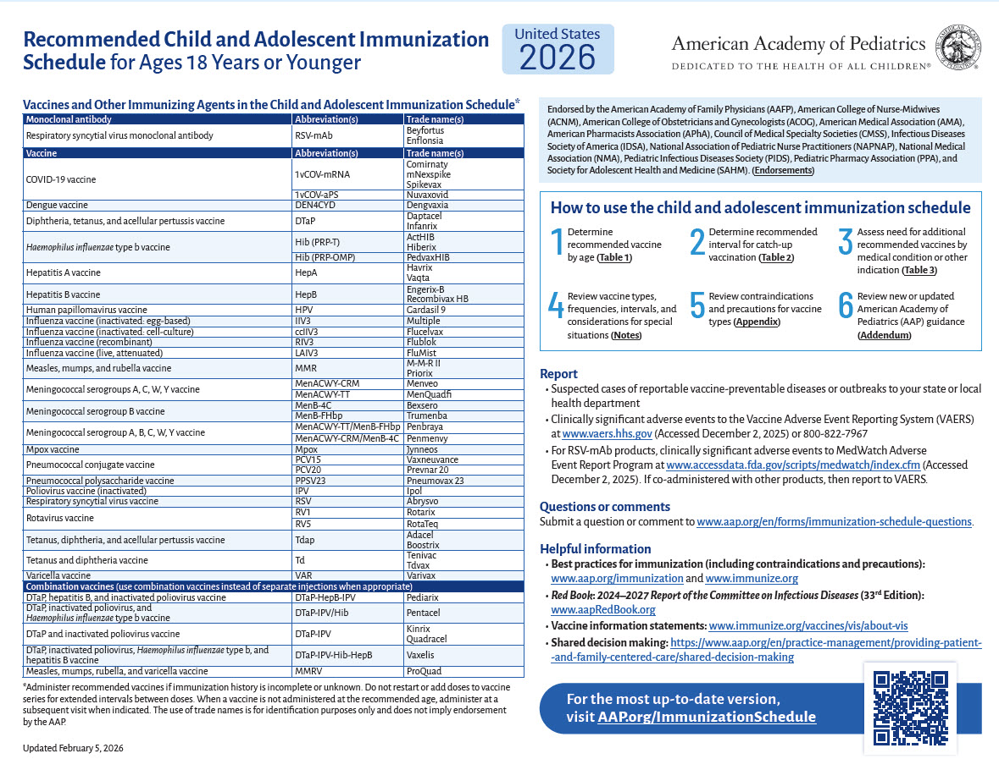
Using the AAP Immunization Schedule
To make immunization recommendations, healthcare providers should:
Determine recommended vaccine by age (Table 1).
Determine appropriate intervals for catch-up, if needed (Table 2).
Assess for medical conditions and other indications (Table 3).
Review special situations (Vaccination Notes).
Review contraindications and precautions to vaccination (Appendix).
Review new or updated vaccine guidance (Addendum).
https://publications.aap.org/pediatrics/article/157/3/e2025075754/206175/Recommended-Childhood-and-Adolescent-Immunization?autologincheck=redirected
Notes:
Here are the steps on how providers should use the AAP immunization schedule. During this session, we will review each schedule and walk through these steps. The AAP schedule follows very similarly to the ACIP vaccination schedules that many medical providers are familiar with. At this time, the AAP no longer endorses the Centers for Disease Control and Prevention's recommended childhood and adolescent immunization schedule. Members of the AAP Committee on Infectious Diseases participated in the immunization work groups of the Advisory Committee on Immunization Practices through May of 2025.

Slide 107
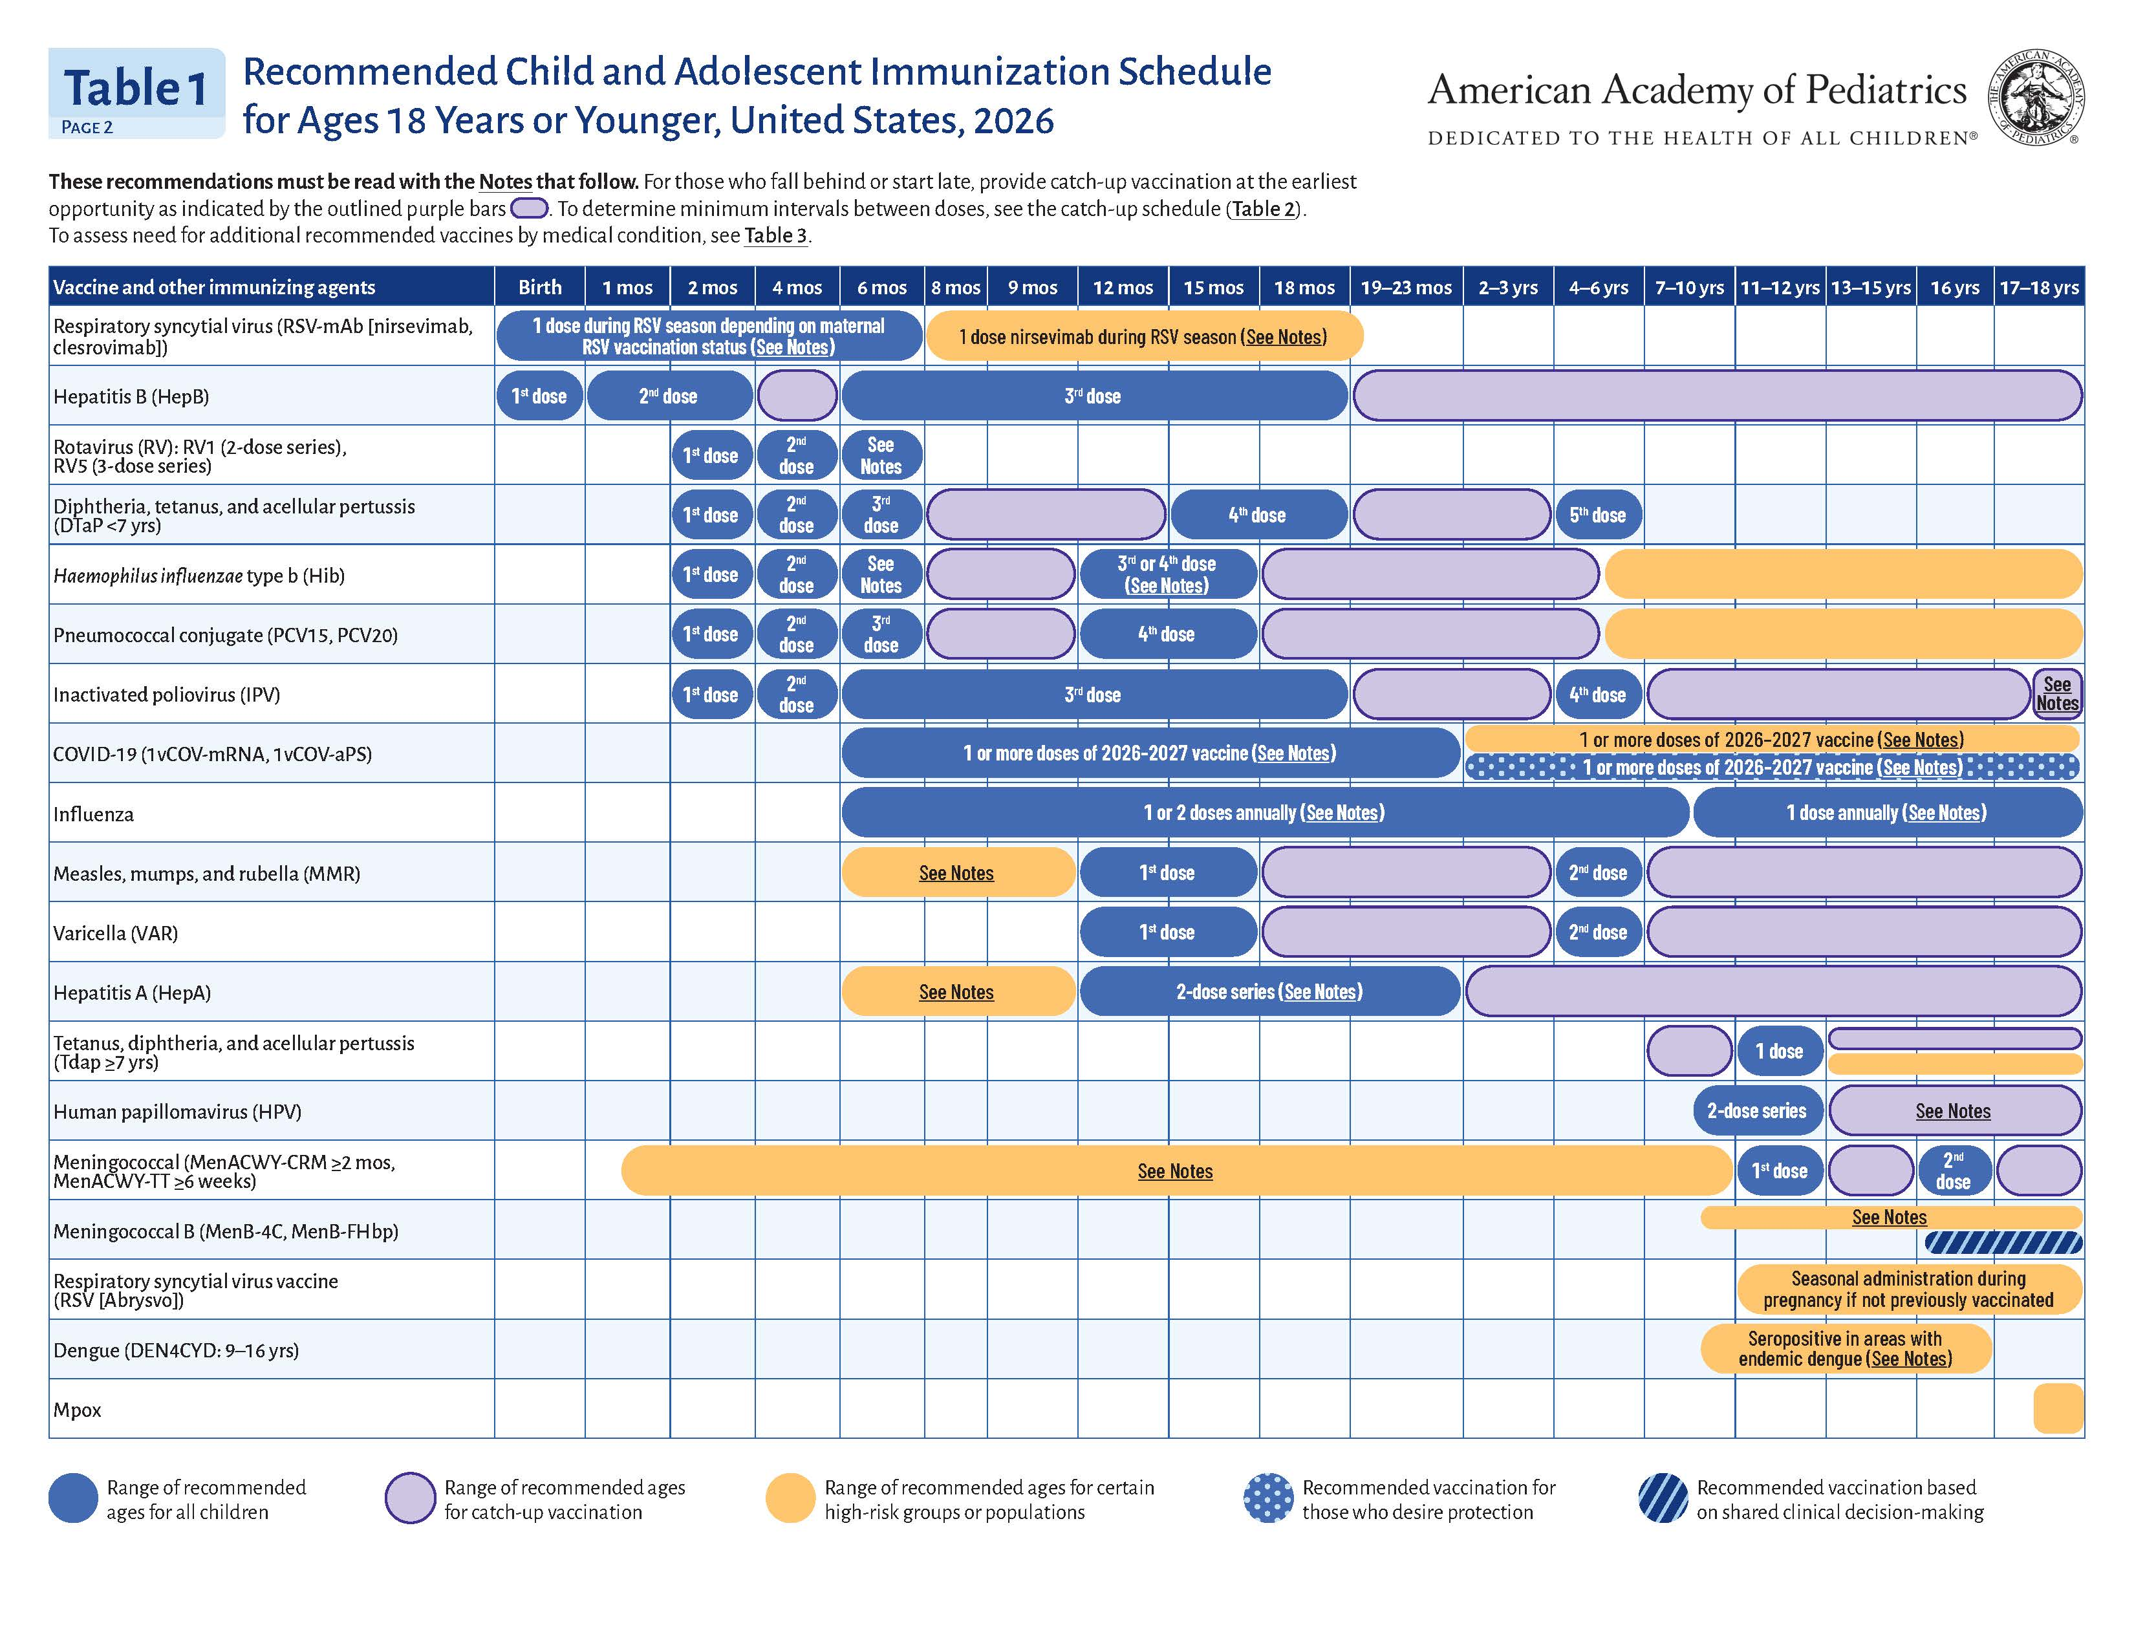
Notes:
Table 1 shows the dosing schedule for each recommended vaccine. It’s a color-coded table. The legend colors and text are as follows: Blue boxes show the range of recommended ages for all children. Purple boxes indicate a range of recommended ages for catch-up vaccination. Orange boxes show ranges of recommended ages for certain high-risk groups or populations.
Blue boxes with dots are a new addition that was added for recommended vaccination for those who desire protection. Blue boxes with diagonal lines are recommended vaccination based on shared clinical decision-making.

Slide 108
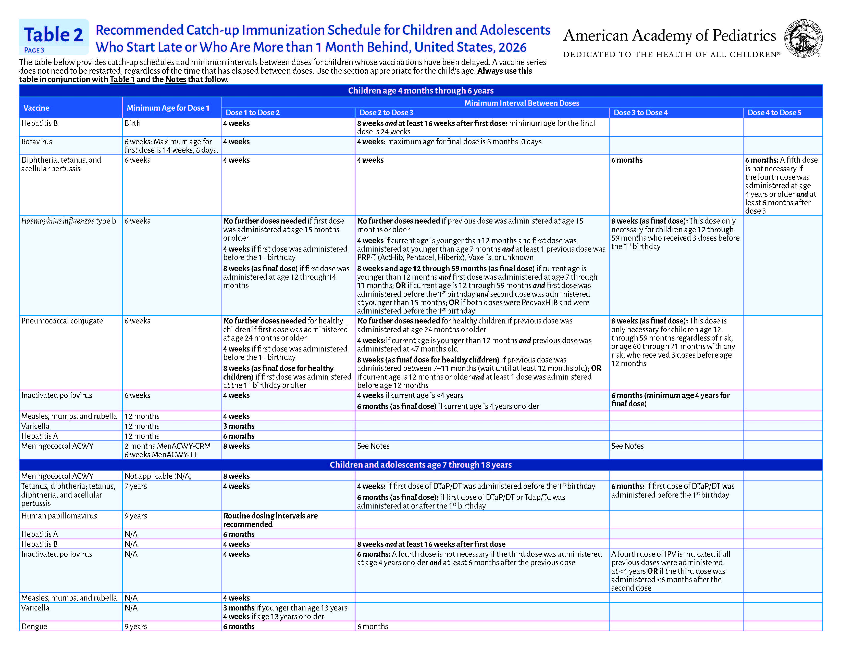
Notes:
Table 2 provides the catch-up schedules and minimum intervals between doses for children whose vaccinations have been delayed. A vaccine series does not need to be restarted, regardless of the amount of time that has elapsed between doses. Always use this table in conjunction with Table 1 and any notes that follow. It is important to work closely with a patient’s caregivers to ensure they get on track with their vaccinations. No changes were made to this table compared to the 2025 AAP Immunization Schedule.

Slide 109
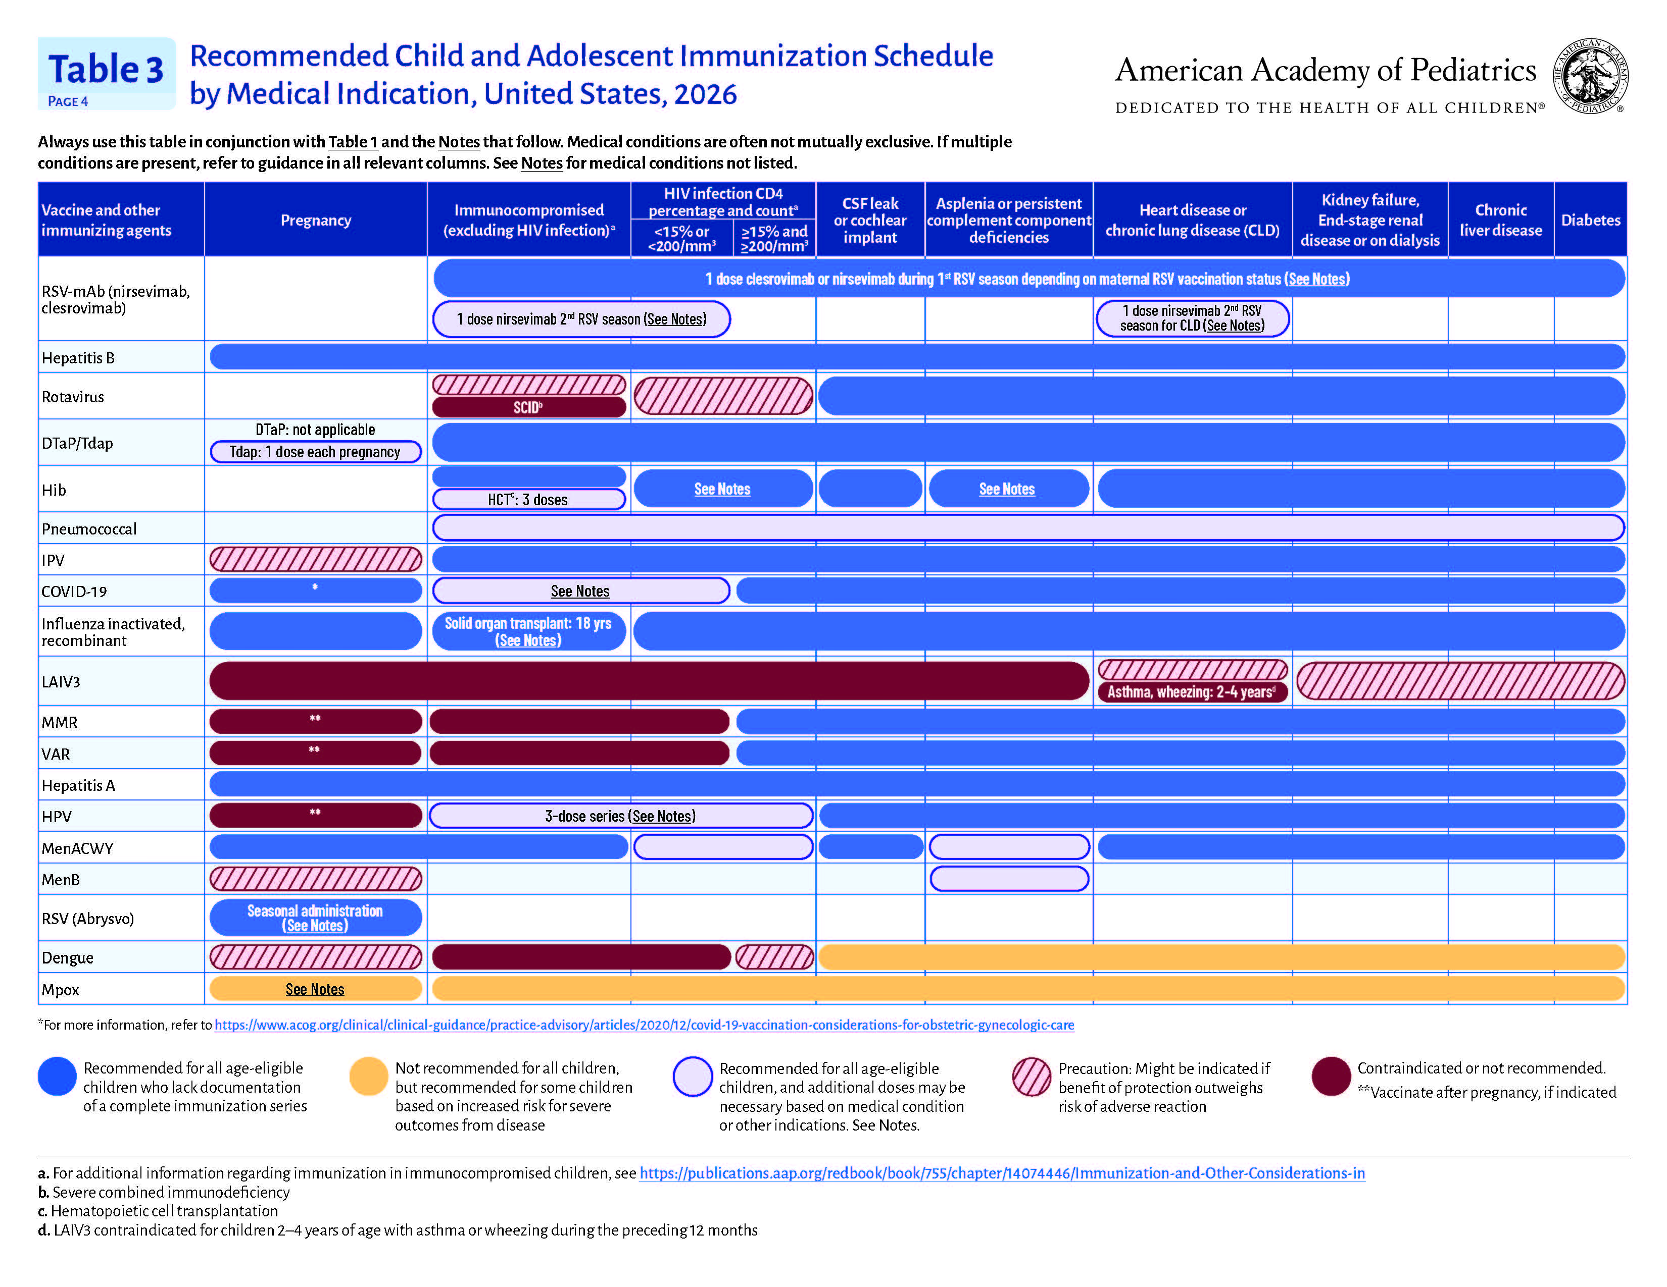
Notes:
Table 3 shows the immunization schedule by medical indication. Red boxes indicate a vaccine is contraindicated or not recommended. Pink boxes with a diagonal red line indicate a precaution; that might be indicated if the benefit of protection outweighs the risk of adverse reaction.

Slide 110
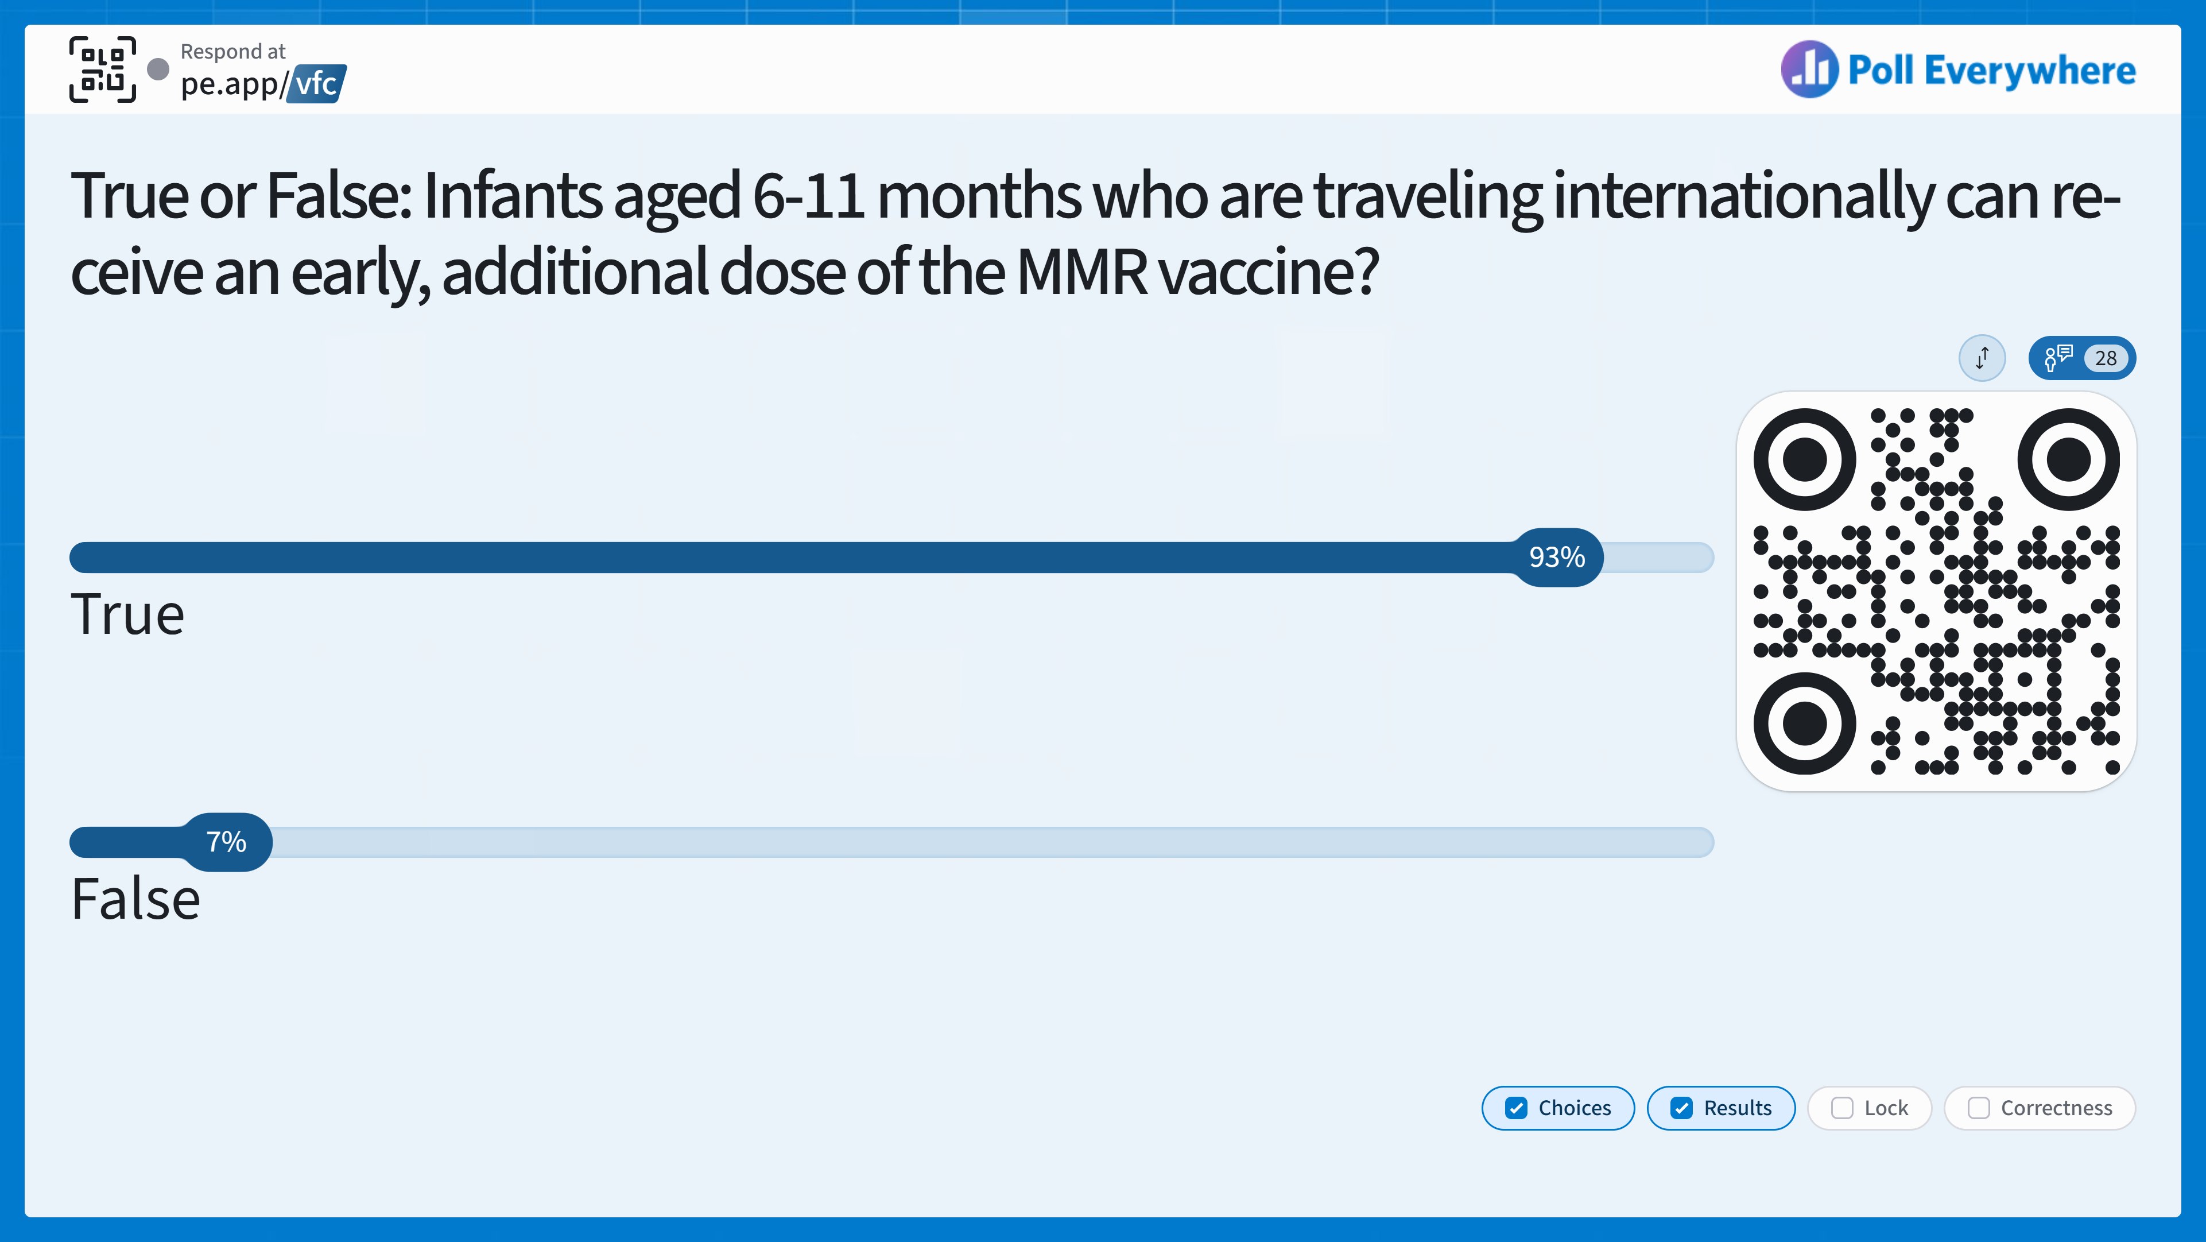
Notes:
Answer: True

Slide 111
Knowledge Check
True or False: Infants aged 6-11 months who are traveling internationally can receive an early, additional dose of the MMR vaccine.
A. True
B. False
Notes:
Answer: True

Slide 112
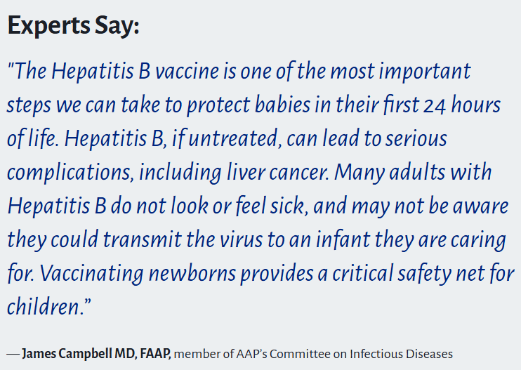
Hepatitis B Vaccine
Recommended for all newborns within 24 hours of birth, one more dose at 1-2 months, and a third dose at 6-18 months.
Notes:
The Hepatitis B vaccine is recommended for all newborns within 24 hours of birth, one more dose at 1-2 months, and a third dose at 6-18 months.

Slide 113
HPV Vaccine
Recommended for children between 9 and 12 years old.
2-3 doses recommended depending on age of initiation.
A Vaccine Integrity Project study found that there is no evidence connecting the HPV vaccine to severe adverse events.
The 2025 National Immunization Survey-Teen reports HPV vaccination coverage did not increase for the fourth consecutive year.
  Among adolescents aged 13–17 years, 77.7% had received ≥1 dose of HPV vaccine and 63.4% were up to date with the HPV vaccination series.
https://www.aap.org/en/patient-care/immunizations/human-papillomavirus-vaccines/how-to-recommend-hpvvaccination/?srsltid=AfmBOoqFnuQ5Lp1QKIZSUowH8BcWA_w80gzlOzxlONL0pXXaAuoNKvLi
Notes:
The AAP recommends starting the HPV vaccination series between 9 and 12 years, at an age that the provider deems optimal for acceptance and completion of the vaccination series. Teens whose health care provider recommended HPV vaccination had higher rates of uptake than those not receiving a recommendation.
Teens whose health care provider recommended HPV vaccination had higher rates of uptake than those not receiving a recommendation, try these tips. Assume that parents and caregivers are ready to have their kids vaccinated. Example: “Now that your child is 12, they are due for three vaccines today that protect against meningitis, HPV cancers, and pertussis.” You can also try sharing personal stories: "I got this vaccine for my children starting at age 9, and I recommend we give your child their vaccine today.” To help reassure apprehensive families, if they are more receptive to data, you can try sharing recent data, like the above Vaccine Integrity Project study, that shows there is no evidence connecting the HPV vaccine. For the fourth consecutive year, HPV vaccination rates have been the same. According to the 2025 National Immunization Survey-Teen, only 77.7% had received ≥1 dose of HPV vaccine and 63.4% were up to date with the HPV vaccination series.

Slide 114
MMR Vaccine
There is no separated, licensed vaccine in the U.S.
  1 dose is 93% effective against measles.
  2 doses are 97% effective against measles.
A valid second dose can be given earlier if administered at least 28 days after the first dose.
https://illinoisaap.org/wp-content/uploads/2026/09/20260902_IDPH_Health_Advisory_Measles_Update.pdf
Notes:
Clinicians should ensure all patients are up to date on MMR vaccination and prioritize timely administration of vaccination. The AAP recommends individuals receive 2 doses of measles, mumps, rubella (MMR) or measles, mumps, rubella and varicella (MMRV) vaccine. As soon as an infant reaches 12 months of age, clinicians should be strongly recommending an MMR vaccine to their patients.
Schedule:
2-dose series given at age 12–15 months & age 4–6 years.

Slide 115
MMR Vaccine Considerations
An early dose* does not count.
International Travel or Domestic Outbreaks**
Infants 6–11 months* who are traveling should receive an early dose before departure.
  Then follow recommended schedule and get another dose at 12–15 months and a final dose at 4–6 years.
Children over 12 months old should get a first dose immediately and get a second dose 28 days after first dose.
**Check LHD vaccination guidance.
https://illinoisaap.org/wp-content/uploads/2026/09/20260902_IDPH_Health_Advisory_Measles_Update.pdf
https://www.cdc.gov/measles/travel/index.html
Notes:
Early vaccination for international travel for infants 6 through 11 months is also strongly recommended. This also applies to any infants traveling to domestic areas with an ongoing outbreak, and clinicians should look to the vaccination guidance of the state or local health department for the residents of the outbreak-affected community to determine whether vaccination is needed. If an early dose is given, the child will still need their regularly scheduled 2 MMR doses at 12 months of age and older.
For either situation, doses received prior to the first birthday do not count toward the recommended 2-dose series.

Slide 116
MMRV Vaccine
Only licensed for use in children who are 12 months - 12 years.
Schedule:
  2-dose series given at age 12–15 months & age 4–6 years.
  2nd dose can be given as soon as 3 months after 1st dose
If the first dose is an MMR administered on or after 12 months of age, and then the second dose is MMRV administered at least 28 days later, it is considered valid.
Notes:
Contains a combination of measles, mumps, rubella, and varicella (chickenpox) vaccines.
If the first dose is an MMR administered on or after 12 months of age, and then the second dose is MMRV (ProQuad) administered at least 28 days later, yes, it is considered valid.
Note: There is an unusual exception. CDC recommends the minimum age for the second dose be 13 calendar months. If the first dose is given before 12 months (but within the 4-day grace period), and the second dose is given just 28 days later, it may fall more than 4 days before the child turns 13 months. In such cases, CDC and I-CARE validation rules will mark the second dose as invalid.
However, if both the first and second doses are ProQuad (MMRV), the second dose should be given at least 3 months after the first. This is because, for children under 13 years of age, the second dose of varicella—whether given as MMRV or single-antigen varicella—should be administered at a minimum interval of 3 months. This is per ACIP recommendations.
One general note: some school nurses may be unfamiliar with the 4-day grace period, and/or their immunization tracking systems might not recognize it. While Illinois allows a 4-day grace period for vaccines given up to 4 days before the minimum age or minimum interval (except between live vaccines), using it may require a letter of explanation if the school requests it. Use caution when applying the grace period.

Slide 117
Live-Attenuated Vaccines
When possible, give first doses of MMR and Varicella at the same encounter.
  If these live-attenuated vaccines are not given on the same day, the patient must wait 28 days before receiving the other live-attenuated vaccine.
  If administered before 28 days, the vaccine administered is considered invalid and must be repeated at least 28 days later.
The 4-day grace period should not be applied to the 4-week interval between two different live vaccines.
Notes:
For catch-up vaccination, 2 doses should be given at least 4 weeks apart. Children 13 years and older are not eligible for MMRV. Please follow the 3-month minimum spacing interval for MMRV for children 12 years and younger. The second dose can be administered early, but at least 4 weeks after the first dose, during an outbreak. CDC also allows children as young as 6 months to receive MMR when travelling internationally. Those who receive this early dose will still need to follow the regular 2 dose schedule afterwards. Please follow all CDC and CDPH guidance during a measles outbreak.

Slide 118
Meningococcal Vaccines
The age indication for MenQuadfi (MenACWY) has been expanded to children as young as 6 weeks, down from 2 years.
Pentavalent vaccines: Allow full meningococcal vaccine series to be completed in 3 injections instead of 4.
  Penbraya (Pfizer) and PenMenvy (GSK).
  To be used when both MenACWY and MenB are indicated at the same visit.
  Approved for healthy people ages 16-23 years who choose to receive MenB vaccination after a discussion with their health care provider and individuals 10 years and older who are at increased risk.
  Penbraya must be followed by Trumenba (Pfizer) after 6 months.
  PenMenvy must be followed by Bexsero (GSK) after 6 months.
Bexsero or Trumenba: MenB
  2-dose schedule, with each dose administered 6 months apart.
https://publications.aap.org/aapnews/news/35919?autologincheck=redirected
Notes:
On September 2nd, the age indication for MenQuadfi (MenACWY) was expanded to children as young as 6 weeks.
Pentavalent vaccines are important because they allow for the full meningococcal vaccine series to be completed in 3 injections instead of 4. This includes Pfizer’s Penbraya and GSK’s PenMenvy which are to be used when both MenACWY and MenB are indicated at the same visit. These are approved for healthy people ages 16-23 years who choose to receive MenB vaccination after a discussion with their health care provider and individuals 10 years and older who are at increased risk. Penbraya must be followed by Trumenba (Pfizer) after 6 months.
PenMenvy must be followed by Bexsero (GSK) after 6 months.

Slide 119
Respiratory Virus Season Guidelines
RSV
COVID-19
Flu
Notes:
Now, as we head into respiratory virus season, we will discuss recommendations for COVID, flu, and RSV immunizations.

Slide 120
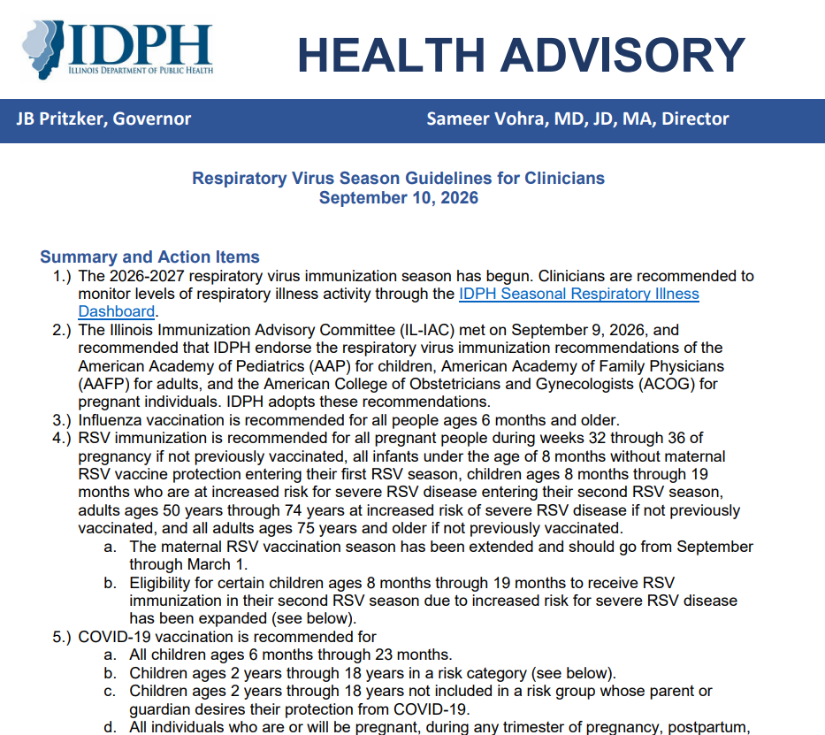
IDPH Respiratory Virus Guidelines
IDPH adopted recommendations consistent with AAP for children, AAFP for adults, and the ACOG.
Director Dr. Vohra issued a standing order for the 2026-27 COVID-19 vaccine.
https://illinoisaap.org/wp-content/uploads/2026/09/respiratory-virus-season-guidance-2026-27.pdf
Notes:
Respiratory virus season is officially here, and on September 10th, IDPH released a health advisory with updated guidelines for clinicians. IDPH endorses the respiratory virus immunization recommendations of the AAP for children, American Academy of Family Physicians (AAFP) for adults, and the American College of Obstetricians and Gynecologists (ACOG) for pregnant persons. IDPH ‘s respiratory virus season recommendations are that all people 6 months and older should receive an influenza vaccination, maternal RSV vaccination is from now until March 1.
IDPH’s COVID-19 vaccination recommendations follow those of the AAP, which is recommended for all children 6 through 23 months of age, children 2 through 18 years of age in specific risk categories or whose parent or guardian desires their protection from COVID-19. All individuals who are or will be pregnant, during any trimester, or who are postpartum and breastfeeding. Lastly, IDPH’s COVID-19 recommendations extend to all adults ages 19 and older. This information and more additional details are in the updated COVID-19 standing order released by Dr. Vohra on September 10th

Slide 121
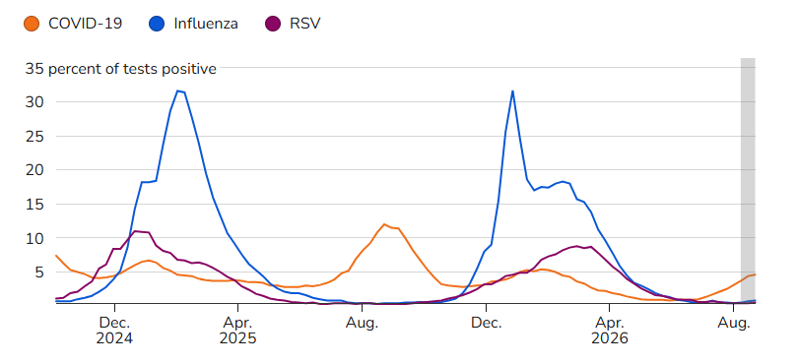
Overall Trends - National
COVID-19 activity is increasing.
  Low compared to previous waves.
Seasonal influenza and RSV activity remain low.
https://www.cdc.gov/respiratory-viruses/data/activity-levels.html?cove-tab=1
Notes:
Nationally, COVID-19 is increasing but continues to be low compared to previous waves. Seasonal influenza and RSV activity remain low.

Slide 122
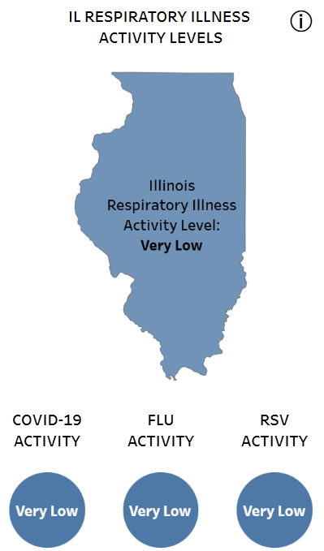
Overall Trends - Illinois
Test percent positivity September 6-12:
  Flu: 1.2%
  COVID: 2.6%
  RSV: 0.2%
  Entero/Rhinovirus: 27.1%
https://dph.illinois.gov/topics-services/diseases-and-conditions/respiratory-disease/surveillance/respiratory-disease-report.html
Notes:
Here is what respiratory virus levels currently look like.

Slide 123
A Look Back: RSV
National
“Delayed” season – cases increased in December and continued into March.
National test positivity for children 0-17 peaked in mid-January at 25.6%.
  RSV immunization season extended to April 30, 2026, in 48 jurisdictions (including IL).
  Across all ages, RSV made up 12% of all ER visits.
    Highest hospitalization rate for those <1 year old: 40.8 /100,000
Illinois
RSV percent positivity was 8% the first week of March, well above the 3% threshold.
RSV-related hospital admissions for 0–4-year-olds peaked in December at 11.8%.
Two pediatric RSV-related deaths.
Notes:
Nationally, last year saw a “delayed” where cases increased in December and continued into March. National test positivity for children 0-17 peaked in mid-January at 25.6%. RSV immunization season extended to April 30, 2026, in 48 jurisdictions including Illinois. Nationally, across all ages, RSV made up 12% of all ER visits. The highest hospitalization rate was for those <1 year old: 40.8 /100,000. Illinois experienced the same pattern. Hospital admissions peaked in December and Illinois saw two pediatric RSV deaths.

Slide 124
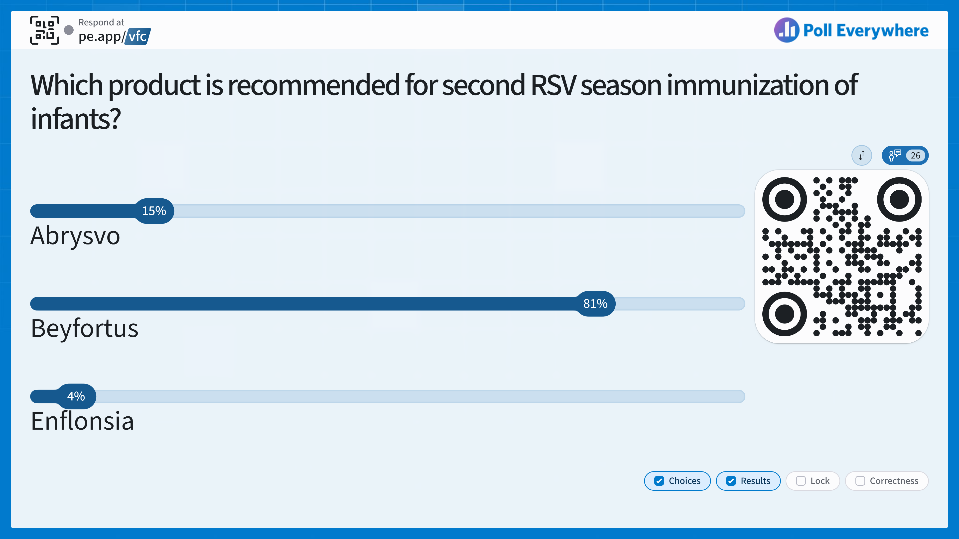
Notes:
Answer: B – Nirsevimab only

Slide 125
Knowledge Check
Which product is recommended for second RSV season immunization of infants?
A. Abrysvo
B. Beyfortus
C. Enflonsia
Notes:
Answer: B – Nirsevimab only

Slide 126
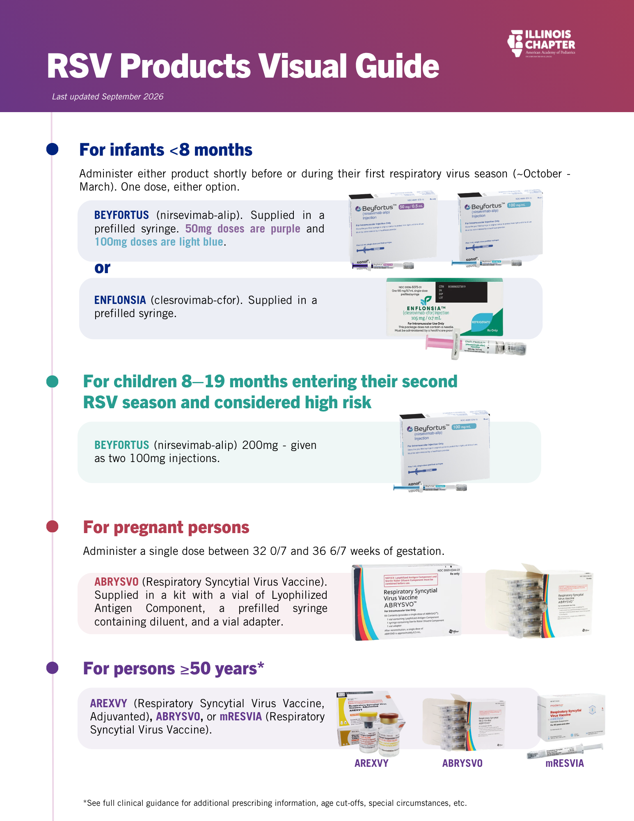
RSV Prevention
Nirsevimab (Beyfortus) – monoclonal antibody
Clesrovimab-cfor (Enflonsia) – monoclonal antibody
Abrysvo – maternal vaccine
AAP RSV Immunization Administration Guide
Source: ICAAP
Notes:
There are 4 RSV prevention products available. Remember: each of these products are only approved for certain age groups. Two products are approved for infants. Beyfortus (remember B is for “baby”) and Enflonsia. Abrysvo is the only approved maternal vaccine. We will go into the administration guidance for each of these products on the following slides.

Slide 127
Nirsevimab - ALL infants <8 months old
Born shortly before/during RSV season or entering their first RSV season (October-March).
Administer one appropriate dose within one week of birth if:
  Mother did not receive Abrysvo
  Mother’s vaccination status is unknown
  Mother received Abrysvo less than 14 days before delivery
Dosing:
  50mg/0.5ml with purple plunger rod (for infants weighing <5kg)
  100mg/1ml with light blue plunger rod (for infants weighing ≥5kg)
Notes:
Nirsevimab is recommended for infants aged less than 8 months born during or entering their first RSV season and for infants and children aged 8–19 months who are at increased risk of severe RSV disease entering their second RSV season. In most cases, infants born to mothers who received Abrysvo do not need to receive nirsvimab. Nirsevimab administration should take place between October and March.

Slide 128
Nirsevimab - High Risk Children 8 - 19 Months
High risk now also includes:
Children born preterm at less than 32 weeks gestation, regardless of the need for medication or other support.
Children with hemodynamically significant congenital heart disease.
Children with anatomic pulmonary abnormalities or neuromuscular disorders that put them at risk for severe RSV disease.
Children with Down syndrome or other chromosomal differences placing them at higher risk of severe RSV disease.
https://publications.aap.org/aapnews/news/35919?autologincheck=redirected
https://publications.aap.org/pediatrics/article/doi/10.1542/peds.2026-079047/208784/Recommendations-for-the-Prevention-of-Respiratory
https://publications.aap.org/pediatrics/article/doi/10.1542/peds.2026-079049/208787/Recommendations-for-the-Prevention-of-Respiratory
Notes:
Recommendations for infants entering their second RSV season have been expanded to include many high risk conditions listed here.

Slide 129
Clesrovimab - ALL infants < 8 months old
Born shortly before/during RSV season or entering their first RSV season (October-March).
Administer one appropriate dose within a week of birth during RSV season if:
  Mother did not receive Abrysvo
  Mother’s vaccination status is unknown
  Mother received Abrysvo less than 14 days before delivery
Dosing:
  105mg/0.7ml same dose for all infants <8 months regardless of weight
Note: Not approved for second season administration.
Notes:
Clesrovimab should be administered to those born shortly before/during RSV season or entering their first RSV season (October-March). Administer one appropriate dose within a week of birth during RSV season if: the mother did not receive Abrysvo, the mother’s vaccination status is unknown, or if the mother received Abrysvo less than 14 days before delivery. It is important to note that clesrovimab is not approved for administration to second season infants.

Slide 130
RSV Immunization Effectiveness
NEJM 2025 - Nirsevimab effectiveness during the 2025-2026 season:
  84% effective against medically attended infection in infants
  77% - 83% effective against hospitalization for babies under 12 months
NEJM 2025 – Clesrovimab:
  60.4% effective against infection
  84.2% effective against hospitalization
Effectiveness of RSV Prevention Strategies in US Infants: 2024–2025
Clesrovimab for Prevention of RSV Disease in Healthy Infants
Notes:
The New England Journal of Medicine found that Nirsevimab effectiveness during the 2025-2026 season was 84% effective against medically attended infection in infants and 77% - 83% effective against hospitalization for babies under 12 months. For Clesrovimab the NEJM found a 60.4% effectiveness against infection and an 84.2% effective against hospitalization.

Slide 131
Abrysvo - Pregnant Persons
      One dose should be administered during RSV season for those between 32 – 36 weeks of gestation.
        The maternal vaccination season has been extended and should go from September 1 through March 1.
      Babies born 1-2 months after maternal vaccination have immediate protection.
      No data on revaccinating with every pregnancy – these studies are ongoing.
      Babies born to pregnant people who received a dose during a previous pregnancy should receive nirsevimab or clesrovimab.
https://www.acog.org/news/news-releases/2026/09/acog-releases-2026-27-respiratory-virus-season-immunization-recommendations
Notes:
Abrysvo is authorized for use in pregnant people between 32 – 36 weeks gestation between September and January. Babies born 1-2 months after maternal vaccination have immediate protection. There is currently no data on revaccination during every pregnancy but these studies are ongoing. Therefore, infants who are born to pregnant people that received a dose during a previous pregnancy should receive nirsevimab or clesrovimab.

Slide 132
VFC RSV Monoclonal Antibody Products for the 2026–2027 Season
Manufacturer | Brand | Age Group | Packaging | NDC Code | Program
Sanofi | Beyfortus (nirsevimab) | 0 – 7 months Less than 5 kg | 50mg/0.5mL PFS 5-dose pack | 49281-0575-15 | VFC IVAP
Sanofi | Beyfortus (nirsevimab) | 0 – 7 months 5 kg and greater and 8-19 months with risk factors, second season (2 injections) | 100mg/mL PFS 5-dose pack | 49281-0574-15 | VFC IVAP
Merck | Enflonsia (clesrovimab) | 0 – 7 months | 105 mg/0.7mL PFS 1-dose pack | 00006-5073-01 | VFC IVAP
Merck | Enflonsia (clesrovimab) | 0 – 7 months | 105 mg/0.7mL PFS 10-dose pack | 00006-5073-02 | VFC IVAP
Notes:
This table shows the expected RSV monoclonal antibody products that IDPH publicly funded vaccine programs will be offering. The CDC will again implement ordering thresholds for RSV monoclonal antibodies and for the RSV vaccine indicated for VFC-eligible pregnant individuals during the 2026–27 season. Under this system, IDPH receives a fixed allocation every two weeks. Because of this structure, early ordering is encouraged. Early ordering helps ensure that inventory is available for all providers ahead of the start of the vaccination season in October.

Slide 133
VFC RSV Vaccine Products for the 2026–2027 Season
Manufacturer | Brand | Age Group | Packaging | NDC Code | Program
Pfizer | Abrysvo | For pregnant children/adolescents 18 years or younger | 0.5 mL Act-o-Vial 1-dose pack | 00069-2465-01 | VFC
Notes:
Orders for RSV monoclonal antibodies and Abrysvo from the VFC Program can be placed now. VFC Abrysvo may be ordered as a routine VFC order using the Pediatric/VFC Ordering Intent. Early in the season, VFC Beyfortus and Enflonsia will be available only through Limited Quantity orders due to allocation limits. Limited quantity orders can be placed by selecting “Pediatric/VFC Limited Quantity” in the Order Intent field when placing your order. This is the same way limited quantity orders can be placed for other respiratory virus vaccines.

Slide 134
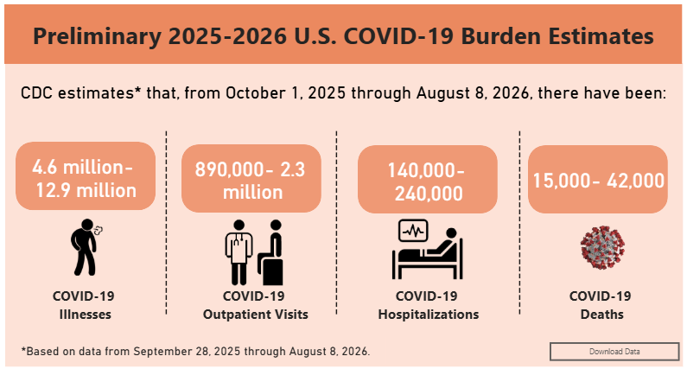
A Look Back: COVID-19
Infants made up a disproportionate number of hospitalizations.
  Highest among those less than 6 months.
Among vaccine eligible groups, hospitalization was highest in children 6-11 months.
Source: CDC
Comparison of COVID−19-Associated Inpatient Burden by Variant Period in Hospitalized Children Age <5 years in the United States
Most US Kids Hospitalized for COVID Had Chronic Illnesses; Less Than 4% Were Vaccinated
Notes:
Infants make up a disproportionate number of hospitalizations and are highest among those that are less than 6 months old. Among the vaccine eligible groups, hospitalization is highest in children 6-11 months old. Less than 4% of children and adolescents hospitalized with COVID-19 between 2022-2024 had received the most recently recommended COVID-19 vaccination.
https://www.cdc.gov/covid/php/covid-net/index.html
https://www.cidrap.umn.edu/covid-19/most-us-kids-hospitalized-covid-had-chronic-illnesses-less-4-were-vaccinated
https://www.cdc.gov/covid/hcp/clinical-care/for-pediatric-hcp.html
https://pmc.ncbi.nlm.nih.gov/articles/PMC12142060/
https://www.cdc.gov/mmwr/volumes/74/wr/mm7440a1.htm

Slide 135
A Look Back: COVID-19
Illinois
Between September 1, 2025 and May 2, 2026: 65 ICU admissions for children aged 0-4 years old.
One pediatric COVID-19 death for the season.
Notes:
Illinois saw a more moderate COVID wave during the 2025-2026 season. There have been 65 recorded ICU admissions for children aged 0-4 years old and one pediatric COVID death.

Slide 136
COVID-19 Recommendations
All children ages 6-23 months.
Children ages 2-18 years: single dose of age-appropriate 2026-2027 COVID-19 vaccine regardless of vaccination status for those who:
  are at high risk of severe COVID-19,
  are residents of long-term care facilities or other congregate settings,
  have never been vaccinated or,
  have household contacts at high risk for severe COVID-19.
Children not in one of these groups whose parent or guardian desires their protection from COVID-19 also should be offered a single dose of the updated vaccine.
Pediatric COVID-19 Vaccine Dosing Quick Reference Guide
Notes:
The COVID-19 recommendations for this year are the same as last year’s.

Slide 137
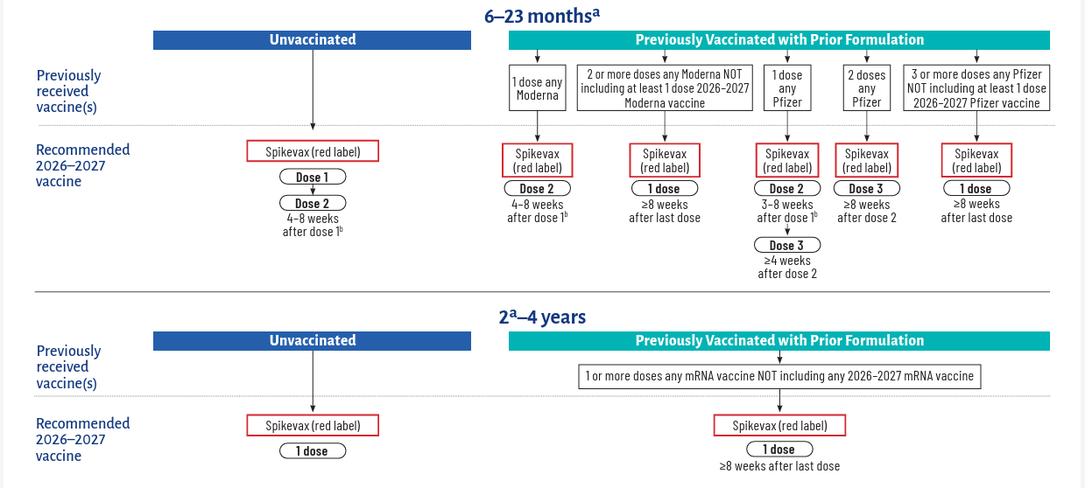
Dosing Schedule 6mo-4yrs
  Pediatric COVID-19 Vaccine Dosing Quick Reference Guide - AAP
Notes:
Here is the dosing chart for non-immunocompromised children from 6-23 months and 2-4 years.

Slide 138
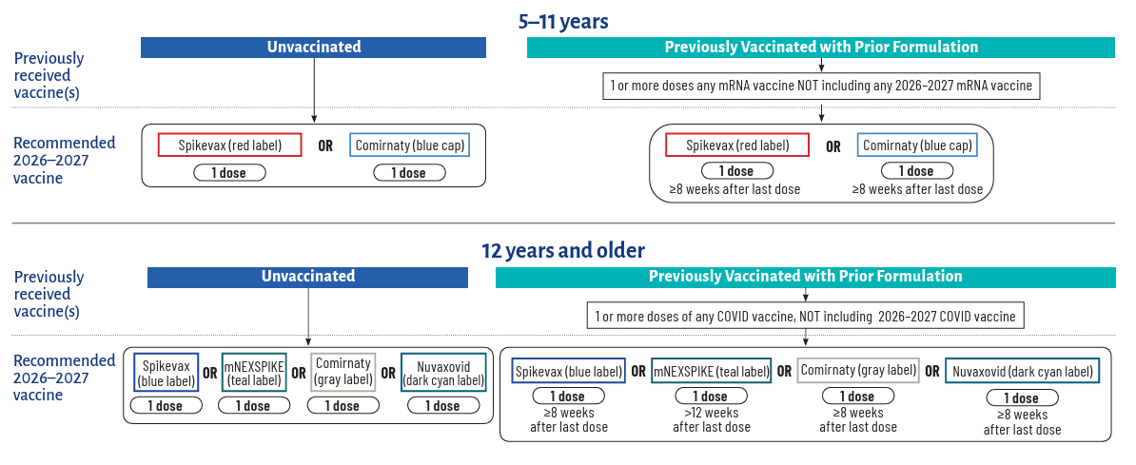
Dosing Schedule 5yrs-12+yrs
  Pediatric COVID-19 Vaccine Dosing Quick Reference Guide - AAP
Notes:
Here are the dosing charts for non-immunocompromised children 5 years+.

Slide 139
COVID Vaccine Effectiveness
Vaccine Integrity Project: 76% reduction in COVID-related ED visits in children 9 months – 4 years.
  Vaccinating pregnant women reduces hospitalization in infants by 50%-54% the first two months of life.
NEJM: For children that did not have a complete vaccine series, 2024-2025 VE estimates ~66%.
  VE of 45-56% against ED visits in children 5 – 17 years old.
Protective against long covid at 57% against one long COVID symptom and 73% against two symptoms.
Linked to a lower risk of myocarditis in teens and young adults.
Updated Evidence for Covid-19, RSV, and Influenza Vaccines for 2025–2026
Vaccinated Kids at 57% to 73% Lower Risk of Long COVID, CDC Study Suggests
Cardiac Outcomes Following SARS-CoV-2 Infection Versus BNT162b2 Vaccination in Adolescents and Young Adults: A Cohort Study of 4 Million Individuals
2026-2027 Respiratory Season Evidence Review Executive Summary
Notes:
COVID-19 vaccine are highly effective. The Vaccine Integrity Project found that there was a 76% reduction in COVID-19 related ED visits in children 9 months – 4 years of years of age. Vaccinating pregnant women also helps to reduce hospitalization of infants by 50—54% in the first two months of life. The New England Journal of Medicine found that for children who did not have a complete vaccine series during the 2024-2025 season, there was still protection, with a vaccine effectiveness of around 66%. Vaccine effectiveness against ED visits for children 5-17 years old was between 45-56%. The vaccines are also protective against long covid at 57% effective against one long COVID symptom and 73% effective against two long covid symptoms. Lastly, the COVID vaccines were linked to a lower risk of myocarditis in teens and young adults.
https://jamanetwork.com/journals/jamanetworkopen/fullarticle/2850668
https://www.nejm.org/doi/full/10.1056/NEJMsa2514268
https://www.cidrap.umn.edu/covid-19/vaccinated-kids-57-73-lower-risk-long-covid-cdc-study-suggests
https://www.sciencedirect.com/science/article/abs/pii/S0264410X26008108

Slide 140
Expected Availability for 2026–2027 COVID-19 Vaccines
It is anticipated that all COVID-19 vaccines approved for use in children will be available through the VFC program.
Adding COVID-19 vaccines to the VFC formulary has been delayed by federal officials until further notice.
Some products are available through IVAP.
Notes:
It is anticipated that all COVID-19 vaccines approved for use in children will be available through the VFC program. However, federal officials are still finalizing decisions about availability in the VFC program. Updates will be provided by IDPH as soon as they are available. Products available through IVAP include Pfizer’s Comirnaty (for those 12 years and older) and Moderna’s Spikevax and mNEXSPIKE (both also for those 12 years and older).

Slide 141
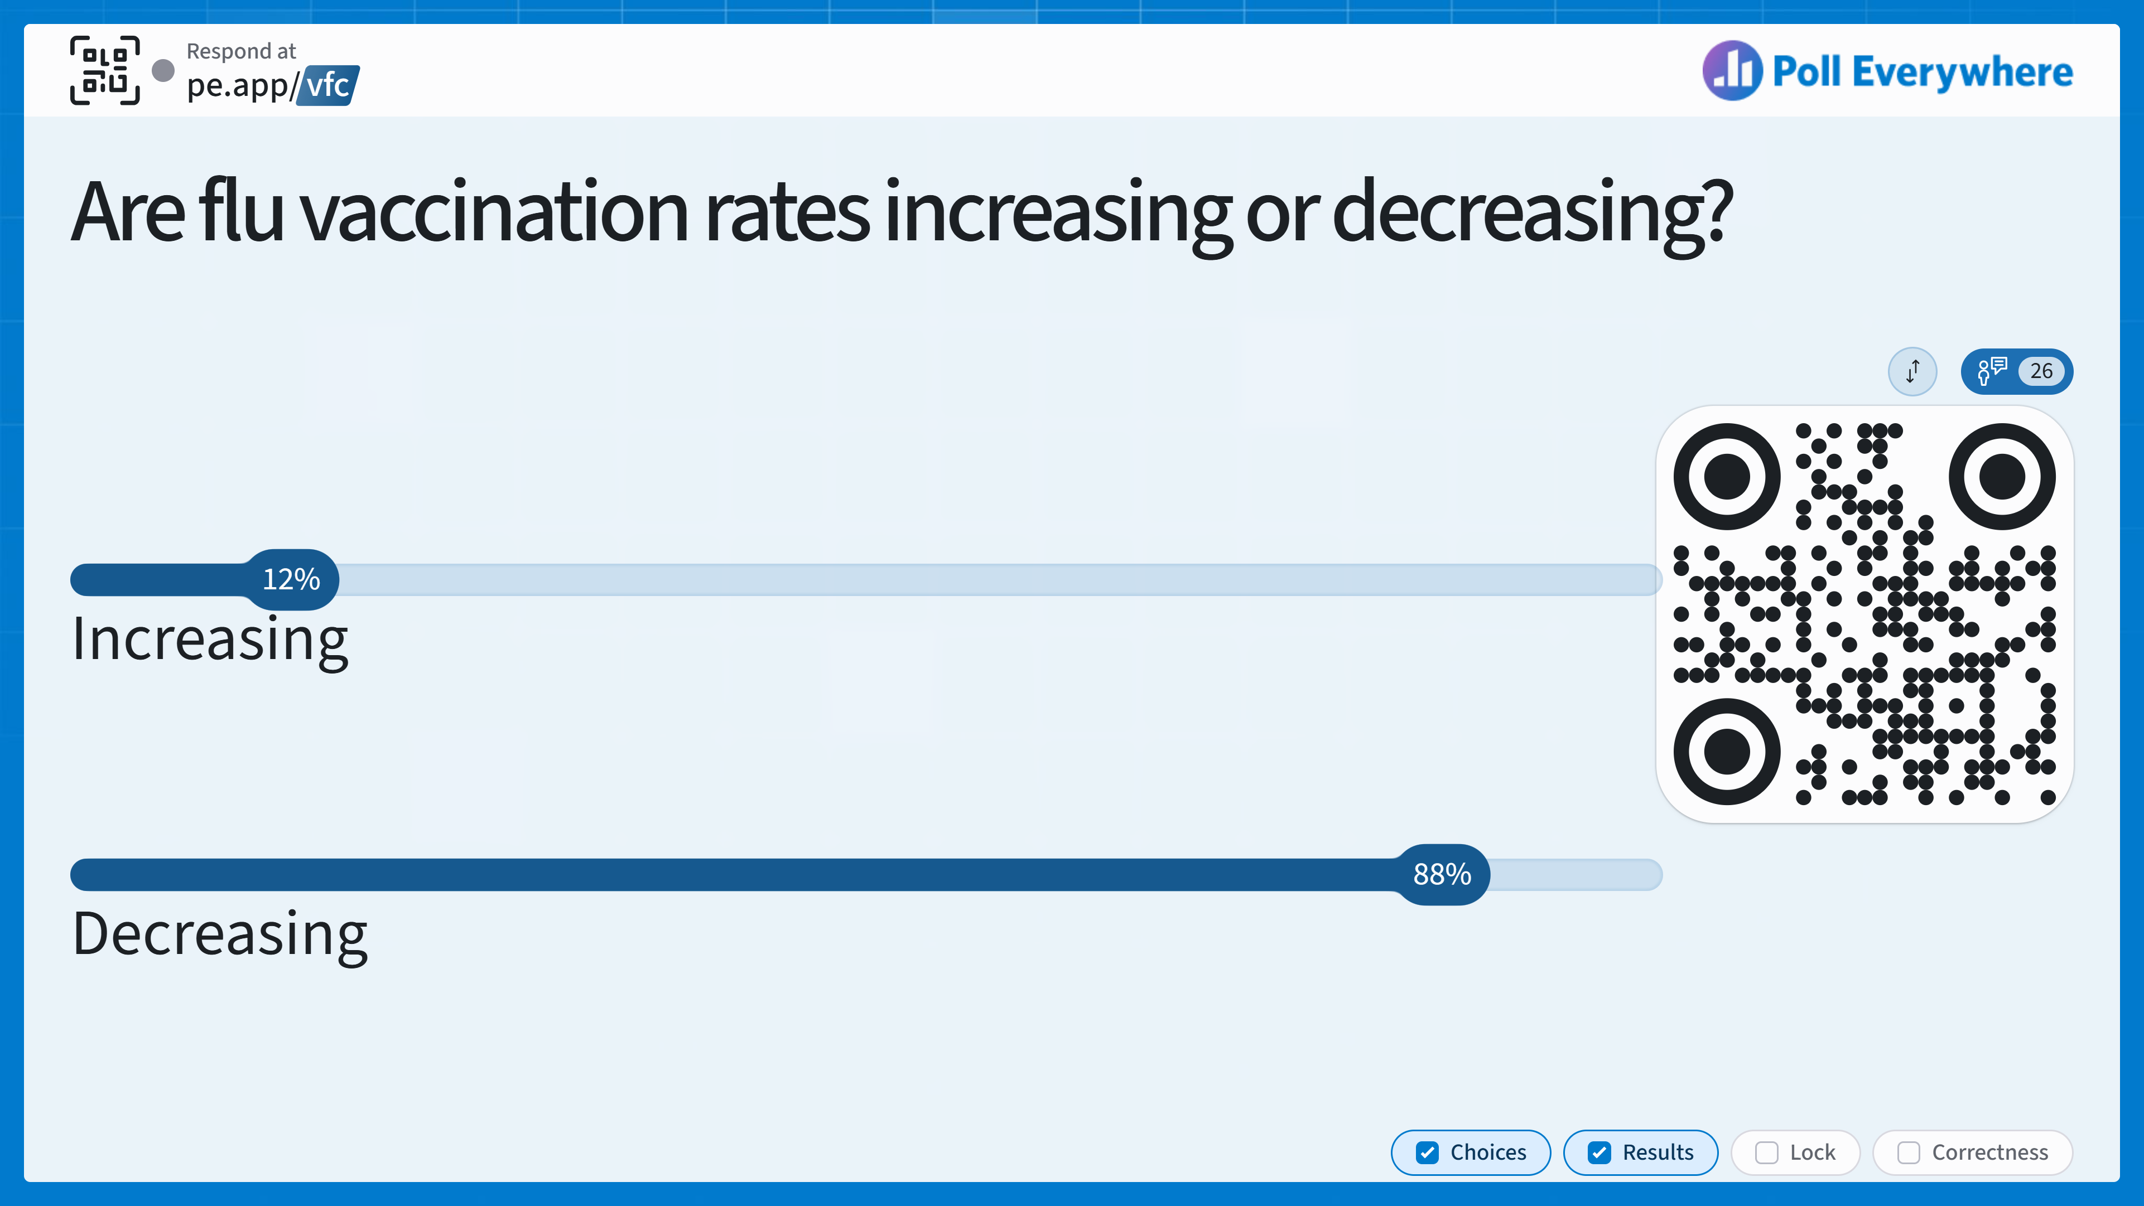
Notes:
Answer: Decreasing

Slide 142
Knowledge Check
Are flu vaccination rates increasing or decreasing?
Increasing
Decreasing
Notes:
Answer: Decreasing

Slide 143
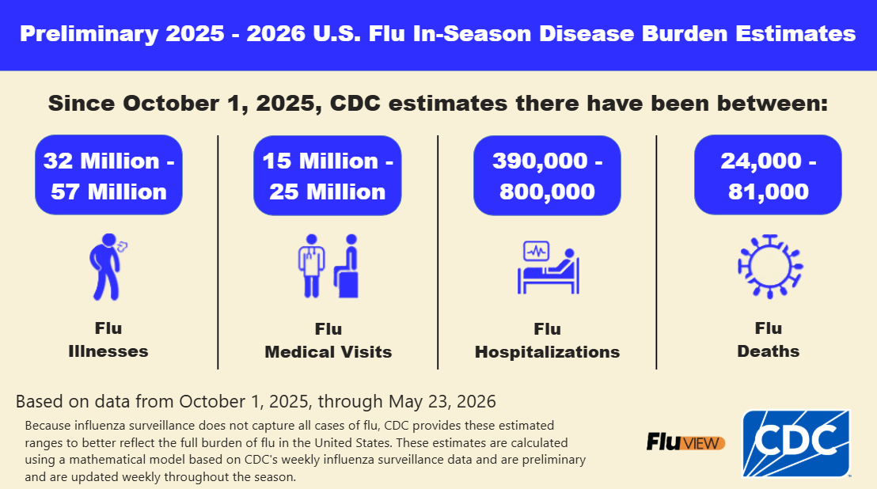
A Look Back: Flu
AAP reports 191 pediatric deaths
Just 49.3% of children and adolescents were vaccinated, down from 50% from 2025 and 54% in 2024.
IL coverage 53.7%.
https://www.cdc.gov/flu-burden/php/php/data-vis/2025-2026.html
Notes:
The 2025-2026 season saw another high severity season for children. As of August 10, the AAP reports 191 pediatric deaths nationwide. Only 49.3% of children and adolescents were vaccinated, down from 50% last year in 2025, and down from 54% in 2024. Illinois’ pediatric flu vaccine rate is slightly higher than the national rate at 53.7%.
Article source: https://publications.aap.org/aapnews/news/29991/CDC-Flu-deaths-in-children-tie-record-officials?searchresult=1

Slide 144
Influenza Vaccine
One dose for individuals 6 months and older without medical contraindications.
Children 6 months through 8 years who have not received at least two doses of the trivalent or quadrivalent flu vaccine prior to July 1, 2026, will need two doses this season.
  Children 9 years+ only need one dose.
Pregnant persons can be vaccinated with IIV3 or RIV3 vaccines.
LAIV should not be used for immunocompromised persons.
Notes:
For this season, one dose is recommended for individuals 6 months and older without medical contraindications. Children 6mo-8 years of age who have not received at least two doses of the trivalent or quadrivalent flu vaccine before July 1, 2026 will need two doses. Children 9 years and older will only need one dose. Pregnant people can be vaccinated with IIV3 or RIV3 vaccines. Live attenuated vaccines should not be used for immunocompromised individuals.

Slide 145
VFC Influenza Vaccine Products for the 2026-2027 Season
Manufacturer | Brand | Age Group | Packaging | NDC Code | Program
AstraZeneca | FluMist TIV | 2-49 years | 0.2mL Sprayer 10-dose pack | 66019-0113-10 | VFC
GSK | Fluarix TIV | 6 months and older | 0.5mL PFS 10-dose pack | 58160-0725-52 | VFC AIP
GSK | FluLaval TIV | 6 months and older | 0.5mL PFS 10-dose pack | 19515-0822-52 | VFC AIP
Sanofi | Fluzone TIV | 6 months and older | 0.5mL PFS 10-dose pack | 49281-0426-50 | VFC AIP
Seqirus, Inc | Flucelvax TIV | 6 months and older | 0.5mL PFS 10-dose pack | 70461-0656-03 | VFC AIP
Notes:
During the early part of the season, VFC influenza vaccines may be ordered only as Limited Quantity
Orders. Later in the season, influenza vaccine may be ordered as part of routine VFC ordering. To avoid delays when placing your orders:
• Update your hours of operation, including planned clinic closures.
• Update temperature logs and submit incident reports for any excursions.
• Ensure data logger calibration certificates are current.
• Ensure vaccine coordinator certificates are current.

Slide 146
Respiratory Virus Testing and Reporting Guidance
With the exception of laboratories enrolled as sentinel site reporters, routine testing performed for inpatient and outpatient clinical care, including PCR testing, should be obtained at clinical and hospital laboratories.
  Only send to IDPH if approved on a case-by-case basis or for influenza specimens that cannot be subtyped
To authorize the submission of specimens not related to the respiratory sentinel program, LHD staff must complete the IDPH Communicable Disease Test Authorization Form.
Specimens received at the IDPH laboratory that are not authorized by IDPH or the LHD will be rejected and stored until further information is obtained from the submitter.
Notes:
For most labs, routine testing performed for inpatient and outpatient clinical care, including PCR testing, should be obtained at clinical and hospital laboratories. Specimens should only be sent to IDPH if approved or they are influenza specimens that cannot be subtyped. For authorization to submit specimens, please complete the IDPH Communicable Disease Test Authorization Form. Unapproved specimens sent to IDPH will be rejected and stored until more information is obtained.

Slide 147
Respiratory Virus Testing and Reporting Guidance
4. Report the following to the LHD:
  Suspected novel influenza
  Pediatric respiratory-associated death due to SARS-CoV-2, Influenza, or RSV
  Intensive Care Unit (ICU) hospitalizations with SARS-CoV-2, Influenza, or RSV
  Outbreaks of respiratory illness in a congregate setting
5. Seasonal Respiratory Illness Dashboard updated weekly.
6. If your practice or facility is interested in participating in respiratory surveillance, please fill out the online form.
Notes:
Here are some guidelines for what should be reported to the local health departments including suspected novel influenza, pediatric respiratory deaths associated with COVID-19, flu, or RSV, ICU admits associated with COVID-19, flu, or RSV, and outbreaks of respiratory illnesses inside of congregate settings.
IDPH will continue to update the Seasonal Respiratory Dashboard each week. If your practice is interested in participating in respiratory surveillance please fill out the Respiratory Sentinel Surveillance Provider Sign-Up Form linked here and a member of the respiratory team will follow up.

Slide 148
Illinois Vaccination Coverage Dashboards
School Vaccination Coverage Dashboard
  Data from ISBE: Showcases immunization data and comprehensive school program information annually from 2014 to the previous school year.
Influenza Vaccination Coverage Dashboard
  Data from I-CARE: Displays flu vaccination coverage data among Illinois residents monthly and cumulatively for current and previous flu seasons from 2019 – current season.
COVID-19 Vaccination Coverage Dashboard
  Data from I-CARE: Displays COVID vaccination coverage data among Illinois residents who have received at least 1 dose of the COVID-19 vaccine, since September 2023
Notes:
IDPH publishes a few different vaccination coverage dashboards that allow you to explore school, influenza, and COVID-19 vaccination coverage throughout the state. We hope these dashboards can serve as useful tools for identifying vaccine coverage gaps where you live.

Slide 149
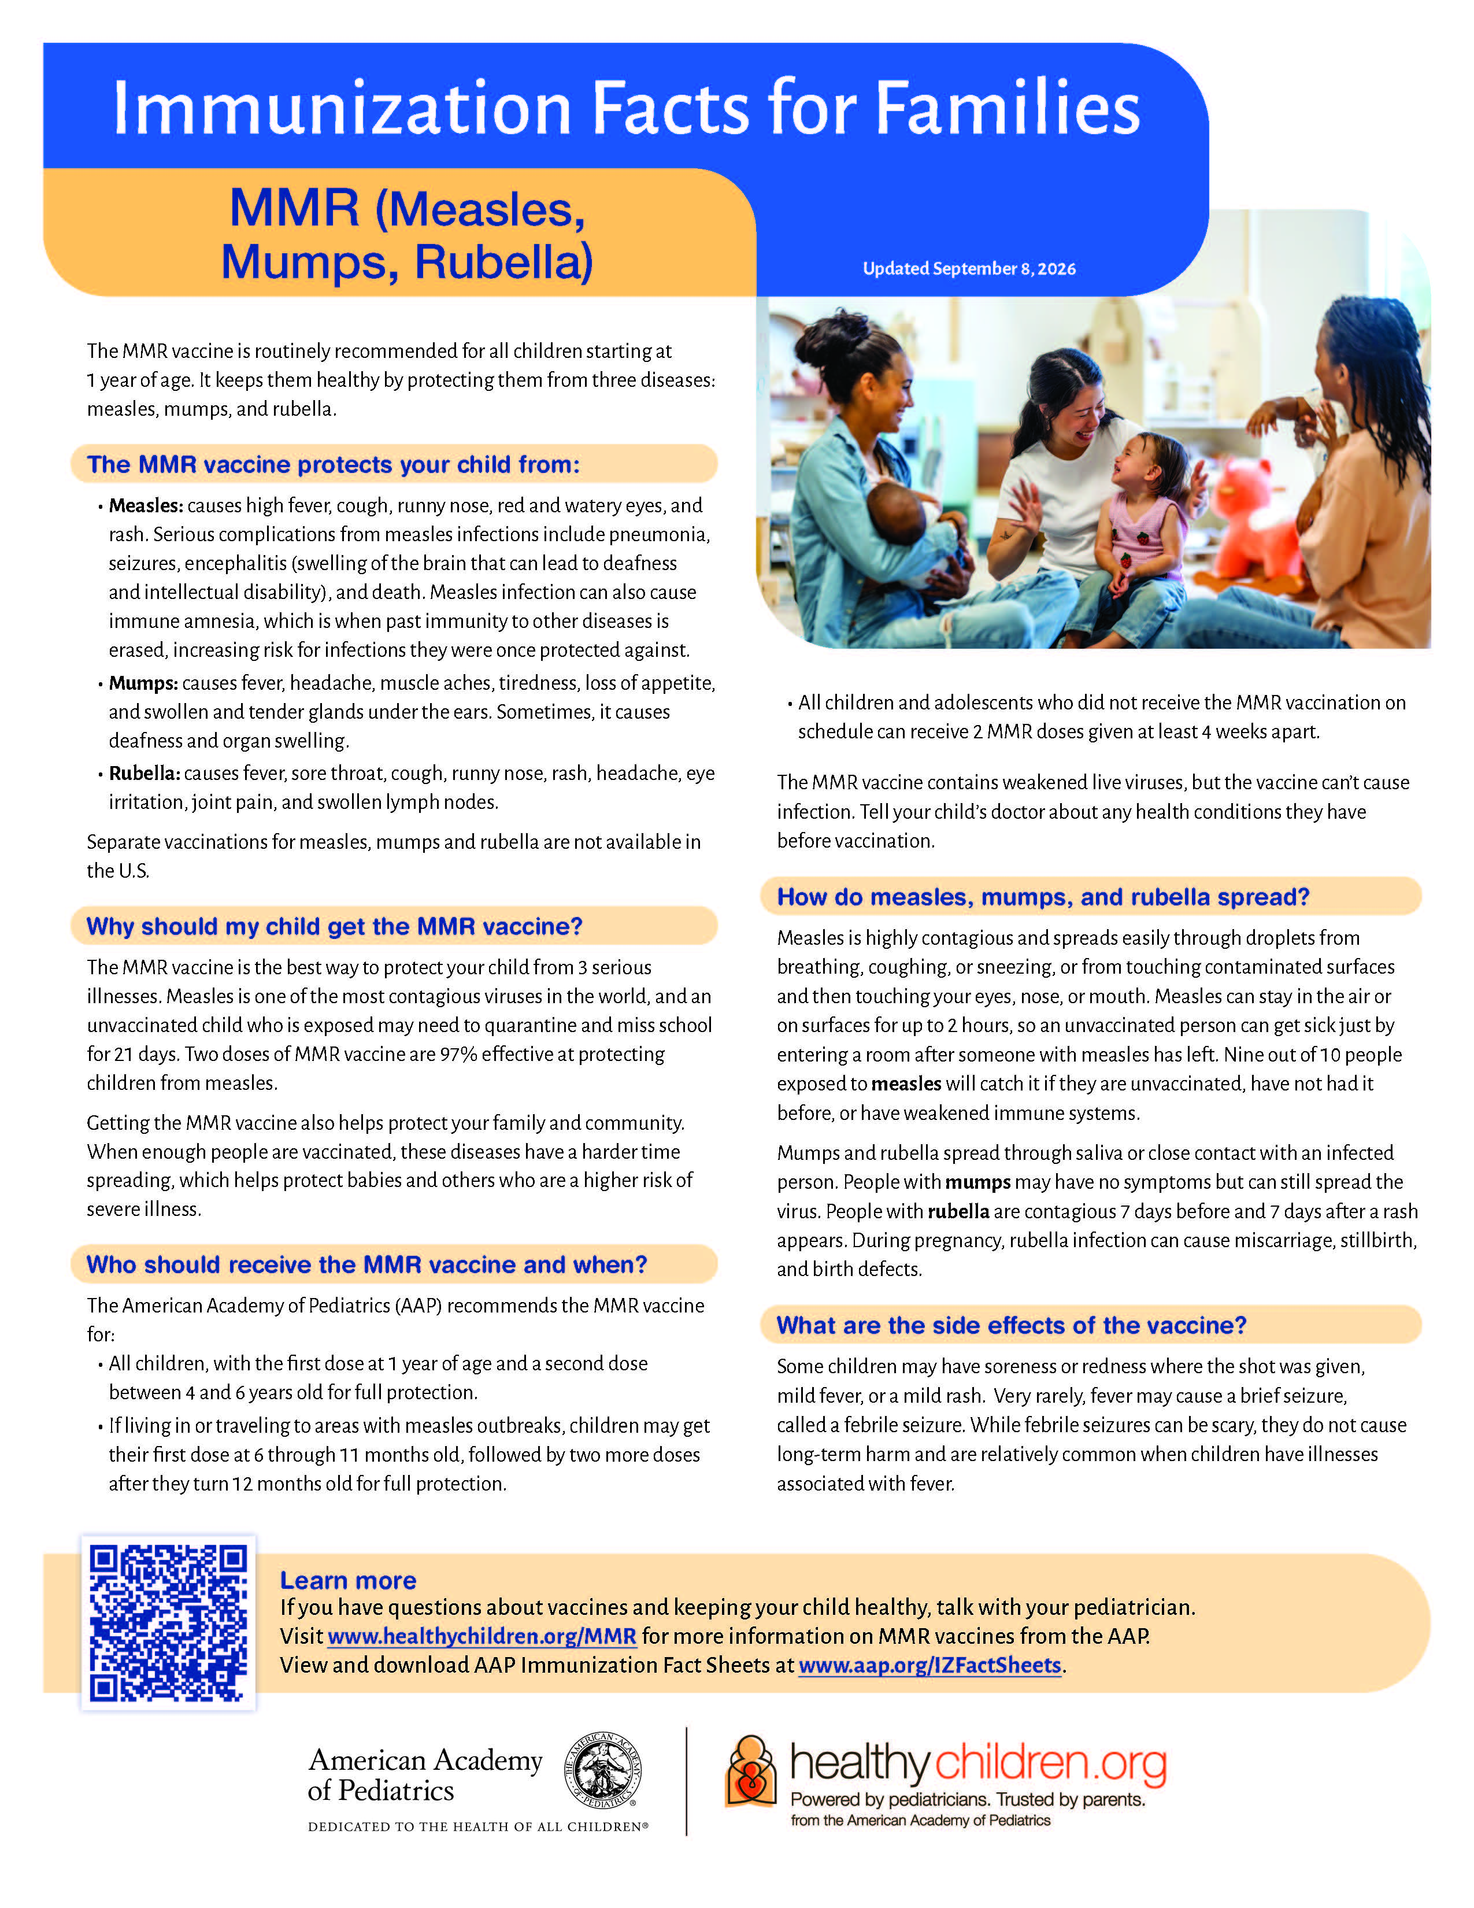
AAP Immunization Fact Sheets
Currently available for flu, COVID, RSV, HepB, Hib, MMR, and rotavirus.
AAP Immunization Fact Sheets
Notes:
Designed to help clinicians facilitate immunization conversations.
An additional resource to accompany the required VIS.

Slide 150
Questions?

Slide 151
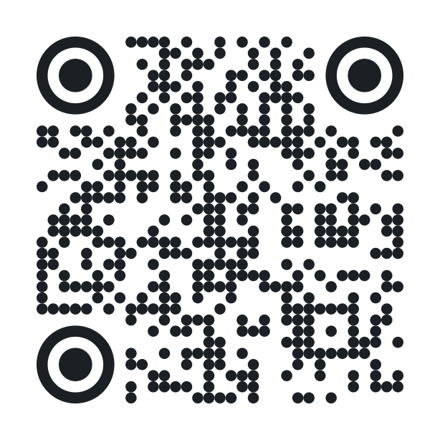
Interactive Activity – How to Join
Go to pe.app/vfc or scan the QR code to join.
  You do not need to rejoin or scan the QR code for every poll, but it is on each poll slide if you need it.
  If you close the device tab with the poll, it can be reopened at any point during today’s presentation.
When a poll is on screen, it will automatically show that poll question on your device.
The leaderboard will be shown halfway through and at the end of the activity.
Notes:
We will once again be using Poll Everywhere, but this time we will be having a 10-question competitive activity. Halfway through, leaders will be displayed on a leaderboard, and the top winner at the end of the activity will win a prize for their participation.
As a reminder, there are 2 ways to join Poll Everywhere: 1. You can open the browser on your phone or computer and navigate to pe.app/vfc. 2. You can scan the QR code with your phone. You do not have to rescan the QR code or retype the join code for every question, but the information will be on each poll slide if you need it. Since there are 10 consecutive questions, we encourage you all to keep your device active to have a chance to win today’s prize!

Slide 152
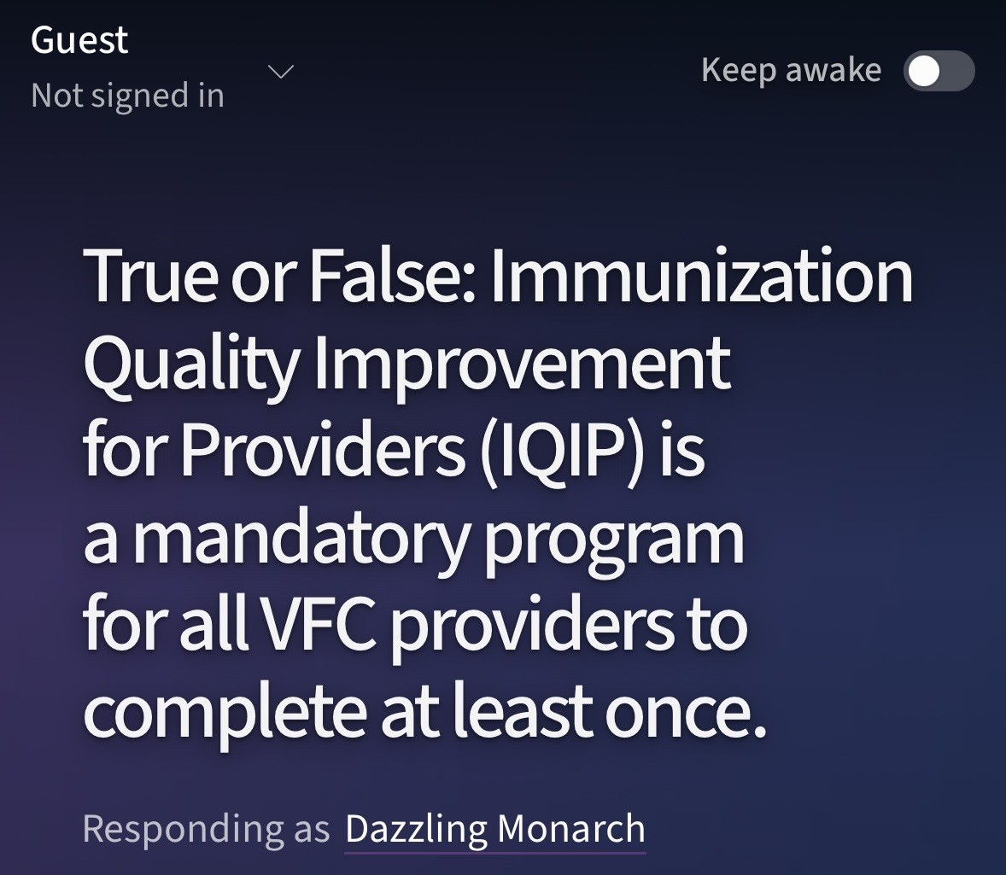
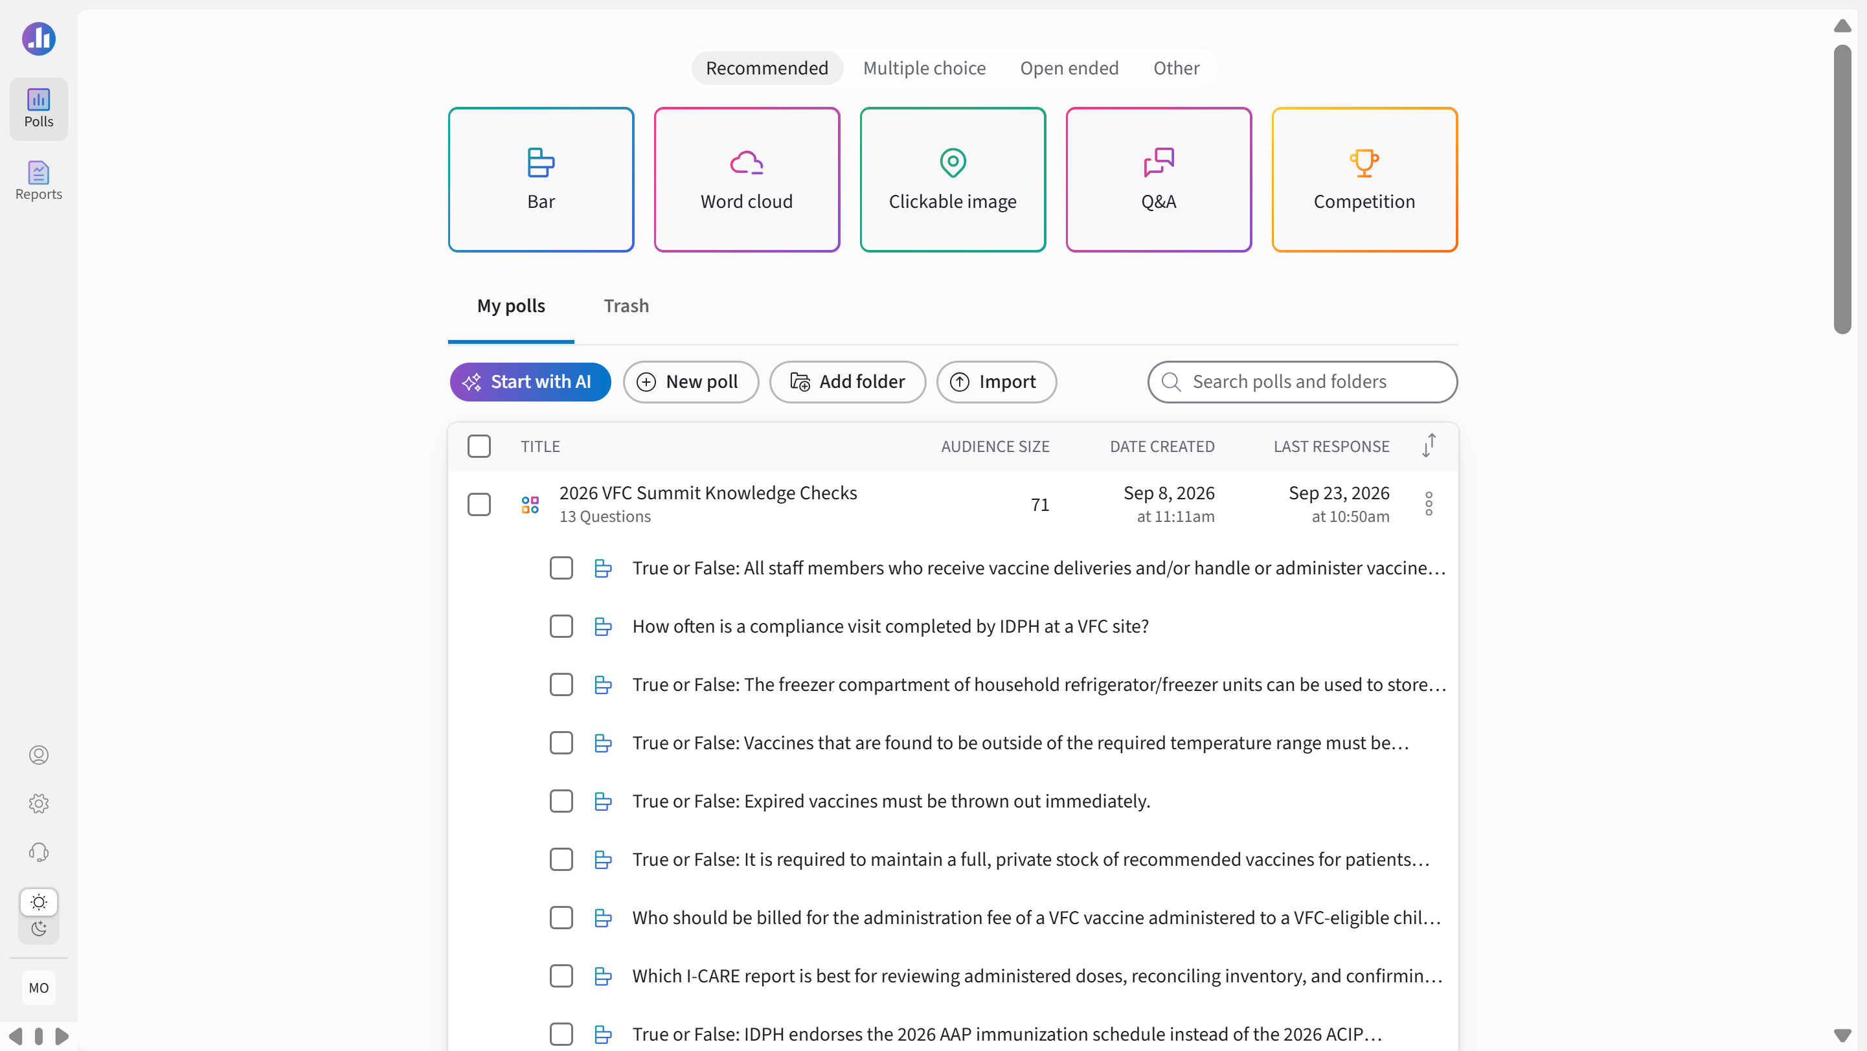
Interactive Activity – Display Name
Click the grey pencil icon next to your unique temporary display name to change your name displayed on screen.
  Change to your real name if you want to be eligible to win a prize!
  You do not need to rejoin or scan the QR code for every poll; on the top right, there is a “Keep Device Awake” setting to prevent your screen from closing between questions.
Notes:
All respondents are asked to type their name at the top of the screen. This is the way we will know who is leading our activity and who the potential winners are. To edit your display name, click the grey pencil icon next to your temporary display name (in the dark blue box) and change it to your first and last name. On the top right there is a “Keep Device Awake” setting to prevent your screen from closing between questions. In order to be eligible to win a prize, you must use your real name.

Slide 153
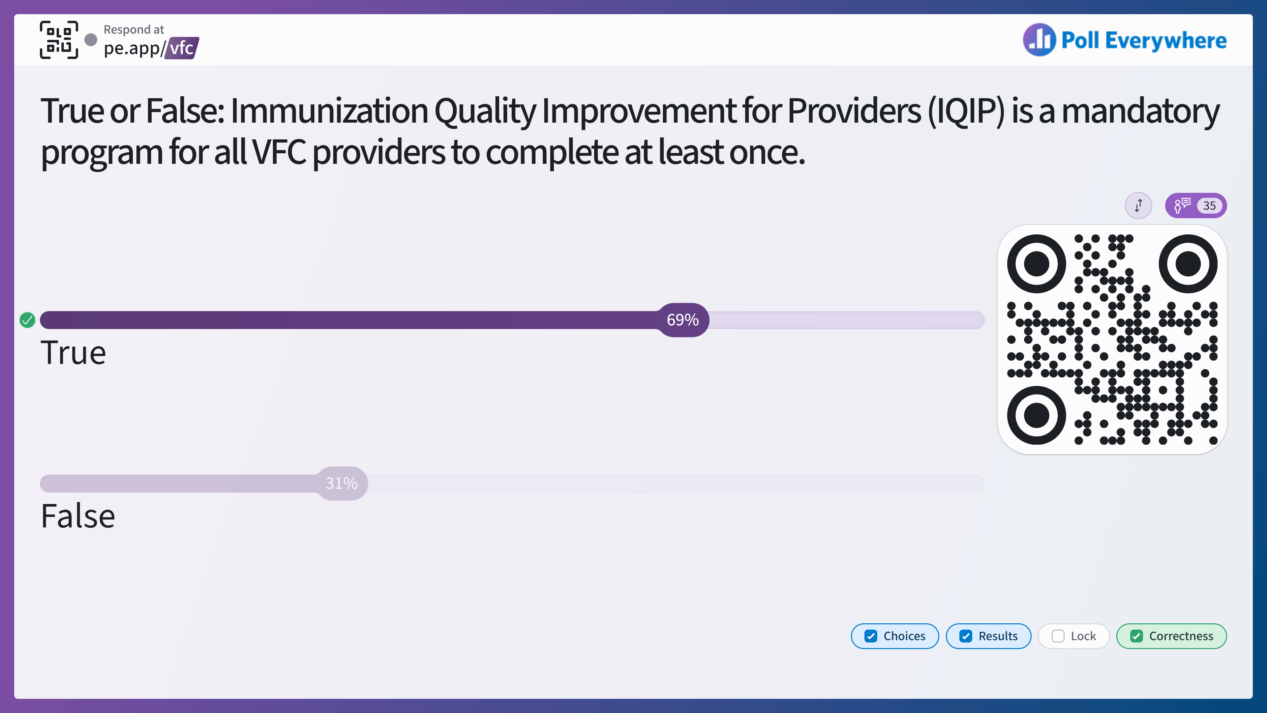
Notes:
Answer: True. If you have IQIP questions, please ask a member of IDPH staff here today for details.

Slide 154
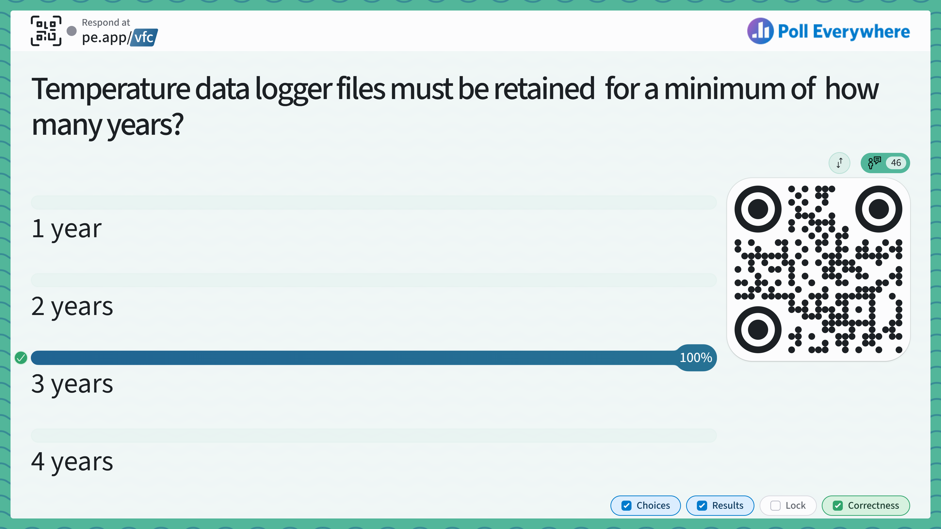
Notes:
Answer: 3 years.

Slide 155
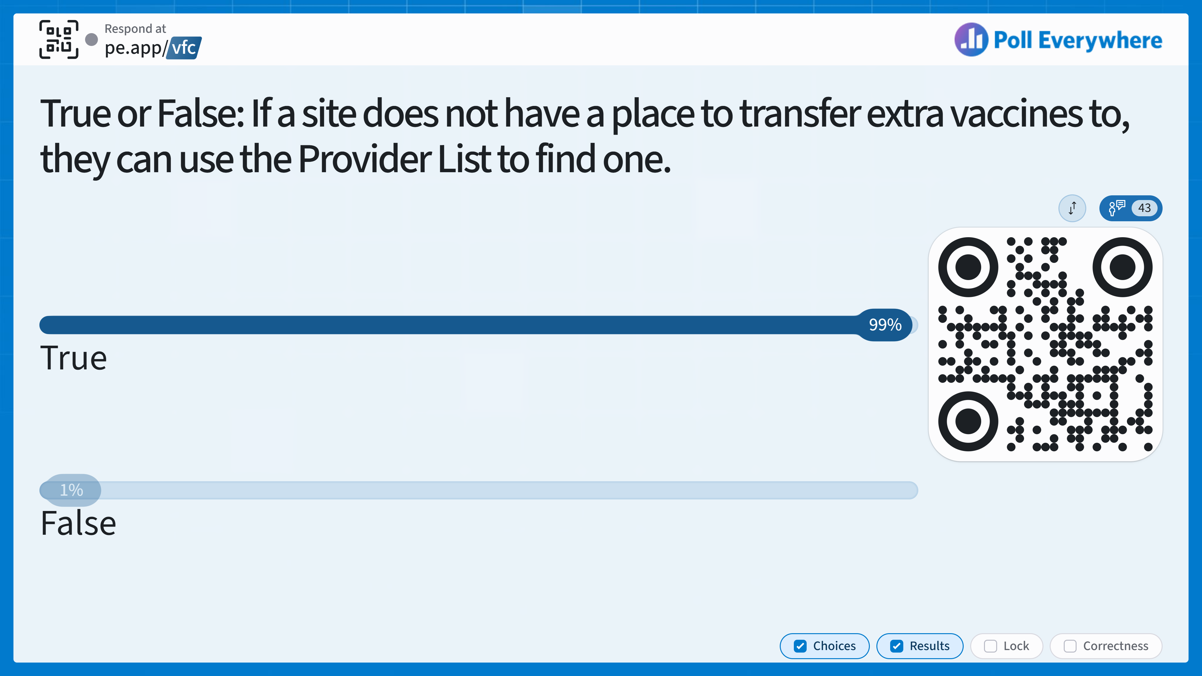
Notes:
Answer: True
This is one of the reasons why it is very important to keep an accurate count of the number of vaccines you have in your clinic, there may be a site that may be viewing the Provider List to send your clinic extra vaccines.

Slide 156
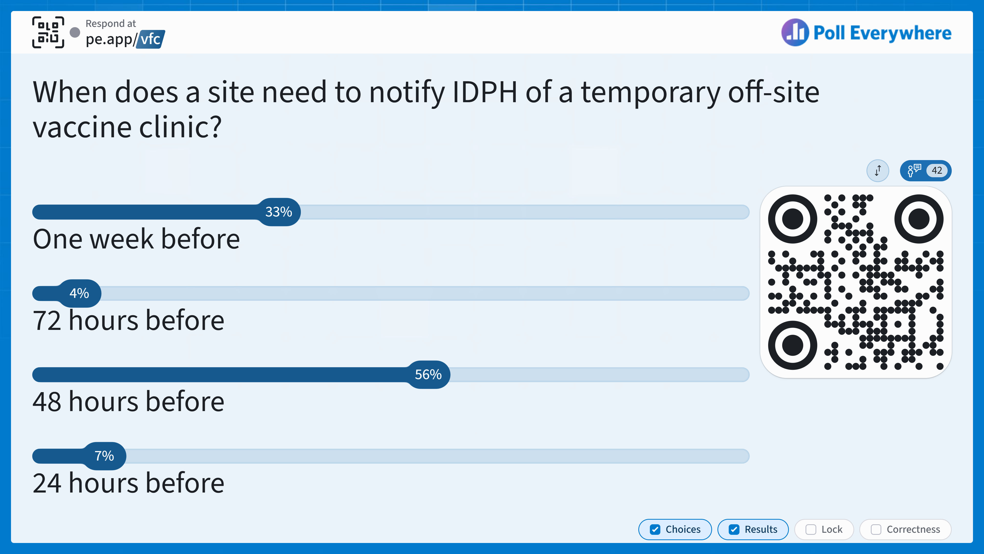
Notes:
Answer: 48 hours before.

Slide 157
Notes:
Answer: True

Slide 158
Notes:
We are halfway through our current activity, these are our current leaders!

Slide 159
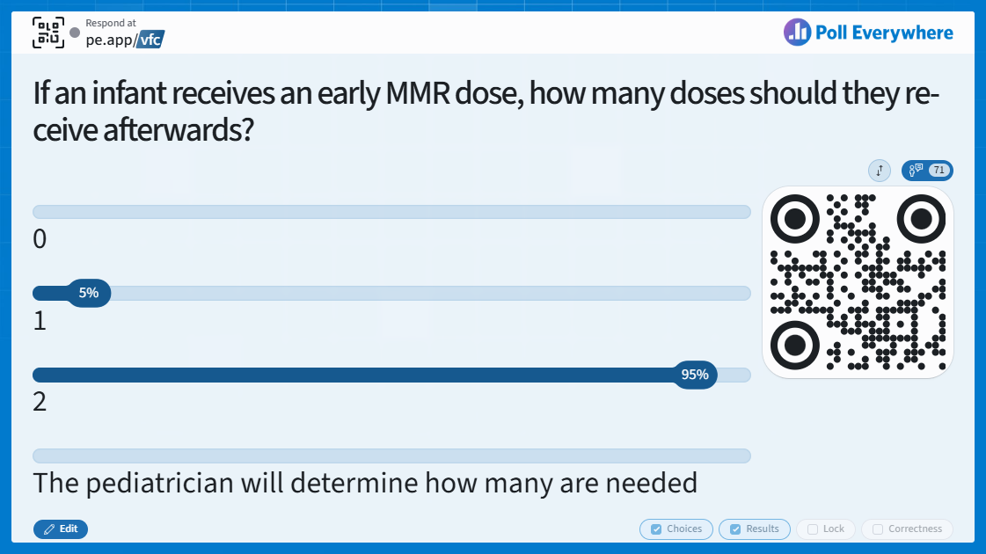
Notes:
Answer: 2
If an early dose is given, the child will still need their regularly scheduled 2 MMR doses at 12 months of age and older.

Slide 160
Notes:
Answer: Abrysvo. Abrysvo is approved for pregnant persons and individuals 50 years old and older.

Slide 161
Notes:
Answer: True
It is safe to give nirsevimab or clesrovimab at the same time as other childhood vaccines.

Slide 162
Notes:
Answer: Federal Health Agencies.
We will discuss this in more detail in the next session, but there has been an increase in the lack of trust in federal health agencies over the past year.

Slide 163
Notes:
Answer: TRUE
HPV vaccination coverage rates have not increased for the fourth consecutive year, according to the CDC’s National Immunization Survey-Teen. 77.7% had received ≥1 dose of HPV vaccine and 63.4% were up to date with the HPV vaccination series.

Slide 164
Notes:
Congrats to our first place winner! Please come to the front to claim your prize!

Slide 165
Vaccine Trends
Brandi Vogt-Cervantes, MSGH, CHES
ICAAP
Notes:
This final session will focus on key vaccine trends and topics that many of you are likely seeing in your clinics.

Slide 166
Learning Objectives
After this session, participants will be able to:
Summarize current routine immunization rates nationally and statewide.
Explain the impact of ongoing vaccine preventable disease outbreaks and how to prepare for potential cases.
Describe the current vaccine landscape and how to address vaccine hesitancy.
Notes:
Here are the learning objectives for this session. After this session, participants will be able to describe the current vaccine landscape, address vaccine hesitancy seen in clinic rooms with easy-to-apply steps, summarize current routine immunization rates nationally and statewide, and explain the impact of ongoing vaccine preventable disease outbreaks and how to prepare for them.

Slide 167
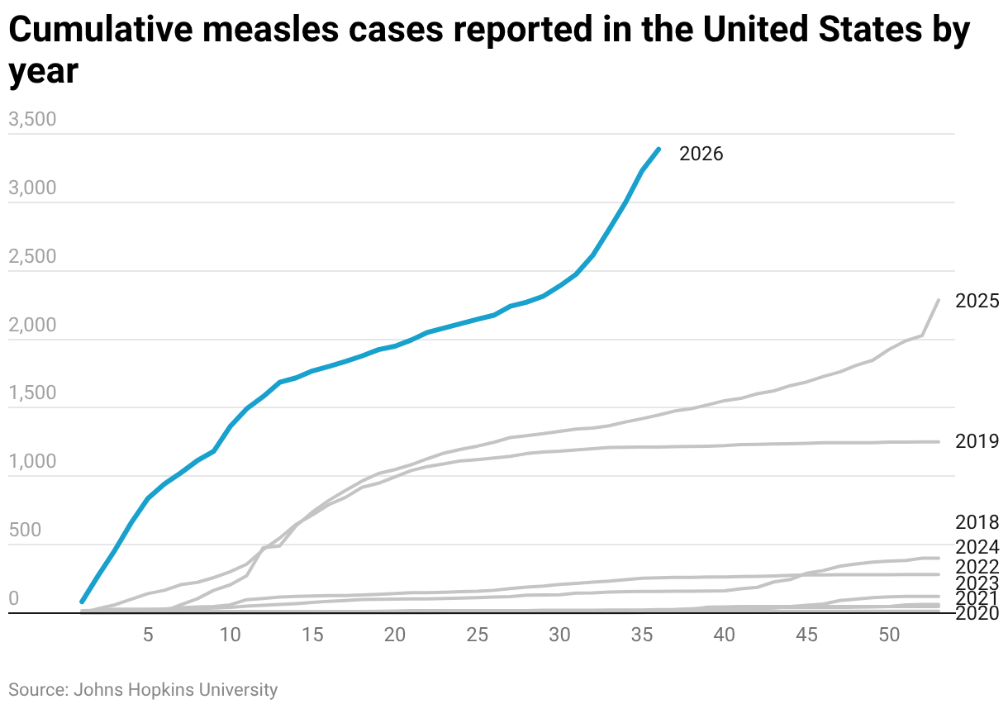
Measles Outbreaks Nationwide
As of September 17, there have been 3,471 confirmed measles cases in the U.S.
95% of cases have been among people who are unvaccinated or whose vaccination status is unknown.
11% of children under 5 with measles required hospitalization.
https://publichealth.jhu.edu/ivac/resources/us-measles-tracker
https://www.cdc.gov/measles/data-research/index.html
Notes:
Measles cases and outbreaks continue to occur across the country, particularly in communities with declining MMR vaccination rates. In July, the total number of measles cases surpassed the record set in 2025, setting a new 35-year record. The United States’ measles elimination status will be reviewed in November. As of September 2026, nearly half (45%) of measles cases are school-aged children between the ages of 5 through 19 and 20% are children under 5.
The Pan American Health Organization (PAHO) will review the U.S.' measles elimination status in November.

Slide 168
Measles Outbreaks in Illinois
As of September 22, there are 23 confirmed measles cases in Illinois for 2026.
Outbreak in Douglas County declared on August 31.
  At least four linked cases..
Known exposure locations are posted on IDPH’s Measles Exposure Location website.
Conduct reminder/recall to ensure patients are up-to-date.
Illinois measles cases locations, source: Johns Hopkins University
https://dph.illinois.gov/topics-services/diseases-and-conditions/measles.html
https://illinoisaap.org/wp-content/uploads/2026/09/20260902_IDPH_Health_Advisory_Measles_Update.pdf
Notes:
Illinois is currently experiencing a measles outbreak in Douglas County. This is after IDPH reported a measles case in a Kane County resident after they returned from international travel on August 22nd. These cases occur amid increasing measles activity across the region, including in Southern Iowa, Southwest Wisconsin, and Western Kentucky. It is important to check IDPH’s measles exposure location website to stay up to date on the latest information that may be impacting your community. For testing, VFC providers should be aware that IDPH laboratories provide PCR testing of throat or nasopharyngeal swabs for measles at no cost to the patient or provider. Suspected measles cases should be tested by PCR at the state lab as testing at commercial laboratories can delay results and subsequent public health. IDPH requests that you do not send PCR swabs to commercial labs unless specifically instructed by public health officials. In light of the outbreak please be proactive in identifying patients who may not yet be up-to-date on their MMR vaccine. You can do this through reminder/recall in I-CARE. Please utilize this feature to remind families of any upcoming or past due measles vaccinations.

Slide 169
MMR Reminder/Recall
Reminder recall is a helpful tool for ensuring that patients who are due or overdue for vaccinations are notified.
  Reminder: immunizations are coming due
  Recall: immunizations are past due
I-CARE can be utilized to see which patients are due/overdue for their MMR vaccination.
There are two reports in I-CARE that can be utilized to generate vaccination reminder recall letters:
  Customize Letters
  Reminder Recall
Notes:
In light of measles outbreaks please be proactive in identifying patients who may not yet be up-to-date on their MMR vaccine. You can do this through reminder/recall in I-CARE. Please utilize this feature to remind families of any upcoming or past due measles vaccinations.

Slide 170
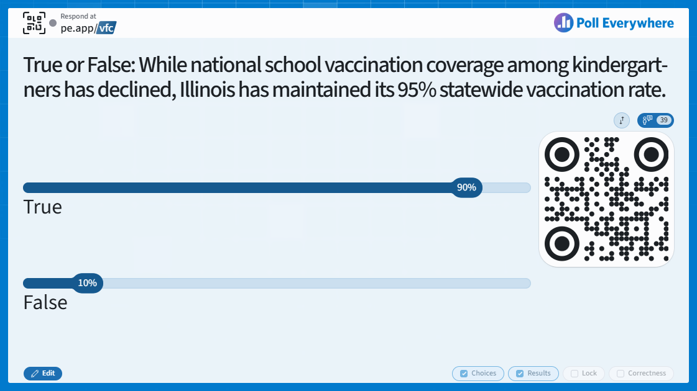
Notes:
Answer: True.
IDPH confirmed that ten of the eleven tracked school-required vaccinations are at or above the community immunity threshold of 95% vaccine coverage, while the nationwide average is 92%.

Slide 171
Knowledge Check
True or False: While national school vaccination coverage among kindergartners has declined, Illinois has maintained its 95% statewide vaccination rate.
True
False
Notes:
Answer: True.
IDPH confirmed that ten of the eleven tracked school-required vaccinations are at or above the community immunity threshold of 95% vaccine coverage, while the nationwide average is 92%.

Slide 172
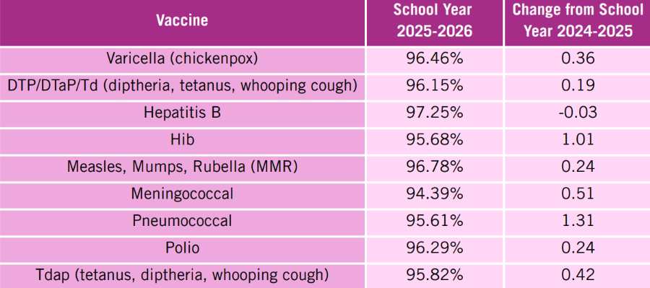
School Vaccination Coverage Rates
For the 2025-2026 school year, 10 of the 11 school required vaccines in IL reached a 95% immunization rate.
Only the meningococcal vaccine was below the 95% threshold, but the vaccination rate has increased from 93.88% to 94.39%.
National school vaccination coverage among kindergartners decreased for all reported vaccines from the year before.
Notes:
On May 4, IDPH published a news release stating that ten of the eleven tracked school-required vaccinations are at or above the community immunity threshold of 95% vaccine coverage. This school year, the only immunization under the 95% coverage rate is the meningococcal vaccine. At a time when many states are seeing declining immunization coverage rates, we are grateful for the work you and your teams are doing to keep children and communities protected against vaccine-preventable illness in Illinois! This is extremely important, as CDC’s national SchoolVaxView data shows that during the 2025-2026 school year, vaccination coverage among kindergartners in the United States decreased for all reported vaccines from the year before, ranging from 92.0% for (DTaP) to 92.4% for MMR and Polio.

Slide 173
School Exemptions
The number of religious exemptions has steadily increased nationally since the COVID-19 pandemic.
  In the 2025-2026 school year, exemptions increased to 4.2%, up from 3.6% in 2024-2025.
Illinois allows for medical and religious exemptions only.
https://dph.illinois.gov/topics-services/prevention-wellness/immunization/coverage-dashboards/school-vaccination-coverage-dashboard.html
https://www.cdc.gov/schoolvaxview/data/index.html?fbclid=PAVERFWATwY5pwZG9mAmZkaWQWUMoRRghkGTjX3NBybjQS5-tkyjm1HGV4dG4DYWVtAjExAHNydGMGYXBwX2lkDzEyNDAyNDU3NDI4NzQxNAABp-oKXR0VaFnRDRzMdab9SACWNmjcfYISArEmsI00q2hbPeA1lwjFHqlri6AM_aem_ZAtkKjzUQ4Rd6WNEmdw_kA
Notes:
Nationally, we are continuously seeing a rise in school exemptions for routine vaccinations. Nationally, exemptions from one or more vaccines among kindergartners in the United States increased to 4.2% from 3.6% the year before, with 24 states reporting exemptions exceeding 5%. It is important to acknowledge that there are three types of school exemptions that some states allow: religious, medical, and philosophical. Illinois is also seeing an increase in exemptions, with 22,994 during the 2025-2026 school year, compared to 18,577 during the 2024-2025 school year. Please note that Illinois does not allow philosophical exemptions; only religious or medical exemptions are permitted.

Slide 174
Religious Exemptions
If a parent brings a religious exemption form, you are required to counsel them on:
    Not following vaccine recommendations may endanger the health or life of the unvaccinated child, or others around them.
    During a disease outbreak or after exposure, schools may exclude children who are not vaccinated to protect other students.
    Options available if the family chooses to vaccinate in the future.
ICAAP Clinician’s Guide to Exemptions for Minimum Immunization Requirements is available to download and print to help during these conversations with parents and guardians.
Notes:
As we approach the October 15 child health exam form deadline, parents may bring you a religious exemption form. It is not your responsibility to validate the reason for the exemption; however, you are still required to counsel the family on what vaccines are needed, the importance of vaccination, how not following vaccine recommendations may endanger the health or life of the unvaccinated child, or others around them, as well as potential school exclusion during outbreaks. Signing the exemption form doesn’t mean you agree with or support the exemption; it just affirms that you counseled the patient on the benefits of vaccination. Illinois also requires school exemption forms to be signed off by the same medical provider who completed the child health exam form, so if you did NOT complete the patient’s child health exam, you cannot sign a school exemption. ICAAP has a Clinician’s Guide to Exemptions for Minimum Immunizations Requirements that can be downloaded from our website and used for any child enrolling or entering a child care facility or school in the state of Illinois.

Slide 175
School Immunization Toolkit
  Includes:
  Outreach & Materials Timelines
  Immunization Requirements by Age
  Legal & School Code Review
  Parent/Guardian Outreach
  Vaccine Info for New Arrivals
  Resources for Un/Underinsured Families
  Exemption Information
Notes:
Our Immunization Toolkit for School Leadership focuses on addressing barriers to school-required vaccination and improving compliance with Illinois' school immunization requirements. The goal of this project is to empower school leadership in enforcing required immunizations through positive and cohesive messaging. The toolkit provides information and resources on all of the sections listed on the slide, including required and recommended school immunizations, review of school forms, tips for working with pediatric providers in your community, and handouts to provide families to promote clarity around school immunization requirements.

Slide 176
Misinformation vs. Disinformation
Misinformation
Disinformation
When people spread misinformation, they often believe the information they are sharing.
Disinformation is crafted and disseminated with the intent to mislead others.
Notes:
There is a difference between misinformation and disinformation. For example: If a political leader claims that COVID-19 is no worse than the flu, despite knowing otherwise, that is disinformation. When an individual hears this, believes it, and then shares it, that is misinformation.

Slide 177
Misinformation Online
The main source of information for most Americans is online sources.
Misinformation goes farther, faster, deeper, and more broadly than the truth
  Misinformation thrives online, receiving more shares and direct messages.
Disinformation campaigns are deliberate, often orchestrated, and highly effective in confusing people enough to change behaviors.
  Social media platforms have rolled back their fact-checking capabilities, allowing for the potential for more mis/disinformation to spread.
Notes:
The way we obtain and share information is changing. Today most Americans receive news in online spaces as opposed to television or print. Misinformation thrives in online spaces. Because disinformation can be so powerful and misleading, we as trusted healthcare clinicians and VFC providers must first understand what credible sources of information are and then in our interactions with patients, help them to understand how to access credible sources of information. We also can be that credible source of information.

Slide 178
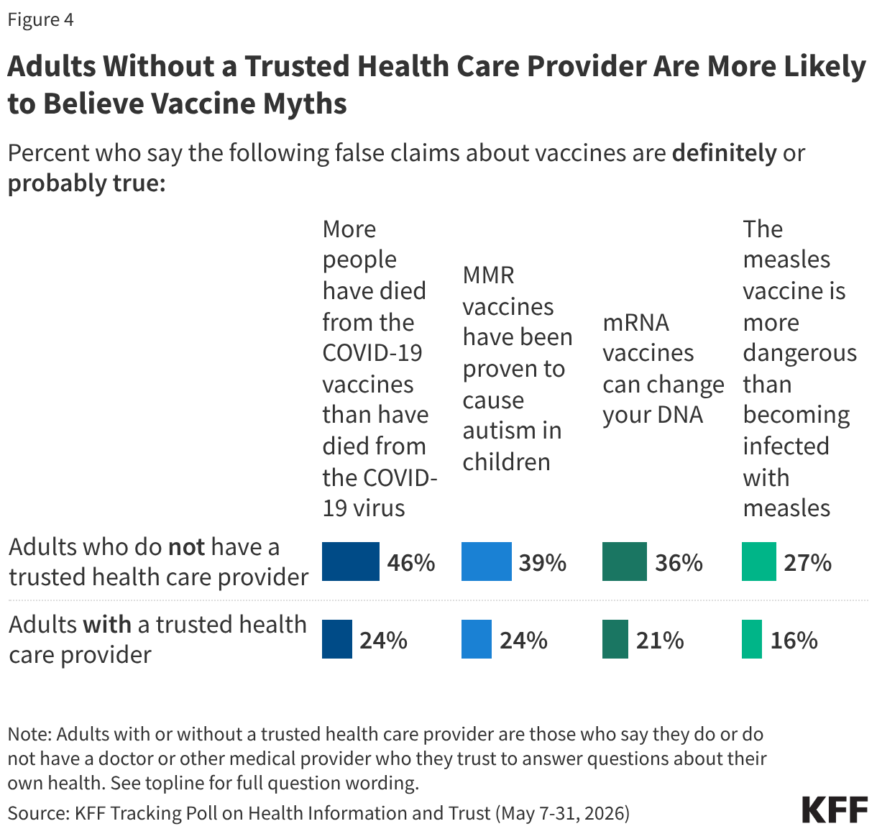
Misinformation Online
Although adults still mostly rely on doctors’ advice, they are seeking more outside information.
Nearly 60% say they’ve made at least one health decision they regret due to inaccurate information.
Source: https://www.axios.com/2025/04/24/trust-health-advice-gen-z-edelman
https://www.kff.org/public-opinion/kff-tracking-poll-on-health-information-and-trust-update-on-common-vaccine-myths/?utm_campaign=Common%20Health%20Coalition&utm_medium=email&_hsenc=p2ANqtz-9s0cixskZjL_j80aFN4V75jknBoQx7k40XAkPrTzY41jvfidIK5CXXsVvVCajdk8h1LK3HN8FeJuxhkJLuaRWfWrBeWeD6J8D7r4GmKlrNgAIEMXA&_hsmi=426254179&utm_content=426254179&utm_source=hs_email
Notes:
Adults who have a relationship with a trusted health care provider are less likely than those who don’t have such a relationship to believe or lean toward believing vaccine falsehoods. While younger adults, Hispanic adults, and uninsured adults are more likely than their counterparts to say they don’t have a trusted provider, the connection between lacking a trusted provider and belief in vaccine myths holds even when controlling for factors like age, race and ethnicity, education, partisanship, and insurance coverage. It is important we continue to build strong relationships with patients and continue to educate the dangers of misinformation and disinformation in online spaces.

Slide 179
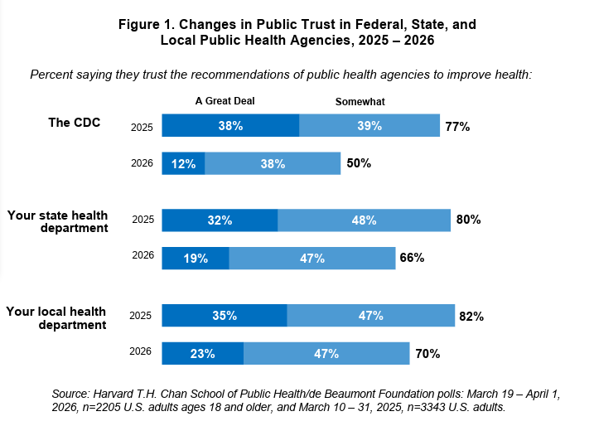
The Source Matters
State and local public health agencies are now substantially more trusted than the CDC.
Clinicians remain the most trusted source for health recommendations.
https://hsph.harvard.edu/wp-content/uploads/2026/06/dBF-Harvard_OneYearInPollReport_June-2026.pdf?utm_source=newsletter&utm_medium=email&utm_campaign=newsletter_axiosvitals&stream=to
Notes:
Overall, nurses, doctors, and pharmacists remain the most trusted source of reliable vaccine information among the public. According to a Harvard Chan School of Public Health study, one year into new leadership of the U.S. public health system, trust in public health agencies, and trust in the CDC in particular, has dropped dramatically. Only 50% of the public now says they trust health recommendations from the CDC. State and local public health agencies are now substantially more trusted than the CDC. Trust in state and local public health agencies has also fallen in the last year, but not by as much. When examining public trust across prominent leaders and groups, the top trusted sources for health recommendations in 2026 are healthcare professionals; nurses (89%), doctors (88%), and pharmacists (85%) followed by friends and family (81%). What you, your colleagues, and your office say to patients has a huge influence, and none of this work can be done without your support and recommendations!

Slide 180
ICAAP Statewide Vaccine Survey
Vaccination behavior (household)
Follow schedule fully: 70.8% (368)
Delay some: 10.6% (55)
Selective vaccination 11.3% (59)
Do not vaccinate: 5.8% (30)
Confidence in vaccine safety (1-5)
5: (Very confident) 41.9%
4: 29.8%
3: 17.5%
2: 5.0%
1: (Not confident) 5.8%
71.7% of respondents were either very confident (5) or confident (4) in vaccine safety.
Notes:
ICAAP fielded a statewide parent/caregiver survey (520 total respondents) to understand attitudes, barriers, and motivators around pediatric vaccinations. 284 unique ZIP codes across Illinois, confirming urban, suburban, and downstate coverage. The survey highlighted that even in Illinois, a large majority of participants follow the vaccine schedule fully and are confident in vaccine safety. This survey reaffirms national trends we are seeing that a majority of parents and guardians do trust the science and pediatric providers like yourselves. Just as a person trusts a hairdresser to cut their hair or a plumber to fix their pipes, your word and experience continue to be the biggest resource to families when it comes to discussing vaccinations.

Slide 181

ICAAP Statewide Vaccine Survey (cont.)
Parents and guardians across Illinois stated that information about vaccine testing and side-effect monitoring was an unaddressed vaccine topic.
Notes:
The survey also highlighted strong demand for vaccine ingredient and testing clarity; honest discussions of side effects and benefits to vaccination, and materials in their preferred-language that are culturally relevant. Many of these concerns raised by parents and guardians we will cover on the following slides, as well as tips for you all to communicate about vaccines more effectively with them.

Slide 182
Strategies for Addressing Hesitancy
Give Your Strong Recommendation
Healthcare professionals remain the most trusted source for vaccine-related information. Ensure information is presented out of concern for children and the community.
Presumptive Approach
Start each vaccine conversation with a strong, positive “You are due for x vaccine today.”
Avoid using the phrase “safe and effective.”
https://www.aap.org/en/patient-care/immunizations/communicating-with-families-and-promoting-vaccine-confidence/talking-with-vaccine-hesitant-parents/?srsltid=AfmBOooe8DbcWVtjGanYfQ6tpiQtwOOxsdPNLB-399IOH1iHugMfiMKW
https://www.smartbrief.com/original/messaging-makes-a-difference-when-it-comes-to-getting-kids-vaccinated?utm_term=1D811E4A-183C-4CF2-AC77-286886860756&lrh=08209ef0e44a68efaec582b1f109b530c9e5d573bd599f488e2ba63d6d8554c1&utm_campaign=754C9E92-7324-4921-8730-2676BDB6861D&utm_content=ED1B26E4-2A7C-4C77-924B-744B8990365D&utm_source=brief
Notes:
We want to make sure you and your clinical team feel confident in having conversations with patients about vaccination. Your voices are the most important in these conversations; parents trust pediatricians most; data and transparency reinforce confidence. Giving your recommendation with an affirmative approach explaining your reasoning for vaccination and ensuring information is presented out of concern for children and the community. You and your clinic are there for your patients and their families, and everything you do is on the side of children’s health. Simultaneously, the phrase “Safe and effective” has become the phrase that health leaders and officials turn to when talking about vaccines and disease prevention, but that does not resonate with anyone who doesn’t already believe it. It’s also helpful to explain that from birth, people are constantly exposed to germs and that vaccination is a controlled way to expose our bodies to germs so the immune system is prepared to respond when it encounters the real thing.
One easy and effective measure is a presumptive approach, which is stating which vaccines the child needs to receive as though you presume that parents are ready to accept them during that visit. A participatory approach would be like starting the conversation with ‘Do you want to talk about vaccines today?’. The presumptive approach is especially important for first-time visits and for vaccinating migrant populations.

Slide 183
Strategies for Addressing Hesitancy
Use Analogies and Comparisons
Compare vaccination to other public health measures families implement without hesitation, like a car seat or seat belts.
Show Your Vaccine Confidence
Display posters in clinic spaces with vaccine confident messages.
Share your own stories of why you got vaccinated and why you recommend vaccines.
Use relatable comparisons, like using an umbrella when it’s raining (you may get a little wet, but it will keep you from getting soaked).
https://www.youcanknowthings.com/introducing-the-communication-lab-and-one-more-thing/?ref=you-can-know-things-newsletter
Notes:
It is okay to acknowledge concerns openly, but replace defensive messaging with clarity about testing, monitoring, and real-world safety. One recommendation is using analogies and comparisons that are relatable to patients and their families. For example, if your patients came to their appointment by car, ask if they used a seat belt and/or car seat coming in. These are other public health measures families implement without hesitation and should view vaccination the same way. Other comparisons can be helpful as well, like comparing vaccination to using an umbrella when it’s raining (you may get a little wet, but it will keep you from getting soaked).
It is recommended to highlight normalcy and community norms, since most families and patients vaccinate, and this can be further reinforced with posters in-clinic with vaccine confident messages. Emphasize that most Illinois parents vaccinate while recognizing common hesitation and interestingly overestimate the number of families not vaccinating their children. If you’re comfortable, communicate with stories! Storytelling from real people is more impactful and memorable than providing statistics to most patients.

Slide 184
Social Media Resources
The Vaccines for Children Social Media Toolkit
This campaign raises awareness about VFC providers and pediatric vaccine messaging to encourage vaccination uptake.
The Super Strength Social Media Toolkit
This campaign builds the relationship between provider and parent/guardian, fostering trust over the shared goal of optimal health for children.
Rory the Lion Social Media Campaigns
ICAAP has two social media campaigns that help families cut through the noise with trusted, easy-to-understand information about vaccines.
The Only Difference Toolkit
Age-specific messaging (babies, kindergarten, 6th grade, 9th grade, and 12th grade) emphasizing how vaccines help children stay the same kids they've always been, just with stronger immune protection.
Notes:
We have some social media resources to help you online! These social media toolkits include ready-to-post images and sample captions so all you have to do is download and post. All of these campaigns and more can be found on ICAAP’s Vaccine Outreach Social Media Toolkits and Education webpage.

Slide 185
Vaccine Health Equity
Health equity means that all people have a fair and just opportunity to be as healthy as possible.
Achieving health equity requires:
  Valuing every person and their health fairly.
  Addressing unfair practices and unjust conditions that can harm the health of specific groups in society.
  Working with different groups in specific, sensitive ways to address health issues that affect them.
https://www.frameworksinstitute.org/wp-content/uploads/2023/05/Talking-about-Health-Equity.pdf
Notes:
Equity means fairness and justice. It involves ensuring that every individual and group gets what they need to thrive and participate fully in society. Achieving equity often asks us to rethink uniform, one-size-fits-all treatment. It sometimes involves devoting more resources or different resources in communities that face injustice, to correct imbalances caused by unfair or unequal treatment. Over the next few slides, we have provided specific recommendations and resources for specific populations.

Slide 186
Vaccine Communication with Spanish-Speaking Audiences
Community-focused messaging: Study participants felt a strong sense of collective responsibility when vaccination was framed as a mutual exchange: “If I do my part and you do yours, we both benefit.”
  This message is only effective when personal, not bureaucratic. Must be warm and welcoming, like an invitation to protect others in the community.
Effective Framing: Historical examples of vaccine efficacy, particularly the chickenpox vaccine, have effectively demonstrated the collective benefits of childhood immunization.
Ineffective Framing: Individualistic family approach; once participants were focused on an individual child, they were more likely to focus on potential vaccine side effects.
https://www.frameworksinstitute.org/resources/dos-and-donts-when-communication-about-childhood-vaccines-with-spanish-speaking-audiences/
https://www.frameworksinstitute.org/resources/framing-childhood-vaccination-for-spanish-speakers-in-the-united-states/
Notes:
The Frameworks Institute released a series of new reports in August that highlighted ways to strengthen vaccine communication with Spanish-speaking audiences. The reports highlight the value of community and highlighting the effectiveness of vaccines in the past, specifically chickenpox, since the introduction of the chickenpox vaccine is within the living memory of most adults. Deep-held values in community and the family within the community provided a resonant “easy-to-think” frame for vaccination, that paired with warm and welcoming messages, seen an invitation to protect others, is very approachable.

Slide 187
Vaccinating Migrant Populations
Newly arrived children eligible for vaccinations through the VFC program
CDC New Arrival Vaccination Schedule
Immigrant Health Coverage
ICAAP Supporting New Arrivals Webpage
  Navigating Vaccine Gaps
  Accessing Health Services in IL
  ICAAP Global Vaccine Schedule Comparison (QR Code)
Notes:
ICAAP has a collection of resources specifically for newly arrived migrant populations in Illinois. All newly arrived children are eligible for vaccinations through the VFC program. To help smooth out the process of connecting them to health services and interpreting international records, ICAAP has a “Supporting New Arrivals” section on their immunization webpage that houses many resources for you and your clinic. Some resources ICAAP created are linked on this slide, including a QR code to the Global Vaccine Schedule Comparison Chart.

Slide 188
Interpreting International Vaccine Records
When reading international vaccine records, place special care in understanding the dates, intervals, and age of vaccination.
Navigating Vaccine Gaps – handout with guidance on assessing new arrival patients, sharing important vaccine information, and developing long-term care plans.
Global Vaccine Schedule Comparison Chart – helps identify which products may have been used before a child arrived in the U.S. and the timing of any vaccinations.
Notes:
When children arriving from other countries have records with them, it is important they are accurately reflected in your medical record system. These records may have documentation of required vaccines with different names or dates recorded differently than U.S. health records. For example, the day may be listed before the month e.g., 30/1/2016 for January 30, 2016. The image on screen is ICAAP’s Navigating Vaccine Gaps handout, which can be downloaded on our website.

Slide 189
People with Disabilities
People with disabilities face many challenges with vaccination
  Making appointments
  Getting to appointments
  Sensory challenges
Some questions to ask…
  What is the impact of vaccines on people living with disabilities?
  What can disability agencies, organizations, and service providers contribute?
  Are people living with disabilities who are employed at your organization willing to share their experiences?
  Are programs and program materials accessible, such as in large-text or audio version for vision-impaired patients?
https://www.nachc.org/wp-content/uploads/2026/07/Best-Practices-Resource-Guide-for-HC-serving-Individuals-with-Developmental-Disabilities.pdf
https://www.ama-assn.org/media/24926/download
https://www.cdc.gov/disability-and-health/about/disability-and-health-information-for-healthcare-providers.html
Notes:
ICAAP’s parent and guardian vaccine survey identified that the third most unaddressed vaccine topic was vaccine information around special health needs. There are many additional challenges patients and caregivers face when it comes to accessing medical appointments, and it is important we ask ourselves key questions to ensure a positive, in-clinic experience for patients. Is your clinic adaptable to meet the needs of individuals with special or personalized needs? On the next slide, we’ll review specific steps you and your clinic can make patient visits more sensory-friendly.

Slide 190
How to Make Vaccination Sensory-Friendly
Provide sensory-friendly hours
Provide less crowded areas or quiet spaces
Reduce bright lights
Allowing additional time for patients
Offering breaks during longer appointments
Give clear and precise instructions
Offer sensory toys
Offer accessible areas
https://www.nachc.org/wp-content/uploads/2026/07/Best-Practices-Resource-Guide-for-HC-serving-Individuals-with-Developmental-Disabilities.pdf
Notes:
Creating a sensory-friendly clinic environment is essential for providing equitable, patient-centered care. By incorporating sensory-friendly practices, such as reducing noise, offering quiet waiting areas, minimizing harsh lighting, providing clear communication, and allowing flexibility during appointments, clinics can help patients feel safe, respected, and comfortable. These accommodations not only improve the patient experience but can also lead to better communication, greater trust between patients and providers, increased adherence to care recommendations, and improved health outcomes. Ultimately, a sensory-friendly clinic demonstrates a commitment to accessibility and inclusion. It ensures that all patients receive healthcare in an environment that supports their unique needs, dignity, and well-being.

Slide 191
Autism & Vaccines
Vaccination is not associated with increased autism risk.
  A July 2026 study of 2.5 million children found that the first MMR vaccination was not associated with increased autism risk. Debunking a prominent myth about the link between the MMR vaccine and autism.
AAP evidence-based resources:
  AAP videos Understanding the Rise in Reported Autism Rates and Do Vaccines Cause Long Term Side Effects: FAQs on Vaccines and in Spanish, ¿Las Vacunas Causan Autismo?
  Additional HealthyChildren.org articles for parents: Autism Spectrum Disorder in Children - HealthyChildren.org and How Is Autism Diagnosed? - HealthyChildren.org
Notes:
As questions about the relationship between autism and vaccines continue to surface in public discussions, we want to ensure you have access to trusted, evidence-based resources to support conversations with parents and caregivers. Families often seek reassurance and clear information when making decisions about their children's health, and your role in providing accurate guidance is invaluable. Decades of research have consistently found no evidence that vaccines cause autism. This includes recent large-scale studies, such as an analysis of 2.5 million pediatric electronic health records, which found no association between receiving the MMR vaccine before 24 months of age and the development of autism. To help you address questions with confidence and compassion, the AAP offers a variety of evidence-based resources for families on autism and vaccine safety. We encourage you to have these materials in your waiting rooms or clinic rooms to support informed discussions and reinforce confidence in the safety and importance of vaccines.

Slide 192
AAP Online and Social Media Resources
AAP has compiled a list of pediatricians with trustworthy and factual content on children’s health online.
AAP Resources:
  Fact-Checked Webpage
  Communicating with Families and Promoting Vaccine Confidence
  Parent Handout for Spotting Misleading Health Claims
  Vaccine Confidence Campaign
  AAP Redbook Webinars
https://www.healthychildren.org/English/family-life/Media/Pages/follow-pediatricians-for-trustworthy-content-on-childrens-health.aspx
Notes:
AAP has partnered with pediatricians with an online social media presence and compiled a complete list across social media platforms with trustworthy, evidence-based information about a variety of children’s health topics. As parents continue to spend time online on social media, it’s important for them to find trustworthy, up-to-date information. That can be hard when the internet and social media can elevate falsehoods and products that claim to improve kids’ health. AAP also has its own webpage, called Fact-Checked, that has pediatricians weigh in to address the latest misinformation by providing clear, science-backed messaging to support children and families. This is a great webpage to visit to see what talking points AAP has on the latest misinformation claims you may be hearing in your clinics. AAP’s other patient-facing resources, such as their Communicating with Families and Promoting Vaccine Confidence webpage is frequently updated with resources for promoting vaccine confidence. Feel free to check out these webpages for updated handouts, videos, social media campaigns, and more from the AAP to help support these important conversations.

Slide 193
Questions?

Slide 194
Awards
Best Infant Series Coverage
Best HPV Coverage

Slide 195
Winners!
Notes:
Now we will be picking winners for today’s drawing. If your name is called, please come to the front!

Slide 196

Upcoming ICAAP Events
October 14 at 12PM: Using Vaccines to Prepare for and Respond to Outbreaks in Pediatrics
November 10 at 12PM: What Pediatric Clinicians Need to Know: Changes to the DCFS Hotline and the New Safe Model
illinoisaap.org/upcoming-events/
Free CME/CE available for ICAAP webinars!
Notes:
All these upcoming ICAAP events, and more, can be found on ICAAP’s event page, or by scanning the QR code on screen. We hope to see you at some of our upcoming webinars!

Slide 197

Notes:
ICAAP’s annual conference is returning on Thursday, November 19 at Northern Illinois University in Naperville. This year’s preconference, taking place on Wednesday, November 18, is focusing on information regarding Autism. There are 8.5 credits of CME available, and registration is still open!

Slide 198

Mental Health Resources for
Rural Communities
Clinician Resources
Family Resources
Medication Quick-Reference Tools
Parent Guides
ADHD Medication Charts: Dosing and formulation guidance for ages Preschool age (3-5 years) | Ages 6+
Anxiety & Depression Medication Charts: Dosing and formulation guidance for Preschool age (3-5 years) | Ages 6+
Autism - A free week-long series walking parents through early signs, the diagnosis process, therapy access, school rights, and Illinois-specific resources.
Pre-Teen/Teen Mental Health - A 6-day series helping parents understand their teen's brain development, navigate social media and screen time, recognize warning signs, and build lasting resilience.
Peer Advisors
Mental health peer advisors are ready to support your needs and provide guidance. While they do not offer case consultations, they can offer support in integrating mental health care screening and delivery into the primary care setting.
Ask an Advisor
Anxiety Management Tools
CBT and Relaxation Techniques - English | Spanish
Apps for Kids and Teens - English | Spanish
Books and Workbooks - English
Scan this QR code to download these resources and more!
illinoisAAP.org
Notes:
ICAAP has created a series of mental health resources for rural communities, both for clinicians and for families. Attendees can access and download these materials by scanning the QR code location in the bottom-right corner of the slide.

Slide 199


Evaluation & CME
Please complete the evaluation by October 7.
  Required if you are seeking CME
  Link will be sent out in a follow-up email
Notes:
Here is the evaluation for today’s (Sept 23) VFC summit. You have two weeks to complete the evaluation, which is required if you are seeking CME credit. Even if you are not seeking CME, we encourage you all to complete the evaluation to let us know how we did today! The link for the evaluation will also be sent in a follow-up email to all attendees by the end of the week.

Slide 200

Evaluation & CME
Please complete the evaluation by October 8.
  Required if you are seeking CME
  Link will be sent out in a follow-up email
Notes:
Here is the evaluation for today’s (Sept 24) VFC summit. You have two weeks to complete the evaluation, which is required if you are seeking CME credit. Even if you are not seeking CME, we encourage you all to complete the evaluation to let us know how we did today! The link for the evaluation will also be sent in a follow-up email to all attendees by the end of the week.

Slide 201
Thank you!

